Slide 1

UCAS – your journey
Welcome.
Public

Slide 2

Get ready to:
Discover the right tools to find your next step (not only University)
Confidently apply to a UK university or college.
Stay on top of key dates.
Track your application effortlessly.
Public
Notes:
UCAS is an independent charity providing information, advice and admissions services; there to help people discover what their next step might be.
UCAS provides information, advice, and support and process applications to UK universities and colleges.
UCAS doesn’t make decisions or offers, set entry requirements, advise on finance, immigration or visas although it has lots of information online to help.

Slide 3
Discover
Explore all your options
Public

Slide 4
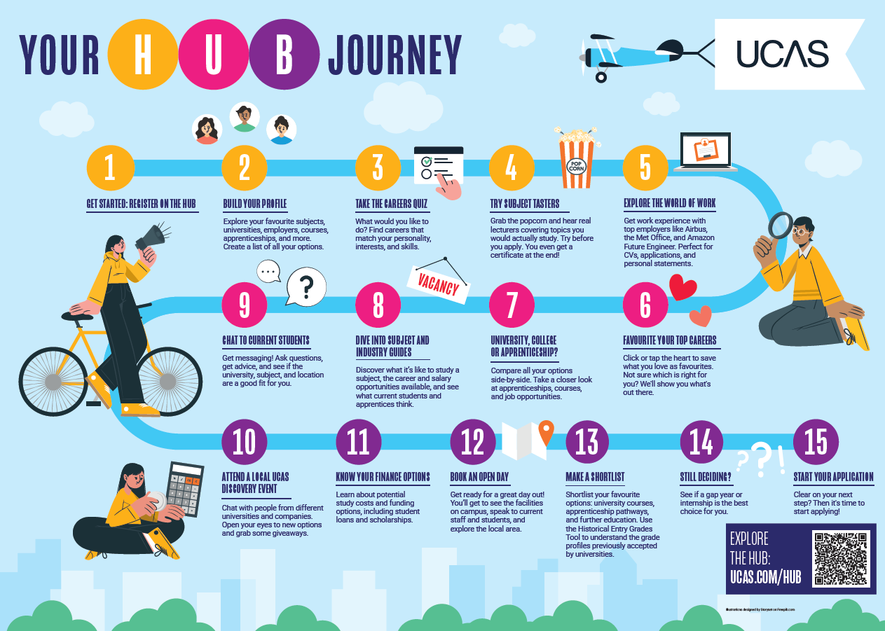
Public
Notes:
Your key steps to success.

Slide 5
Discover options
Higher education
Apprenticeships
Studying abroad
Gap year
Getting a job
Head to UCAS to understand all your options and make the right choices for you.
Public
Notes:
Maybe you’ve already got big ideas about the future; maybe you’re still figuring things out. One thing’s certain: there are many options after leaving school or college.
Read our ultimate guide to help you decide. https://ultimateguides.ucas.com
Find out more about apprenticeships, gap years, study outside the UK and the world of work at www.ucas.com/applying/you-apply/what-and-where-study/what-do-next

Slide 6
Discover PATHWAYS
Certificate of Higher Education (CertHE) and Diploma of Higher Education (DipHE): first and second year of a degree course.
Higher National Certificate (HNC) and Higher National Diploma (HND): HNC is a one-year industry specific course, and the HND is a two-year industry specific course. Higher technical qualifications (HTQs) in England are an example of these.
Foundation degree: flexible vocational qualification, combining both academic study and workplace learning. It usually takes two years to complete.
Bachelor’s or undergraduate degree: a three to four-year course which can also be available as a part-time option, allowing you to study and work.
Apprenticeships: typically take between 8 months to 6 years to complete depending on their level. Apprenticeships are offered for levels 2-7 in N.I. and England, levels 2-6 in Wales, and SCQF levels 4-11 in Scotland. All nations offer degree level apprenticeships.
Public
Notes:
You don’t just have to head to higher education to do a full-time degree. Maybe you're not ready to decide on what you want to do for the next 3 years to 4 years? Have you thought about doing a different pathway that helps you reach your next step, but also keeps your options open, Have you thought about continuing your training through work – it isn’t just degree apprenticeships you can do, think about higher level apprenticeships too.
Level 4 and 5 qualifications in England, Wales, and Northern Ireland include, but are not limited to, Foundation Degrees, Certificates of HE (CertHE), Diploma in HE (DipHE), Higher National Certificates (HNCs), and Higher National Diplomas (HNDs). Some of them are approved in England by the Institute for Apprenticeships and Technical Education (IFaTE) as Higher Technical Qualifications (HTQs). Please be aware that the government are proposing to transfer IFaTE responsibilities to Skills England in 2025. Please note that at the time of writing, a range of Level 7 apprenticeships are available in England, however this is currently under review by the government and may change during the academic year.
In Scotland at SQCF Level 7 and 8 (equivalent to Level 4 and 5 in other UK nations) qualifications are unique but also called HNCs and HNDs. In national frameworks, these qualifications sit in between A levels, T Levels, BTECs and Scottish Highers and Advanced Highers (at Level 3 or SCQF 6/7), and an undergraduate degree (Level 6 or SCQF 9-10).
While Level 4 and 5 qualifications can be taught in a range of education providers, around half in England are taught in further education (FE) colleges, a third in universities, and the rest in other providers. They often provide vocational and technical training, preparing students with the skills and knowledge to succeed in the workplace. Providers may also design them to support progression to academic courses at a higher level, for example, HNCs and HNDs in Scotland are notably often used to support articulation to degree level. Level 4 and 5 qualifications are included in overall higher education figures.

Slide 7

DISCOVER YOU
Is it right for you?
Is it something you enjoy? You’re investing time and effort
Is it right for your career path? Check with employers and professional organisations
What about location? Stay at home, move away, city or rural, transport links
Is it a learning and assessment style that suits you?
What will your environment be like?
What about cost?
Public
Notes:
What you choose to do after school depends on you and no one else. You have the power to set your end goal. Whatever you decide to do next is it the right step for you?
Read our ultimate guide on how to decide on your next steps https://ultimateguides.ucas.com/howtodecideyournextsteps/

Slide 8
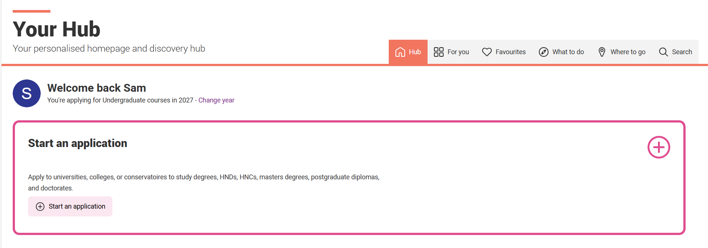
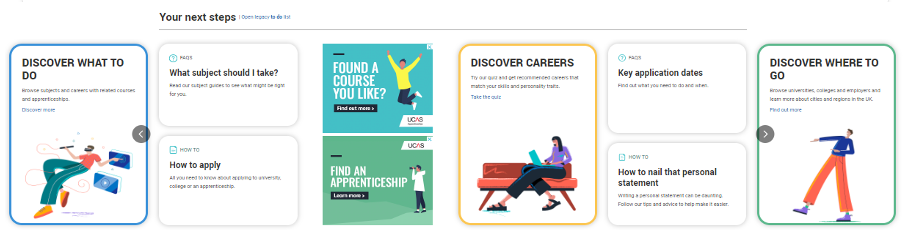
Start your discovery journey
Public
Notes:
Your key steps to success.
Personalised Dashboard – Track applications, save favourite courses, and get tailored recommendations.
Search and Compare – Use filters to explore universities, apprenticeships, and employers side by side.
Application Support – Access tips, deadlines, and expert advice to navigate your next steps with confidence.

Slide 9
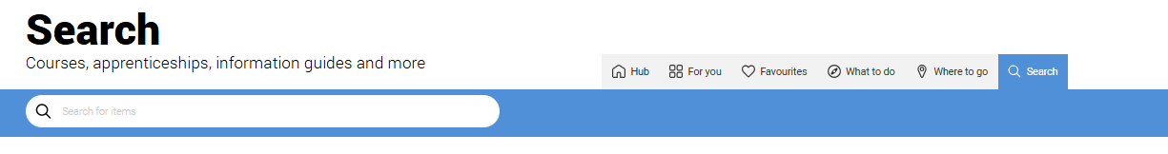

Public
Notes:
Explore your future
What to do? Where to go? Discover all the options with UCAS subject, industry, and career guides. Explore city, employer and accommodation information. Compare apprenticeships and course options.
All in one place to explore over:
Hundreds of universities and colleges
Thousands of courses
75 location guides and 75 subject guides
Over 100 subject tasters
Nearly 60 virtual work experiences
Over 850 student ambassadors to chat to
Hundreds of open days and events to explore
Employer profiles and industry guides
Thousands of apprenticeships including sector specific application guides
Nearly 40 personal statement subject guides
CV builder

Slide 10
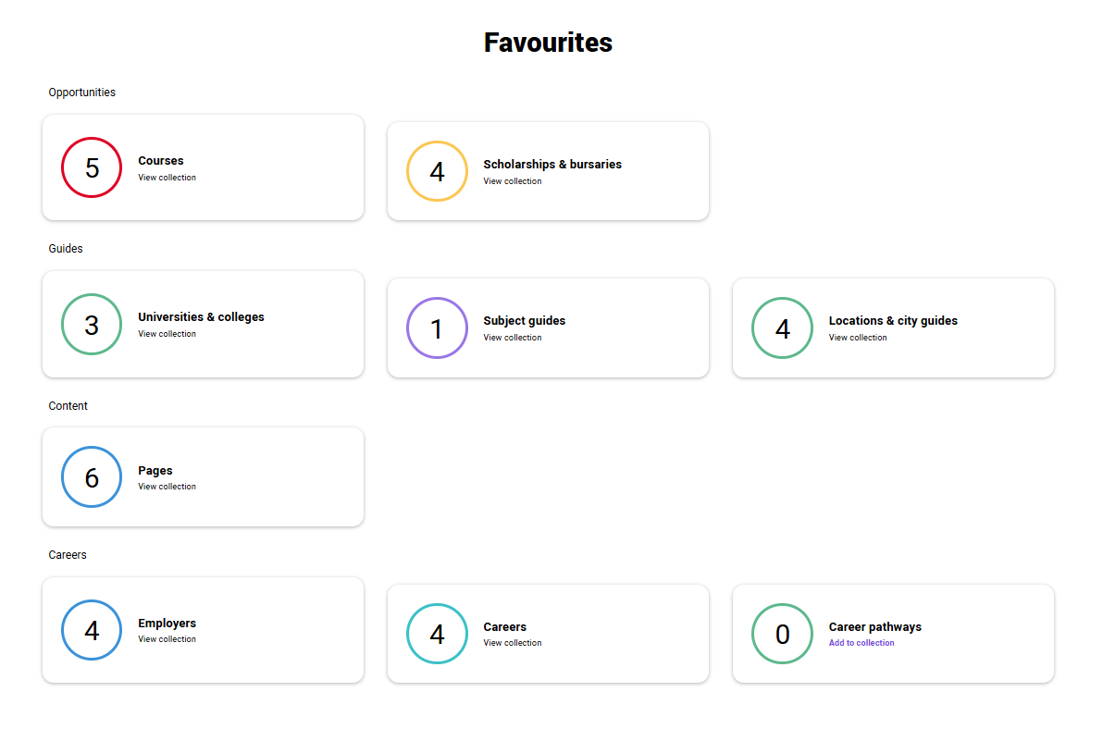
Build your profile. Favourite as you go.
Public

Slide 11
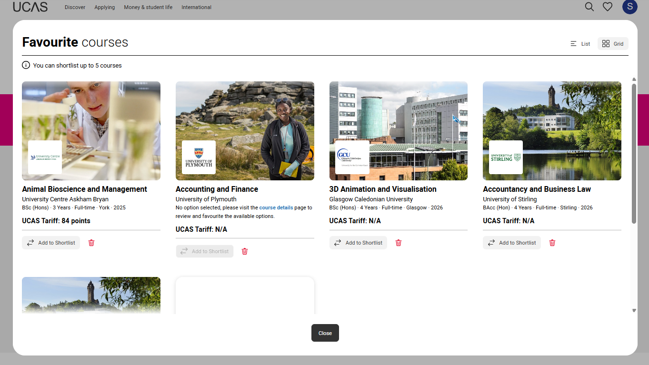
Notes:
For courses you can then add to the shortlist directly from favourites.

Slide 12

Tools for success
Explore the Careers Quiz, What to Study Next, Subject Spotlights and Virtual Work Experiences for career and course inspiration.
Use the Tariff Calculator, Personal Statement Builder, and CV Builder to stay on track and plan your path.
Search for events, open days, videos to get expert help and questions answered.
Public
Notes:
Make an informed decision about the right path for you. University, apprenticeships or the world of work.
Tariff calculator – for tallying up your UCAS points to see if you meet entry requirements.
Events search – find events to meet unis, colleges and employers, and get your questions answered. Find UCAS events, open days and more. Filter to explore events, open days and tours to suit your needs. Register straight from the Hub for our UCAS Discovery events, with exciting new zones covering all pathways
CV builder – Create a professional, industry-standard CV in minutes. Easily update and download your CV anytime see more at www.ucas.com/careers-advice/cv-builder
Personal statement builder – to help you structure your writing and get started. Jot down your thoughts as your research your choices.
What to Study Next – find inspiration, input your qualifications and find out what people with your combination of subject wen on to study.
Careers quiz - find your ideal job matched to your personality and a list of courses previous students studied to get there.
Subject Spotlights - Experience what a university course would be like with Springpod's Subject Spotlights.
Virtual Work Experiences - Led by industry experts from the world's leading employers, Virtual Work Experiences give you a taste of what a career would look like through interactive, on-demand programmes.
Hub Live video wall - joined by experts from across the education sector to support students with guidance on their journey.
Notepad – so you can keep all your thoughts about your next step in one place.
Got a Question – check out hundreds of common questions to help you know what to do next. Don’t forget to give UCAS a ring or get in touch on social media if you need more help.

Slide 13
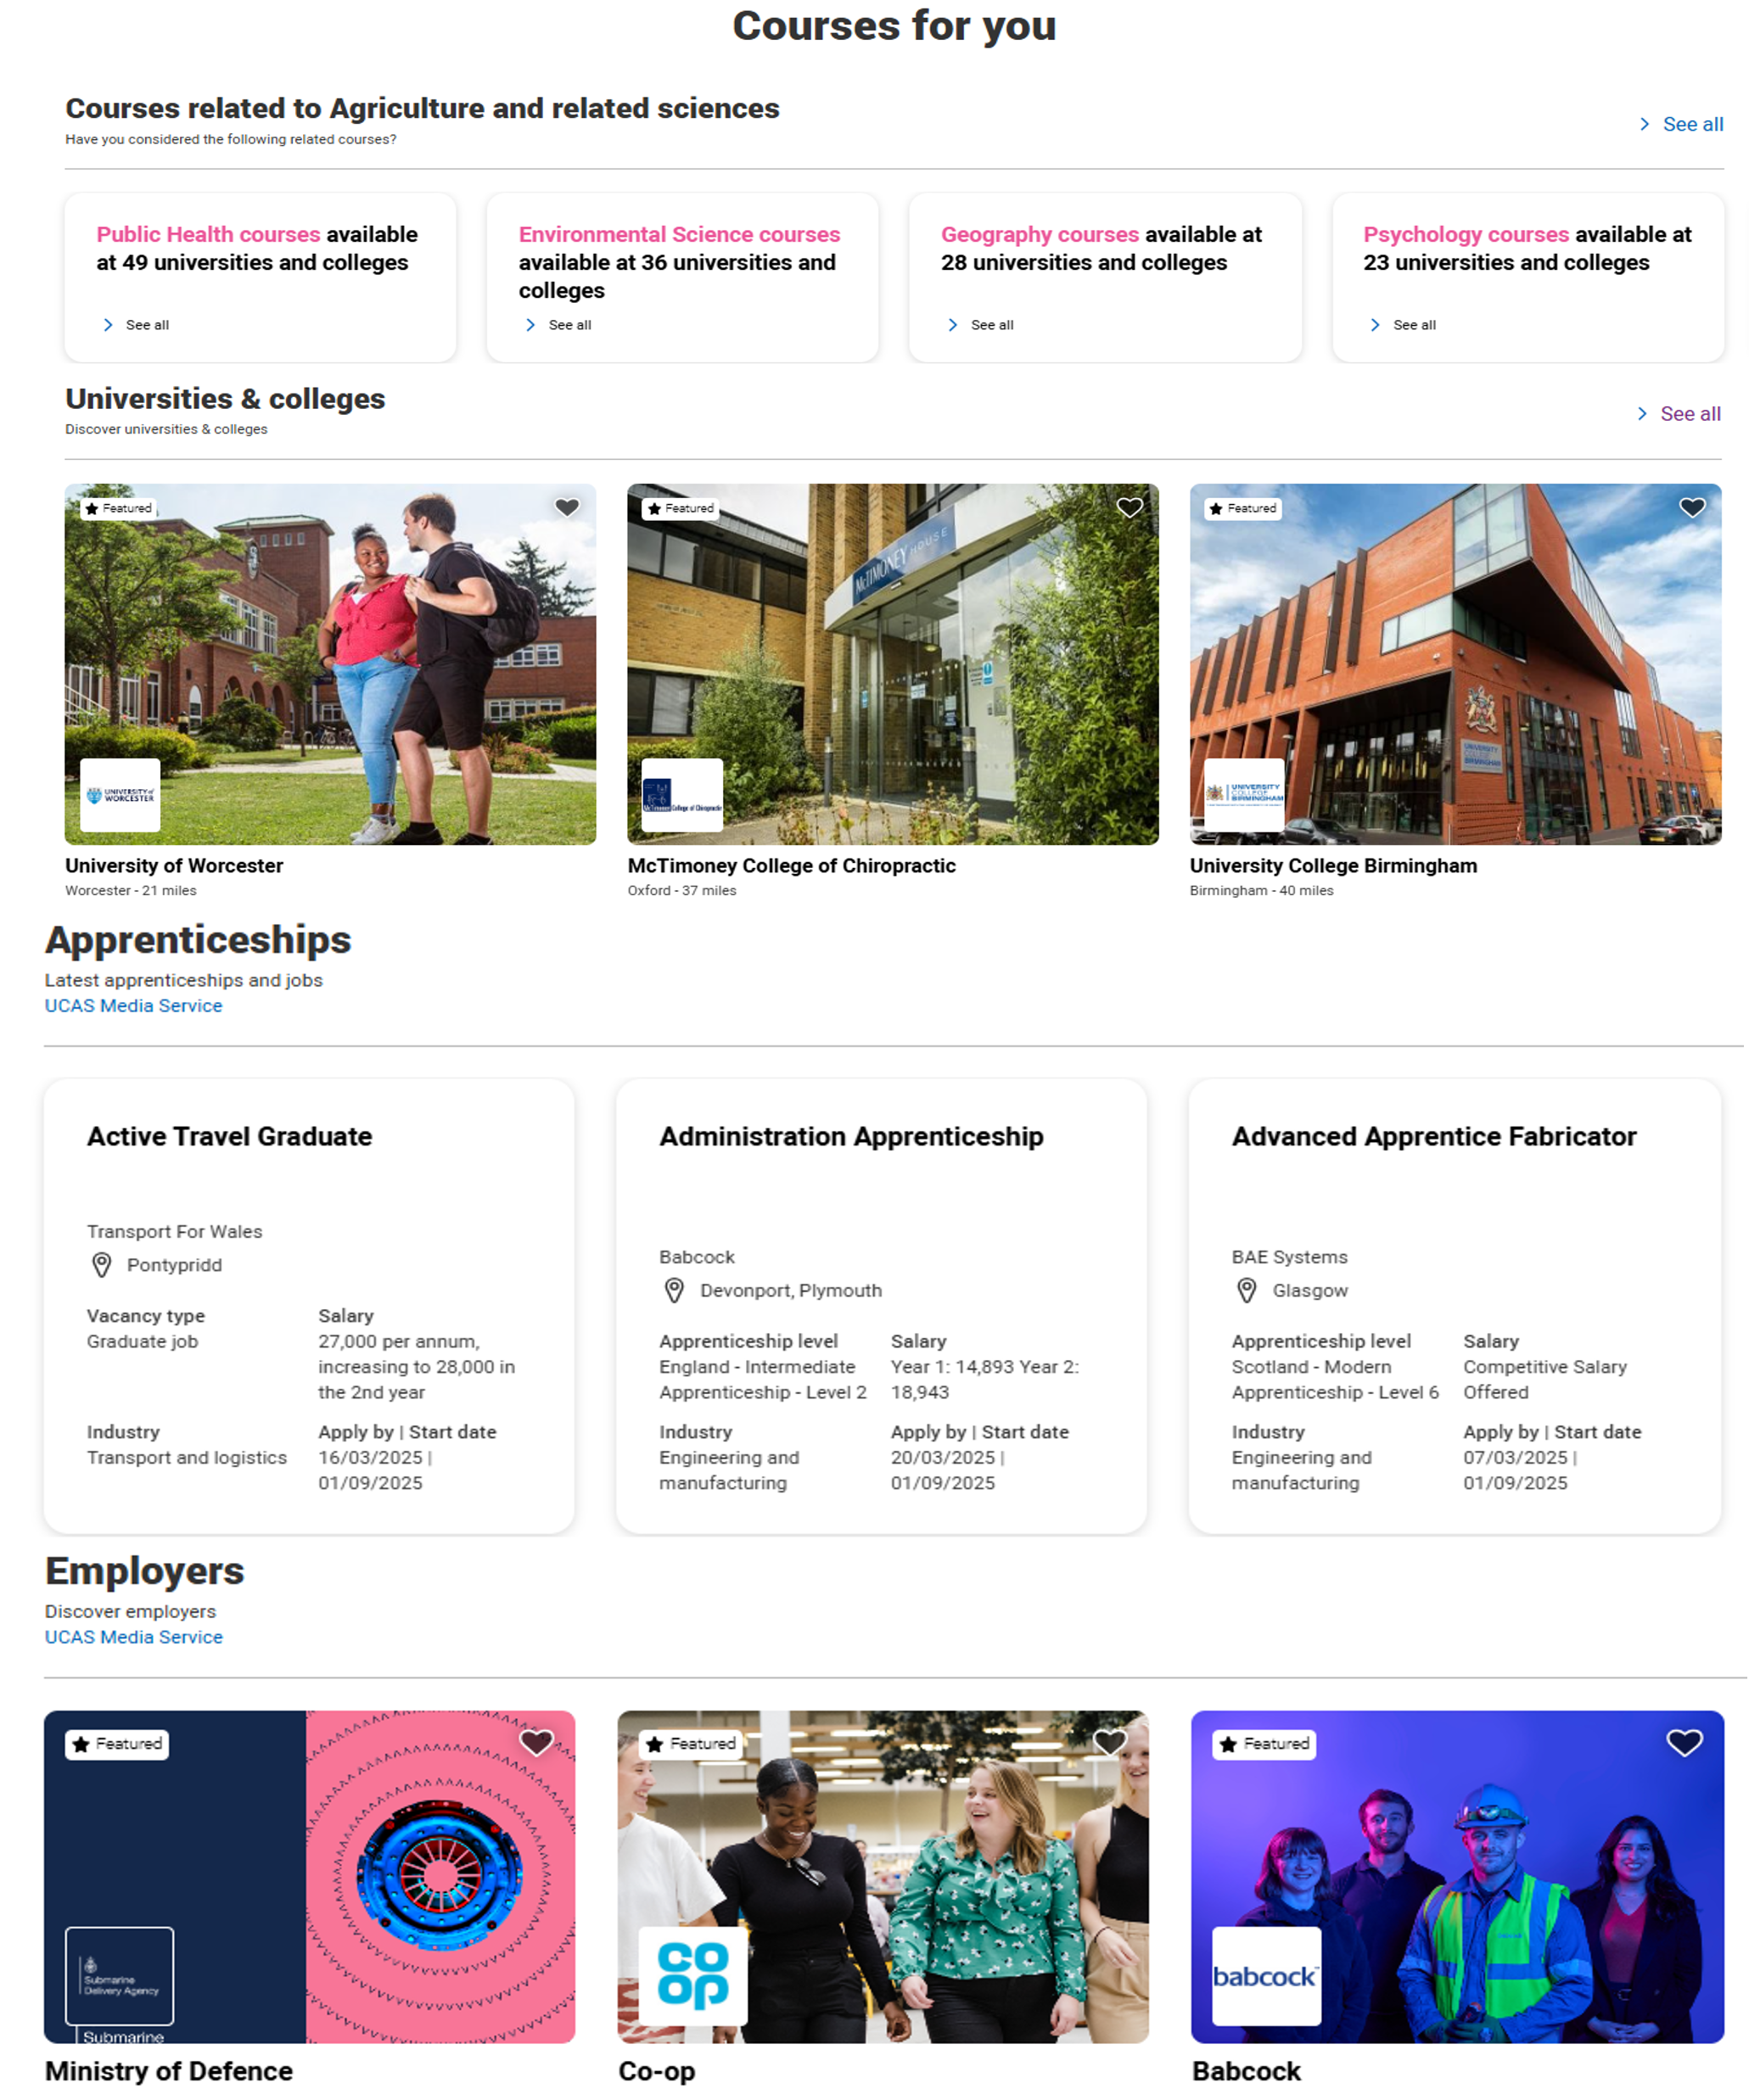
Options side by side
Compare all your options side-by-side. Take a closer look at apprenticeships, courses, and job opportunities - all in one place.
Build your personalised UCAS Hub profile and find your best fit!
Public
Notes:
Use our information on careers, apprenticeships and university to explore what routes are available and which one is right for you.

Slide 14
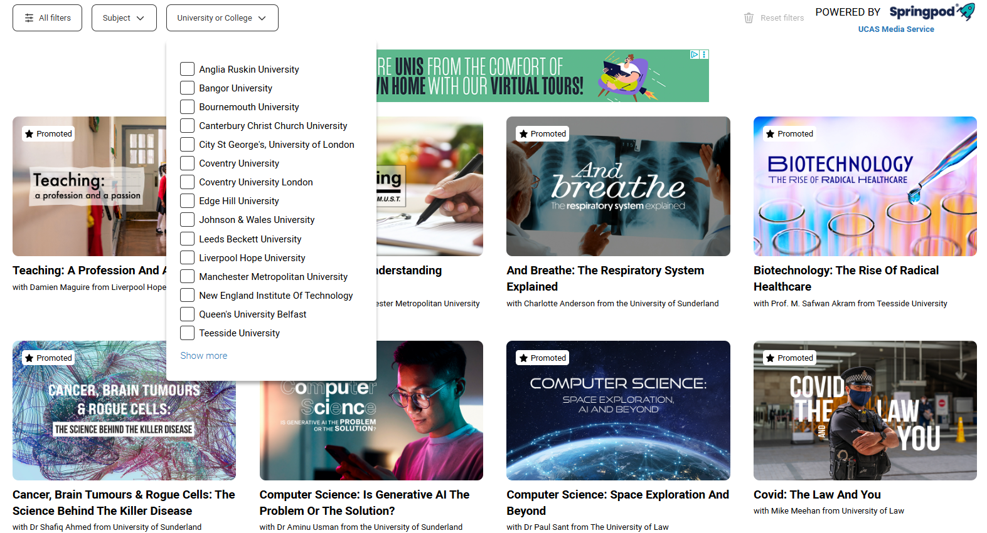
Subject spotlights
Public
Notes:
These interactive, virtual university course tasters feature real-life lectures, seminars, and academics. They can help you decide if a subject is right for you or not.
Content that you can watch in sections.
You can filter and search by subject or university.
Delivered by the lecturers themselves you will gain insight into what it’s like to study the course and give your personal statement a boost.
On-demand interactive video experiences
Have a go at interactive quizzes and activities
Get feedback on how you’ve done.
Try university degrees before you apply.
Certificate of completion

Slide 15

Virtual work experience
Public
Notes:
Gain experience and earn certificates to reference on your CV or personal statement.
Get stuck in with immersive and informative virtual work experiences with leading employers such as the NHS, Barclays, and Airbus. These incorporate real workplace activities – from observing a live surgery to designing a lunar landing module – and the chance to speak with, and hear from, industry professionals.
Springpod’s in-depth and interactive Virtual Work Experience programmes help you understand industries and organisations as if you were already working there. Thanks to programmes led by industry experts from the world's leading employers, Virtual Work Experiences give you a taste of what a career would look like, as well as giving you invaluable experience to include in your personal statements and apprenticeship applications.
Virtual Work Experiences vary in length, from 6-10 hours, and you can pause and come back to the program at any time.
You receive a completion certificate at the end of the program.
Once you set up a UCAS account, you can browse Virtual Work Experiences via UCAS search, industry guides, and across UCAS.com.
On finding the perfect Virtual Work Experience, click ‘Take Virtual Work Experience' and follow the steps to create and link a Springpod profile.

Slide 16
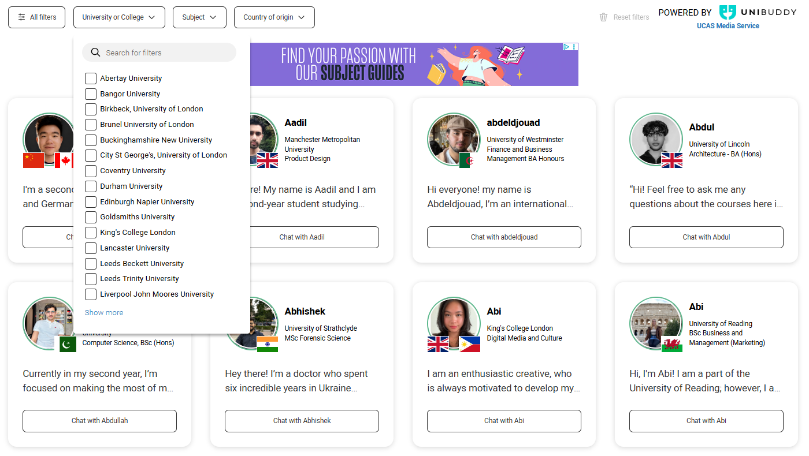
Chat to students
Public
Notes:
Chat with UK and international students who are already studying the courses you've applied for at universities and colleges across the UK, on Unibuddy
Almost 900 active ambassadors, with unlimited chats available.
Connect, ask questions and learn about student experiences.
Peer-to-peer chat facility hosted on ucas.com powered by Unibuddy.

Slide 17
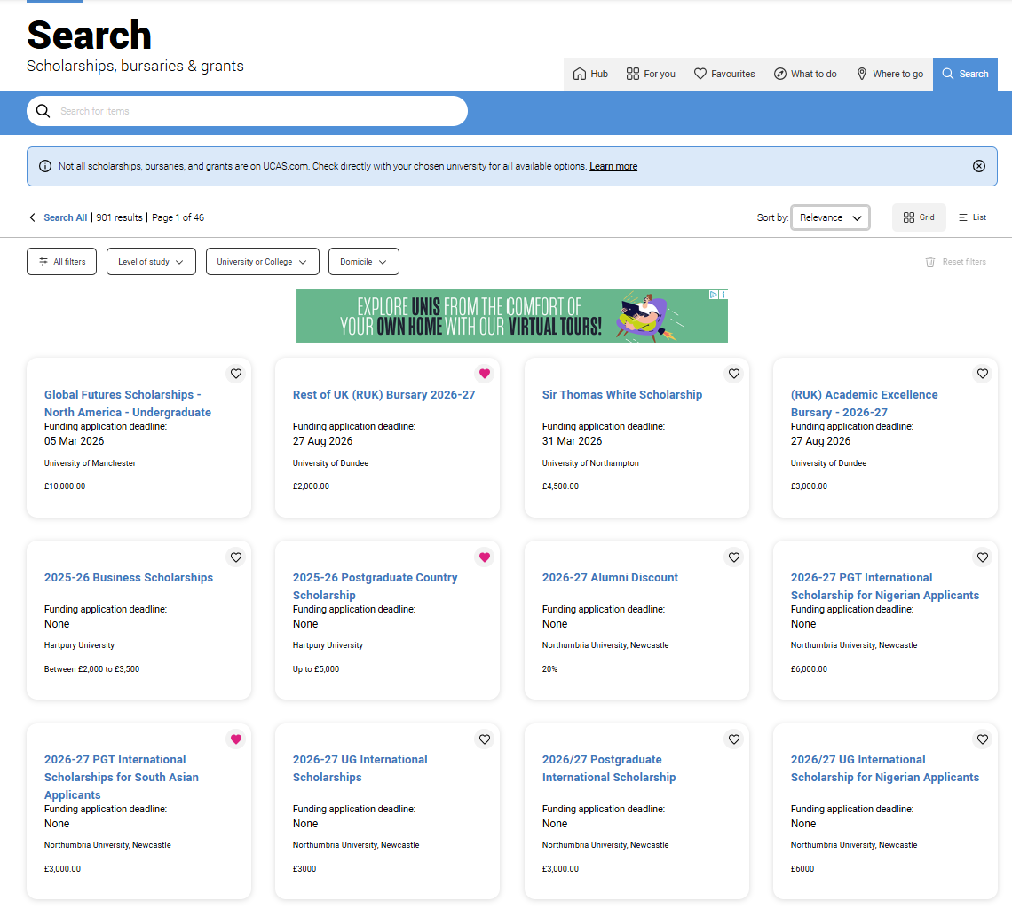
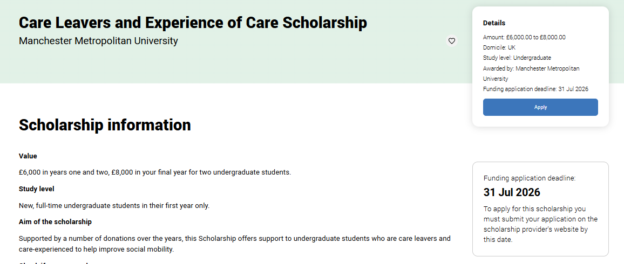
SCHOLARSHIPS, BURSARIES & grants
Public
Notes:
Explore scholarships, bursaries, and grants matched to your background, achievements, or chosen course, and get support for your study and living costs.
Before applying, always check the following details. It might save you considerable time and effort applying to something you’re not eligible for in the first place:
Award
Eligibility criteria
Application process
For more information on scholarships, grants and bursaries visit https://www.ucas.com/money-and-student-life/money/scholarships-grants-and-bursaries

Slide 18
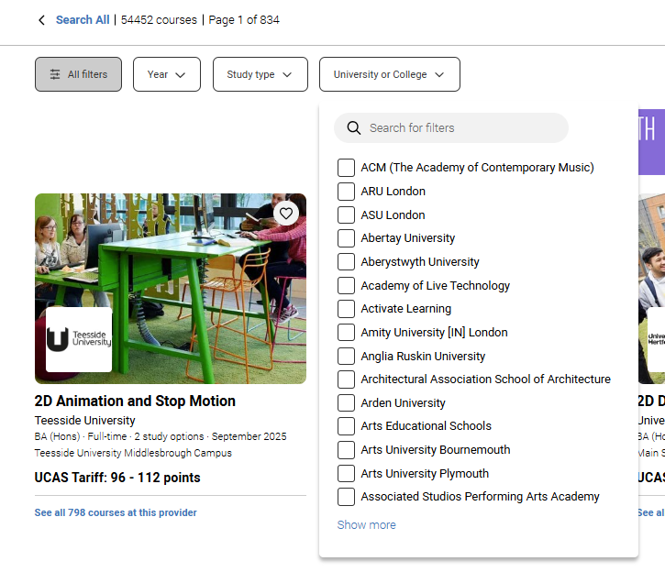

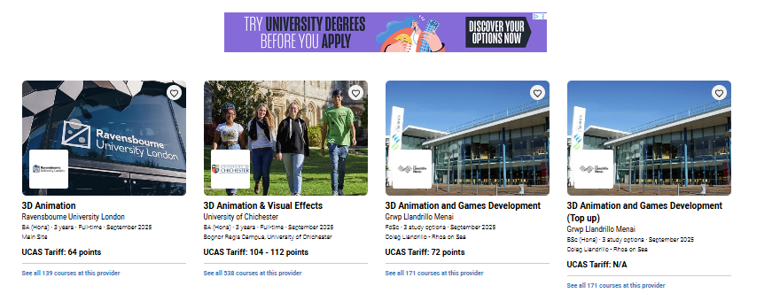
UCAS Course Search
Public

Slide 19
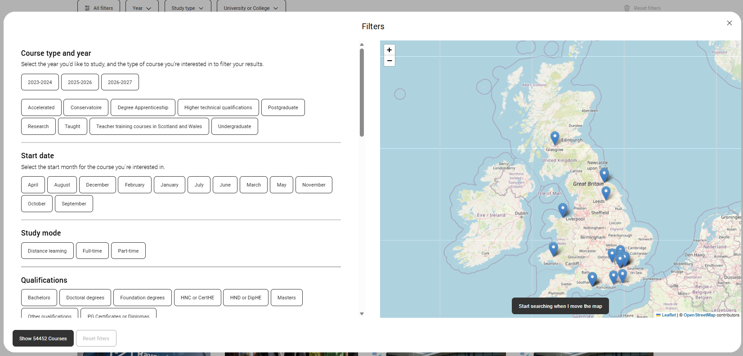
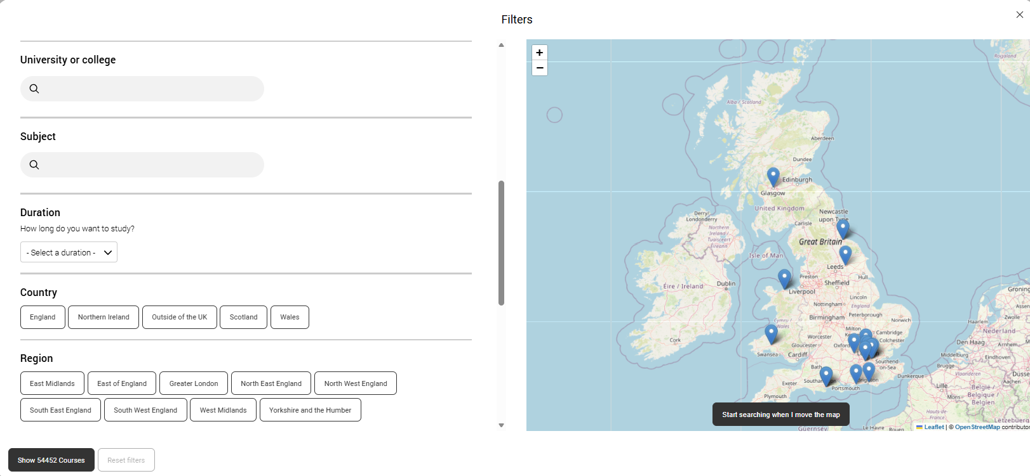
UCAS Course SEARCH
Top Tips for Using the UCAS Search Tool
Explore broadly first to avoid missing great courses you may not have considered.
Use filters to refine results by year, study type, or university/college.
Sort results in the way that works best for you, such as alphabetically or in a way that helps you compare courses.
Check course details (entry requirements, placement options, study modes) to see how well they match what you want.
Favourite courses you like so you can easily return to them later; save time and keeps everything organised.
Public

Slide 20
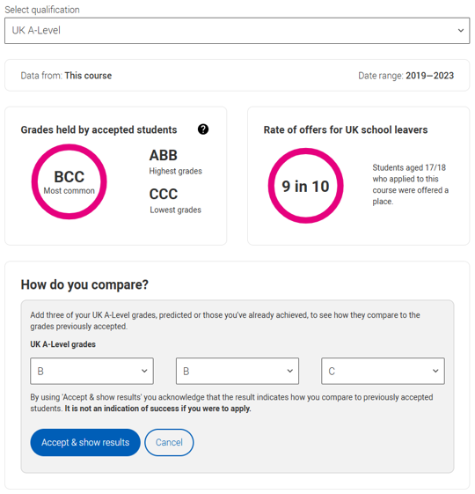
The course matters
Teaching & learning
Teaching hours, self-study, lectures, and group work.
Assessment & structure
Coursework, exams, practical work, and module choices.
Entry requirements
Grades, skills, interviews, or auditions.
Career links
Placements, internships and study abroad.
Class size & experience
Student numbers and learning environment
Public
Notes:
How many teaching hours vs. self-directed study does the course have?
How many lectures are there, and how much group work will be done in seminars?
How is the course assessed (e.g. coursework, exams, practicals, presentations, group work)?
How many students will be on the course?
What grades do you need to get on the course?
What qualities or experience do they look for in an applicant?
Will you need to attend an interview or audition?
What modules are compulsory and optional – are there any work placements or years abroad? Look carefully at the core course content, and the range of optional studies/modules available.
What links does the course/department have with employers?
Which modules are the most interesting and relevant to your career aspirations?
Does the course or university/college research, any internship, placement, or study abroad opportunities?
The UCAS course search is a great place to start your research, and you can access the historical entry grades tool.
Universities and colleges set their own entry requirements for higher education courses, and these vary widely depending on the subject, the specific course, and the course provider. They set the entry requirements for each course to ensure you have the right skills and knowledge to successfully complete the course. You can see grade profiles of students previously accepted, and offer rates for the course, under the entry requirements in the UCAS search tool.
Find out more online at:
https:// www.ucas.com/applying/you-apply/what-and-where-study/entry-requirements.
https://www.ucas.com/applying/before-you-apply/what-and-where-to-study/entry-requirements/understanding-historical-entry

Slide 21
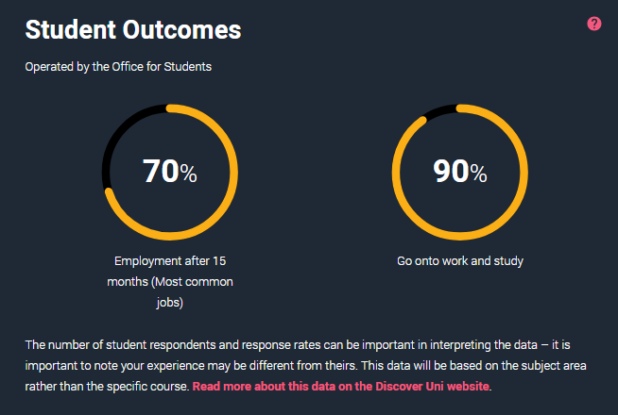
Find your best fit uni or college
Style and focus
From research-intensive to practical, career-orientated learning.
Location and size
Ranges from small campuses to large city-based universities with over 20,000 students.
Culture and facilities
Environment, resources, and student life.
Graduate outcomes
What careers have recent graduates gone on to?
Costs
Include living costs, accommodation, and transport.
Public
Notes:
Style & Focus – Traditional universities that might emphasise research, or modern ones that have a wider range of new and vocational courses.
Location & Size – Choose from bustling cities, quiet towns, or coastal areas; student populations range from a few thousand to over 20,000.
Culture & Facilities – Diversity, campus resources, and student life shape your experience. Check out UCAS university and college profiles to learn more.
Graduate Outcomes – Check job prospects and further study options. What careers have recent graduates gone on to?
Costs – Compare tuition fees, scholarships, and living expenses like accommodation and transport. Are there any scholarships or bursaries available?

Slide 22
Apply
How to apply to universities and colleges for 2027 entry.
Public

Slide 23
Key dates for 2027
28 April 2026
1 September
13 January 2027*
25 February
2 July
UCAS search displays courses
First day we can receive a completed application
UCAS equal consideration date
UCAS Extra opens
Clearing
opens
UCAS application opens for 2027 entry
Deadline for courses in medicine, veterinary medicine/science, dentistry, and courses at Oxford or Cambridge
UCAS equal consideration date
Last date to send an application
12 May
15 October 2026*
13 January 2027*
30 June
* 18:00 UK time
Public
Notes:
These are the key UCAS dates. It’s important that all students, parents, carers, and guardians are aware of the internal timelines and deadlines your school or college is working to when supporting UCAS applications.

Slide 24
Application key facts
Invisibility - Universities and colleges can’t see your other choices
Apply by the relevant equal consideration date.
Five choices, with some restrictions (medicine, veterinary, dentistry, Oxford and Cambridge).
Research is key to a successful application.
Public
Notes:
Equal consideration dates:
15 October - all applications to the universities of Oxford and Cambridge must be submitted by this date, as well as most applications to medicine, veterinary science / medicine, and dentistry courses.
13 January - Equal consideration date – applications submitted by this time must be considered equally by universities and colleges.
Each student can make a maximum of five choices on their application, including:
no more than four choices to any one of medicine, dentistry, veterinary medicine, or veterinary science
no more than one course at either the University of Oxford or the University of Cambridge.
Students who are in receipt of UK government funded free school meals at some point during the last six years (i.e. during their secondary education), or who are care leavers will be eligible to have the or application fee waived by UCAS (UK students only). See our advice and guidance online https://www.ucas.com/application-fee-waivers.

Slide 25
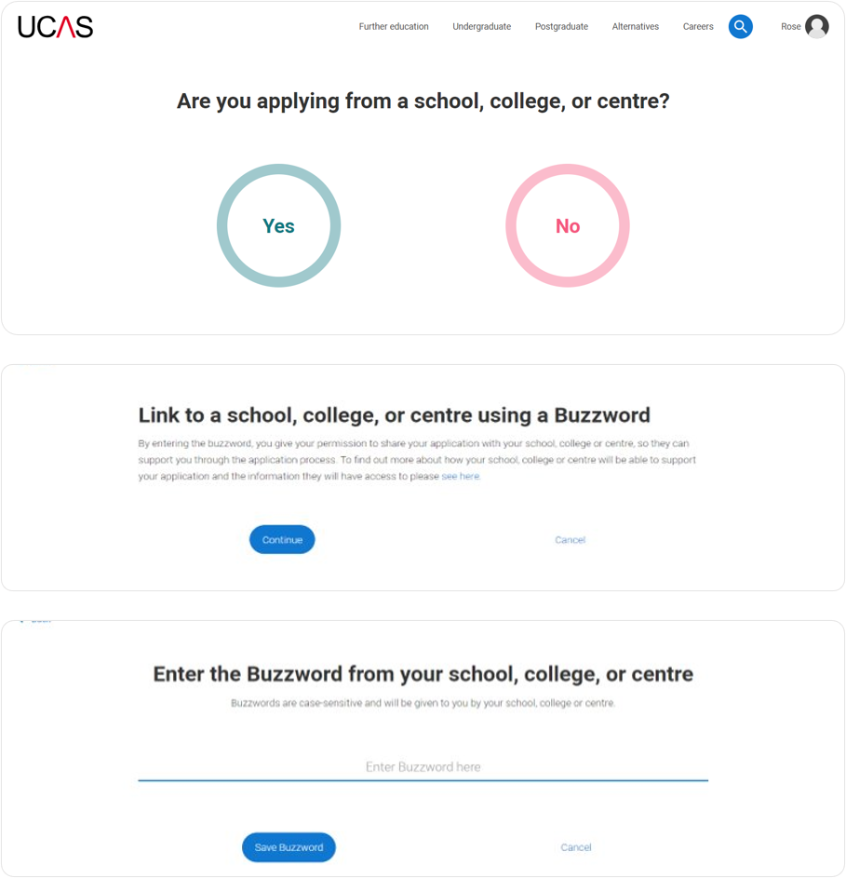
Linking to our centre
Enter the ‘buzzword’ to link your application.
The buzzword is a unique code.
By linking your application you’re giving us permission to view and track your application.
We send your application to UCAS on your behalf.
KingsSchoolHove2027
Public
Notes:
Linking means you connect your UCAS application to your school or college using their buzzword. It allows them to support your application, check your details, add your reference and predicted grades, and submit everything to UCAS on your behalf.

Slide 26
the ucas application
Your application is checked by your school or college, adding your reference and UCAS predicted grades.
Start your application
Universities and colleges review your application.
Complete all sections and submit your UCAS application to your school or college.
Your school or college sends your application to UCAS.
Public
Notes:
It’s essential that students work towards the internal dates and deadlines that their school or college set.

Slide 27
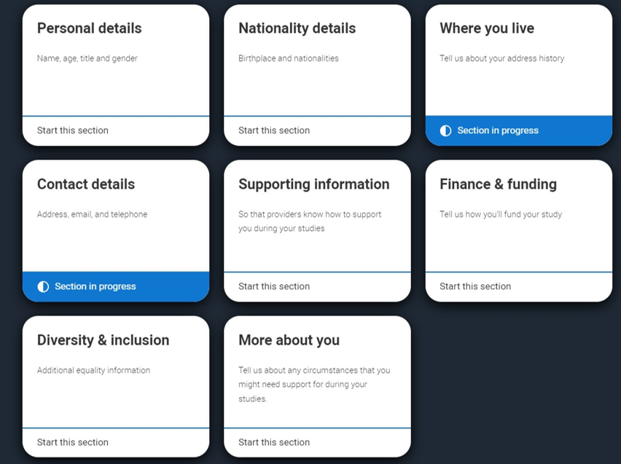
application profile
Personal details
Nationality details
Where you live
Contact details
Supporting information
Finance and funding
Diversity and inclusion
More about you
Public
Notes:
For further details to share with student see the Applying through UCAS ppt in the UCAS 2027 toolkit. It contains screenshots for you to copy and paste into your own materials and guides to share the application journey with your students.

Slide 28
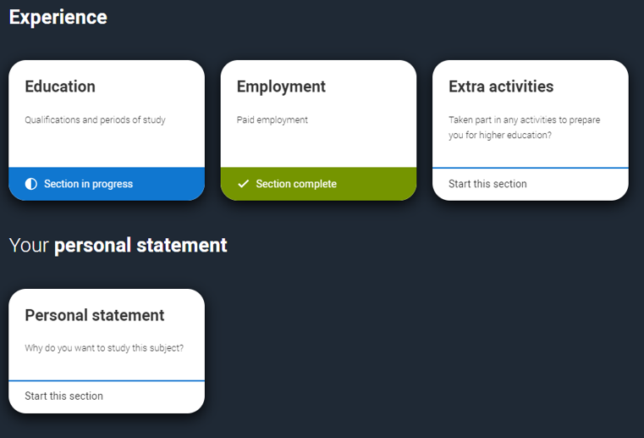
application experiences
Education
Employment
Extra activities*
Personal statement
Reference**
*(for students with a UK home address)
**(not visible if linked to your school/college)
Public
Notes:
For further details to share with student see the Applying through UCAS ppt in the UCAS 2027 toolkit. It contains screenshots for you to copy and paste into your own materials and guides to share the application journey with your students.

Slide 29
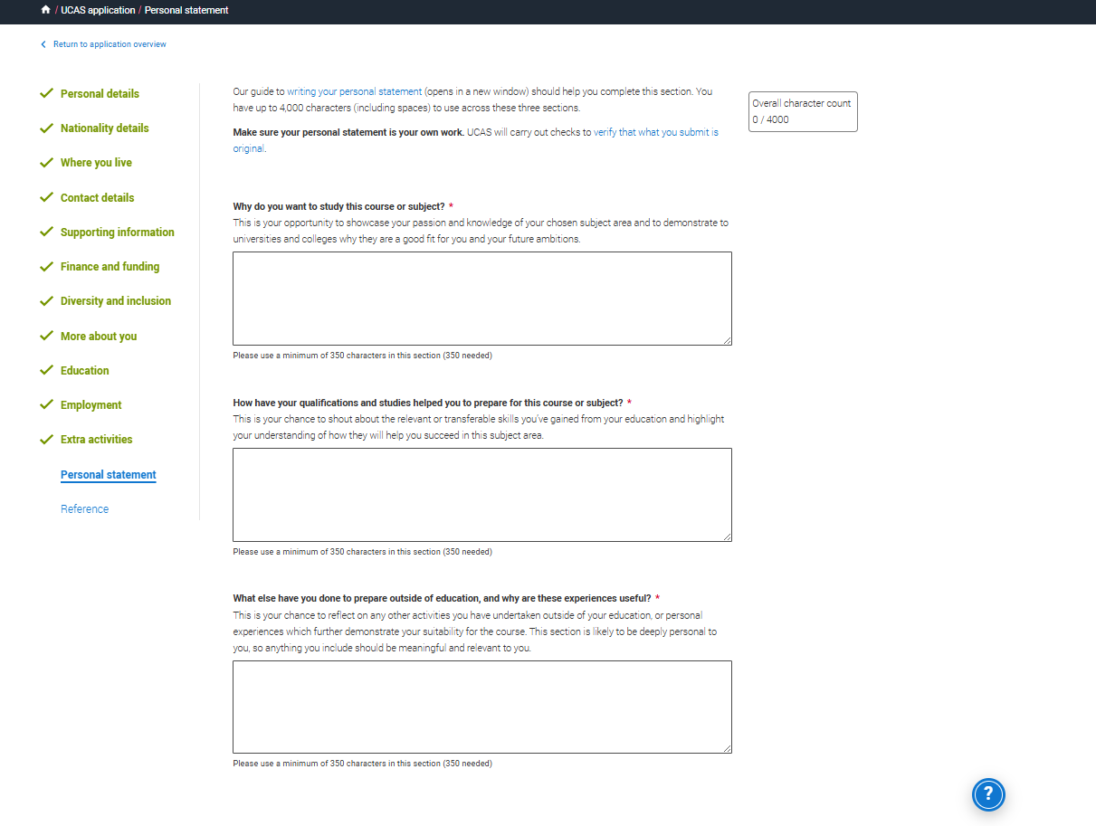
the personal Statement
Your chance to show your passion, curiosity, interest.
.
Three separate sections with question prompts.
A maximum of 4,000 characters, minimum of 350 characters per section.
The same for all your choices.
There isn’t a spelling or grammar check.
No formatting allowed.
Every personal statement is run through similarity detection software.
Public
Notes:
Similarity detection is used by UCAS on all applications, to identify personal statements containing content which has similarities with previously submitted personal statements, or with those held as a library resource. Generating (and then copying, pasting and submitting) all or a large part of your personal statement from an AI tool such as ChatGPT, and presenting it as your own words, could be considered cheating by universities and colleges and could affect your chances of an offer.
For more information see:
www.ucas.com/ai-tools-guide
www.ucas.com/applying/applying-university/writing-your-personal-statement/fraud-and-similarity

Slide 30
What are the questions?
Why do you want to study this course or subject?
How have your qualifications and studies helped you to prepare for this course or subject?
What else have you done to prepare outside of education, and why are these experiences useful?
Public
Notes:
For Students
Get inspiration on how to complete your personal statement with our range of subject specific personal statement guides.
Access the guides the Hub or personal statement builder tool.
www.ucas.com/applying/applying-to-university/writing-your-personal-statement
For Teacher and Advisers
Access the full suite of personal statement resources that have been created (including ppt decks) that you can copy and paste into your own materials and guides to support student in writing the personal statement.
www.ucas.com/advisers/help-and-training/toolkits/personal-statement-toolkit
www.ucas.com/ai-tools-guide

Slide 31

Build A personal Statement
Ultimately, think of it like a jigsaw.
Each piece is reflective evidence.
Public
Notes:
We would advise all schools and colleges access the full suite of personal statement resources available for you to use with students including classroom resources (full teaching scheme with 5 lesson and accompanying resources), checklists, videos and more find it https://www.ucas.com/advisers/help-and-training/toolkits/personal-statement-toolkit.
Research and preparation is key when you’re starting to think about your personal statement.
Before you start writing anything, take some time to:
mind map what you might want to include
build up a bank of examples you can refer to
list evidence of your skills and experiences
rank your evidence and examples that are MOST relevant to the course(s) you're thinking of applying to
Don’t worry about making your notes perfect; this is about checking you fully understand the course and have specifics to refer to in your personal statement. Whether you know what you’re applying to or still considering your options, the more research you do the easier it will be to write.

Slide 32


personal Statement support
Public
Notes:
For Students
Get inspiration on how to complete your personal statement with our range of subject specific personal statement guides.
Access the guides the Hub or personal statement builder tool.
www.ucas.com/applying/applying-to-university/writing-your-personal-statement
For Teacher and Advisers
Access the full suite of personal statement resources that have been created (including ppt decks) that you can copy and paste into your own materials and guides to support student in writing the personal statement.
www.ucas.com/advisers/help-and-training/toolkits/personal-statement-toolkit
www.ucas.com/ai-tools-guide

Slide 33
Offers and Decisions
Public

Slide 34
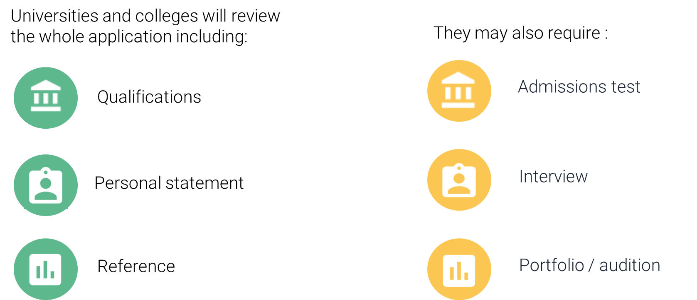
decisions
Public
Notes:
The universities and colleges begin their decision-making process. This differs between them, and even for different courses at the same university or college. The application forms are viewed holistically, each section is important and will be used by universities and colleges in different ways – this is why is it so important for students to do detailed research to know what is being looked for by each choice. There may even be differences across individual universities in how they are used.
Most admissions tests happen between August and November the year before you're due to start your studies. Some have a registration deadline before you need to submit your UCAS application. You should check the UCAS course search to check whether the course you are applying for requires an admissions test. www.ucas.com/applying/applying-university/admissions-tests.
Depending on the kind of courses you apply for, your chosen unis and colleges may invite you for an interview or audition – in fact, they’re compulsory for some courses, such as teaching and nursing. It could either be sent to you directly, or through your UCAS application. It’s best to contact the uni or college to find out how and where you will receive information about your interview. For more advice www.ucas.com/applying/after-you-apply/undergraduate-interview-invitations

Slide 35
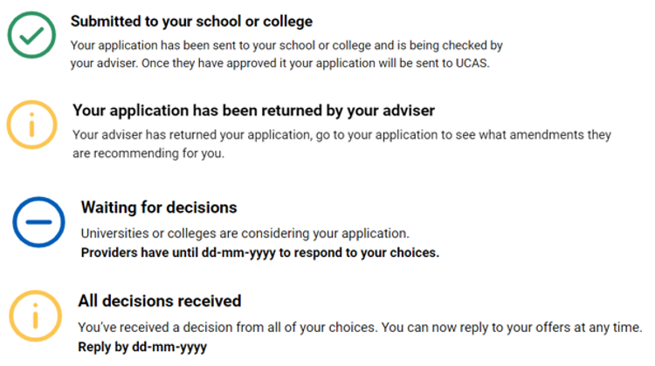
Tracking your application
Follow your application to:
check progress
see your choices
update contact information
view and reply to your offers
One of three decisions:
unconditional offer
conditional offer
unsuccessful
Public
Notes:
Your application will update as the status of your application changes. Click on it to go to your application and see more details. It’s essential that contact information, particularly your email is kept up to date. This can be changed at anytime in the application. We always advise students use a personal email address for their UCAS application so they can have access to this at all times.
You will hear about each of their choices at different times – sometimes you might be contacted very quickly, or it may be several months before you hear anything. To see all the deadlines that universities and colleges must adhere by visit www.ucas.com/key-dates.
An offer will be either conditional or unconditional.
Conditional offer – the offer has conditions. For example, certain qualification results must be achieved. Unless a different date is specified, the conditions must be met by 3 September (even if entry is deferred to the following year). The conditions may include achievement of specific grades, possibly in named subjects, or a certain number of UCAS Tariff points.
Unconditional offer – this usually the university or college’s entry requirements have already been met for the course. They might still have to meet other requirements, such as financial or medical conditions.
They may also receive:
Unsuccessful – the university or college has not offered a place on the course.

Slide 36
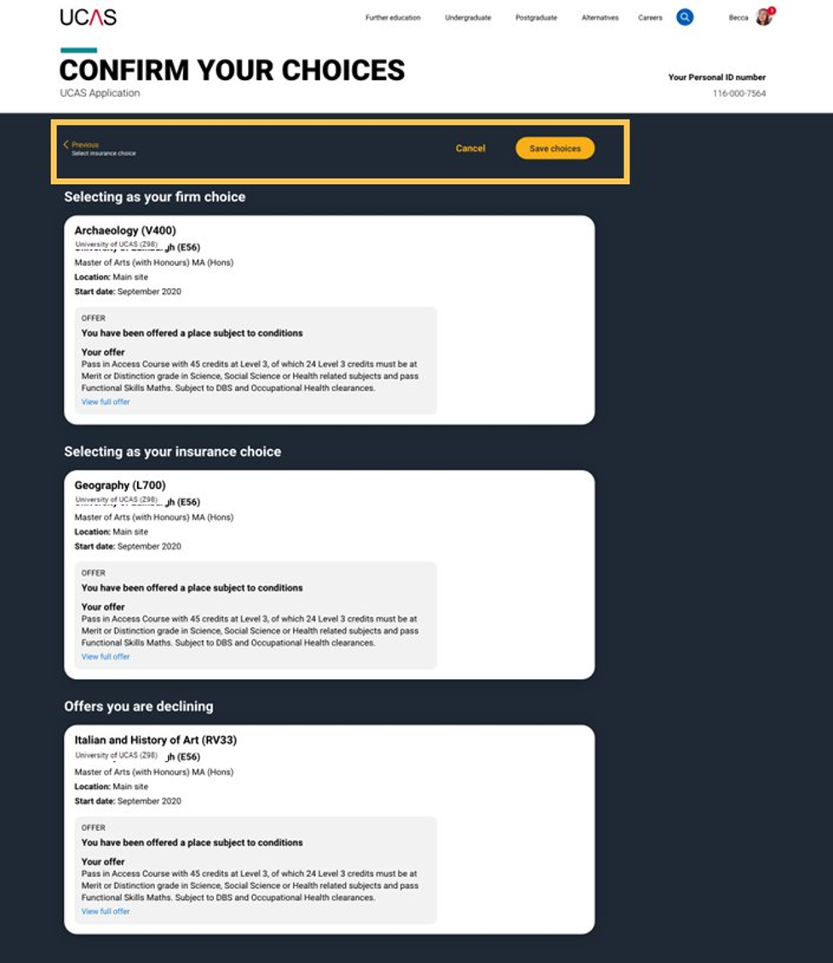
Replies to offers
Once you've made your decisions, choose a 'firm' and 'insurance' choice.
Decline any remaining offers.
If you're not holding an offer, use Extra or Clearing to find available places.
Public
Notes:
When you’ve had all decisions from your choices, you need to decide which one(s) you want to accept. The date you must reply to your offers is shown in your application.
You can accept one offer as your firm choice.
If that’s a conditional offer, you can accept a second offer as an insurance choice, if you want to, in case you don’t meet the conditions of your firm choice.
You don’t have to have an insurance choice. If you aren’t sure any of your other offers are right for you, it might be better to wait and see what’s available in Clearing once you have your results.
Remaining offers are automatically declined when the 'Firm' and 'Insurance' are selected.
If you firmly accept an unconditional offer, you cannot hold an insurance choice.
Choosing the right course and university or college is a very important decision, and it can be difficult to change later in the admissions process. To help you make an informed decision about where to apply, what to study, and whether to accept an offer, the university or college you should read all the information the university or college has shared with you; before making a decision. You need to think very carefully, and make sure you do not accept an offer from any university or college if they you’re not prepared to study there.
AN IMPORTANT MESSAGE FOR YOUR STUDENTS
If you don’t reply to your offers on or before the reply date shown in your application UCAS will decline them on your behalf (often referred to as declined by default [DBD]). This means you will lose all your offers.
TOP TIP
Before making any decisions, encourage your students to look at our advice on making informed choices – www.ucas.com/undergraduate/after-you-apply/making-right-decision

Slide 37

Other options
Extra (25 Feb – 1 Jul)
Used all five choices and had no offers find a place using Extra.
Clearing (2 Jul – 18 Oct)
Whether you've exceeded expectations, changed your mind, or don’t have a place.
Clearing is for everyone.
Understand the process to take control of your options.
Public
Notes:
All is not lost if you aren’t offered a place at any of your five choices, or you choose to decline all your offers. You can use Extra to apply to other universities and colleges that still have vacancies. It gives you an opportunity to look for a place earlier, instead of waiting for Clearing. Find out more at www.ucas.com/extra.
Clearing is an opportunity for students to find a course using UCAS’ search tool – the only official vacancy listing. Clearing is used by tens of thousands of student’s each year and runs from the beginning of July. Find out more www.ucas.com/applying/after-you-apply/clearing-and-results-day/what-clearing.

Slide 38
apprenticeships
What you need to know
www.ucas.com/apprenticeships
Public

Slide 39
How does it work?
Study
Job
Wage*
It’s a real job where you learn, gain experience, study for a qualification and get paid.
An apprentice is an employee, with a contract of employment and holiday leave.
Over 600 different apprenticeships available, from Nuclear Engineer to Architect to Digital Marketer.
* Foundation apprenticeships in Scotland are unpaid
Public
Notes:
An apprenticeship is an opportunity to work and study at the same time. Most of your time is spent doing on-the-job training, and the rest is spent working towards a qualification. You’ll get paid a salary and be part of a team, just like a standard employee, but you’ll also get dedicated study time throughout the week.
Course/tuition fees will be covered by your employer and the government.
The qualification you can achieve could vary from the equivalent to GCSEs, to a master’s degree depending on the level of apprenticeship you take.
There are different types or levels of apprenticeships depending on where you are in the UK.
Each level apprenticeship will have different entry requirements.
www.ucas.com/apprenticeships/what-apprenticeship

Slide 40

Who are they for?
Anyone 16 and over
Anyone not in full time education*
Apprenticeships in Scotland, Wales or England require you to be living in the same country as the apprenticeship
Apprenticeships in Northern Ireland require you to:
be employed or be about to take up paid employment in Northern Ireland
be working a minimum of 21 hours per week on a permanent contract
* a foundation apprenticeship in Scotland is typically taken alongside Scottish Higher and National 5s
Public
Notes:
Apprenticeships are available to everyone over the age of 16.
An apprenticeship may suit you if you:
enjoy both hands-on and classroom-based learning
are willing to commit to work and study at the same time
are ready to start work with an employer, and be based in the workplace most of the time
are ready to be assessed through a mix of assignments and written work, including essays, reports, and practical exercises
To be considered for an apprenticeship programme, you need to be:
aged 16 or over
living in the UK
not in full-time education

Slide 41
The a-z of apprenticeships
There are over 600 possible apprenticeship 'standards' (training programmes) which exist. It’s probably easier to name an industry that doesn’t have an apprenticeship then to list all that do. Here are just a few…
Accounting and Taxation
Architect
Boat Builder
Building Surveyors
Civil Engineer
Cyber Security Technician
Data Analyst
Doctor (from 2023)
Early Years
Ecologist
Farrier
Food Technologist
Game Programmer
Geospatial mapping
Harbour Master
Historic Environment Adviser
Internal audit professional
Intelligence analyst
Journalist
Junior 2D artist (visual effects)
Knitted product manufacturing
Laboratory scientist
Licensed conveyor
Midwife
Marketing Manager
Nuclear Scientist and Engineer
Nursing
Operational firefighter
Orthodontic therapist
Paralegal
Physiotherapist
Quality practitioner
Rail engineer
Research scientist
Social worker
Software Developer
Teacher
Town planning assistant
Utilities engineering
Veterinary nurse
Vehicle damage assessor
Water process technician
Workplace pensions consultant
Youth worker
www.apprenticeships.gov.uk/#
Public

Slide 42
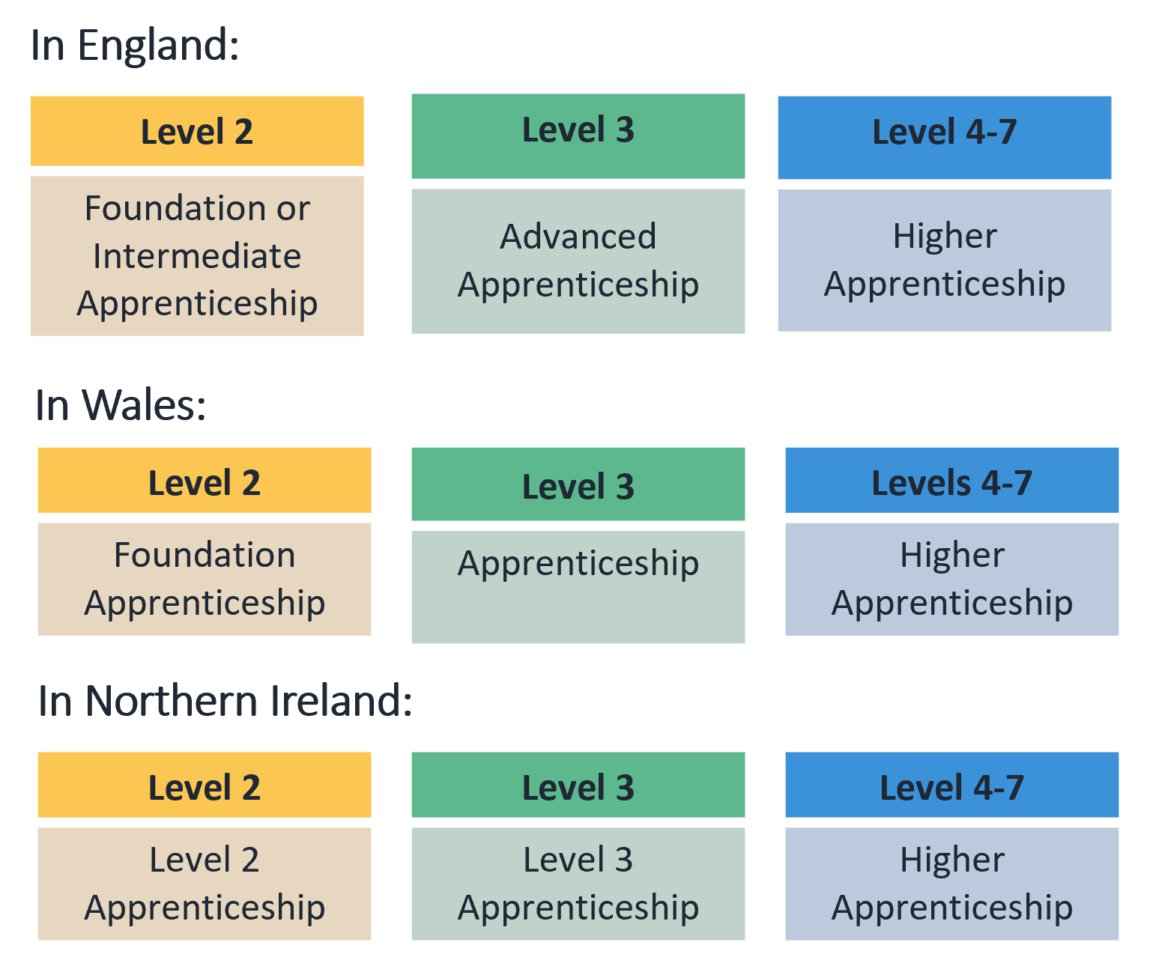

What am I doing now?
Apprenticeships work in levels too!
For example, in England, Northern Ireland and Wales:
GCSE grade 9-4 is a
Level 2 qualification
A level or T level is a
Level 3 qualification
Did you know?
An apprenticeship offering a degree may also be called a Level 6 or Higher Apprenticeship
Public

Slide 43

When can I apply?
Advertised throughout the year; with no single application deadline.
Larger organisations with multiple application processes may recruit earlier than smaller local organisations.
Higher apprenticeships with a Sep/Oct start tend to recruit in the previous academic year.
www.ucas.com/apprenticeships
Public

Slide 44

How do I apply?
Applications are made directly through the company or training provider.
There is no limit on the number of applications you can make.
The application process might vary across vacancies, you could be asked for:
CV and Covering Letter
Application Form
In App/Site application
You can apply for universities and apprenticeships at the same time!
Public
Notes:
You do not apply to apprenticeships via UCAS.
Apprenticeships do not count towards your 5 UCAS choices.
Apprenticeship applications are made directly to the employer or training provider, there is no limit on the number you can apply to.

Slide 45

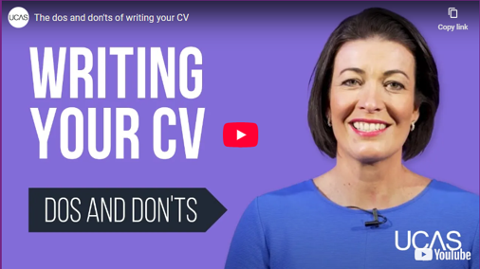
How can ucas help?
Apprenticeship Application Guides
Get to grips with what to expect when applying for specific industries.
Live studio apprenticeship podcast
Radio 1's Katie Thistleton chats to apprentices and experts about what you need to know.
UCAS CV builder
Create a professional CV in minutes.
Find it all and more ucas.com/apprenticeships
Public
Notes:
UCAS Employer Profiles showcases employers offering apprenticeship opportunities outside of their vacancy period, perfect for year 12 wish lists of companies to apply for in the following year.
Check out all our information, advice and guidance, including support for students applying to apprenticeships with individual needs including neurodiversity all www.ucas.com/apprenticeships
Apprenticeship Application Guides
www.ucas.com/apprenticeships/application-guides
Apprenticeship podcast
www.ucas.com/apprenticeships/getting-ahead-apprenticeships-katie-thistleton

Slide 46
Next steps
UCAS Support
Public

Slide 47

THINGS TO DO
research, research, research
attend open days and events
independent learning outside the curriculum
work experience
volunteering
focus on this year’s studies
Public

Slide 48


www.ucas.com/parents
Are you supporting someone who’s exploring their options?
Whether they’re set on going to uni, or still deciding, we can help!
Sign up for our parent newsletter - we’ll send you everything you need to help them.
UCAS Parents' Podcast - listen to our live studio podcasts covering everything you need to know about education and careers.
Parent, Guardian and Carer Guides - everything you need to support a young person with their options and decision-making and help them through the UCAS application process.
Public

Slide 49

Thank you
Public

