Slide 1
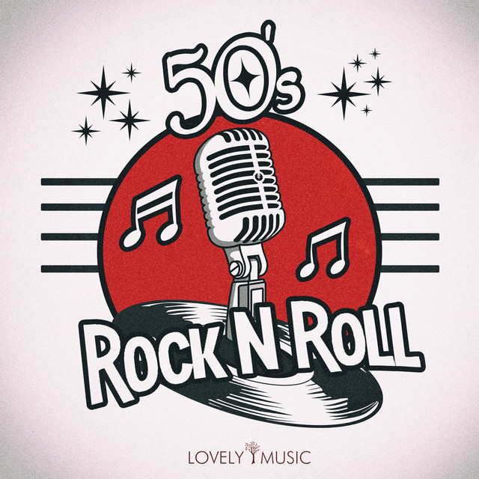
1950s
Rock ‘n’ Roll
CMI372 Music in Context
C1.2 Analysis of Musical Styles

Slide 2
C1.2 Criteria
PASS | MERIT | DISTINCTION
Give an explanation of the main musical elements of each style identified in 1.1, with a discussion of the importance of the elements 1.2a–g, where appropriate, within each style. | Give a clear and detailed explanation of the main musical elements of each style identified in 1.1, with a thorough discussion of the importance of the elements 1.2a–g, where appropriate, within each style. | Give a comprehensive explanation of the main musical elements of each style identified in 1.1, with an insightful discussion of the importance of the elements 1.2a–g, where appropriate, within each style.
a) Instrumentation (texture/timbre)
b) Structure
c) Rhythm
d) Melody
e) Lyrical Content
f) Use of technology
g) Production

Slide 3
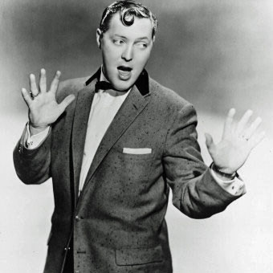
Historical Context: PART 1
Rock ‘n’ Roll began in the American south; a combination of the many styles of music that existed in the country at the time.
Life in America during the early C20th was one of segregation and up until the 1940s, different cultures in America had created their own styles of music, including blues, jazz, folk, country, gospel, and swing. Around that time, musicians began to combine the different styles of music, and soon they came together in an amalgamation that resembles what we now know as Rock ‘n’ Roll. The earliest Rock ‘n’ Roll songs are mainly influenced by the FUSION of country and blues.
When American country singer, Bill Haley, combined these two musical genres and started including the word “rock” in his song titles, Rock ‘n’ Roll was born. One of Bill Haley’s early hits “Rock Around the Clock” (released in 1954) is still heard regularly today. It became a massive hit and is often credited with bringing Rock ‘n’ Roll into mainstream culture. However, it was the signing of Elvis Presley to SUN RECORDS in Memphis (a mostly black label) that really made Rock ‘n’ Roll popular. He recorded his first single “That’s All Right” in 1945. This led to the acceptance also of black artists, such as Little Richard, Fats Domino, and Chuck Berry.

Slide 4
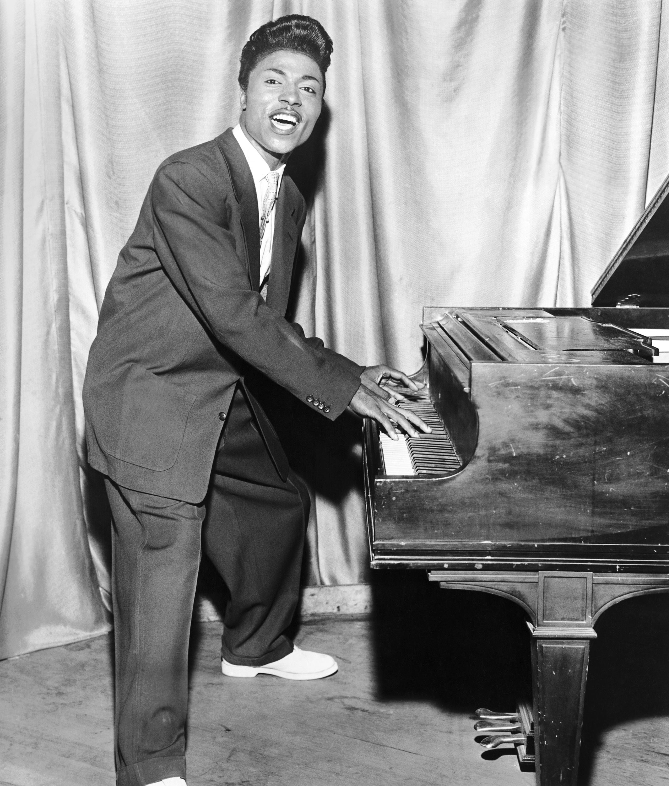
Historical Context: PART 2
Rockabilly, influenced by country music was popularized by white musicians like Elvis Presley. Rhythm & Blues was made mostly by African-American musicians. Some of the first Rock ‘n’ Roll hits by white musicians were simply re-recorded covers or re-writes of earlier black-owned Rhythm & Blues or blues songs.
Despite this, many African-Americans broke through into the mainstream, including legendary names like Chuck Berry, Fats Domino, Bo Diddley and Little Richard. Their energetic performances brought a new level of excitement to popular music. Chuck Berry’s “Maybelline” (1955) and Little Richard’s “Tutti Frutti” (1955) are often listed as some of the most influential Rock ‘n’ Roll recordings.
The popularity of Rock ‘n’ Roll was an important step toward integration, as people of all races came together to both make and enjoy the music. The appeal of Rock ‘n’ Roll across racial lines also reflected and contributed to the CIVIL RIGHTS MOVEMENT.
You may wish to research more about the Civil Rights Movement and the impact that this had on America and around the world.

Slide 5

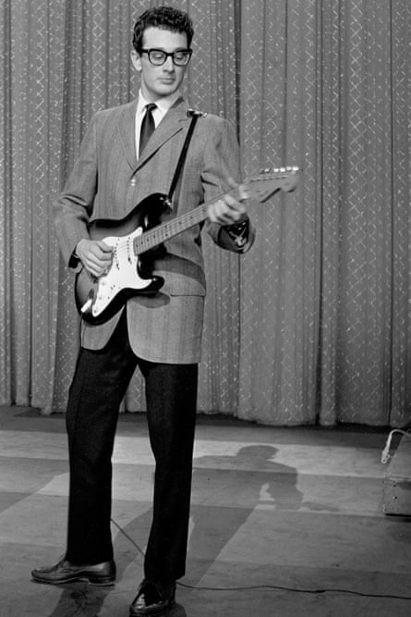
Historical Context: PART 3
Improvements in recording, pioneered by Sam Phillips and the availability and mass distributions of records paved the way for the first pop mega-stars. Sam Phillips was the founder of Sun Records in Memphis, who signed Elvis Presley. He was also known for launching the careers of both Jerry Lee Lewis and Johnny Cash.
To further help spread the popularity of these new songs and artists was a new TV show called American Bandstand, hosted by Dick Clark in 1957. TV shows like this played a crucial role in popularising Rock ‘n’ Roll music and new dance crazes across America.
At the very end of the 1950s, as Rock ‘n’ Roll was gaining popularity, three of its most popular artists met a tragic end. In a sudden plane crash in 1959, known as “The Day the Music Died”, Buddy Holly, Ritchie Valens, and The Big Bopper were killed. It was Buddy Holly’s innovative approach to songwriting and recording, that had made him incredibly respected in the industry. In particular, his use of double-tracked vocals would influence future legends like The Beatles, who were becoming a sensational new band in the UK at the time.

Slide 6
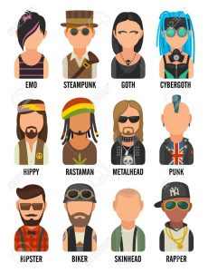
Section 1: PART 1
Introduction to 1950s Rock ‘n’ Roll
Subculture
Rock ‘n’ Roll music is often linked to the emergence of teen culture with the so-called Baby Boomer generation.
Post war-prosperity had a huge influence on youth culture and music in the 1950s, including the subculture fashion and aesthetic.
There was a strong need and desire within teens of the time to pull away from the darkness of WWII (ending in 1945) and to carve out an identity for themselves within a new era of stability. Rock ‘n’ Roll music managed to encapsulate this feeling.
A subculture is a group of people who share similar values and opinions, and are united by their musical preferences, appearance and lifestyle. It is often linked to youths, which creates discomfort and suspicion amongst older generations, often causing controversy and outrage. Music can be an important way for people to express themselves.
You may wish to look at later teen subcultures, such as 70s Punk and 00s Emo as further examples.

Slide 7
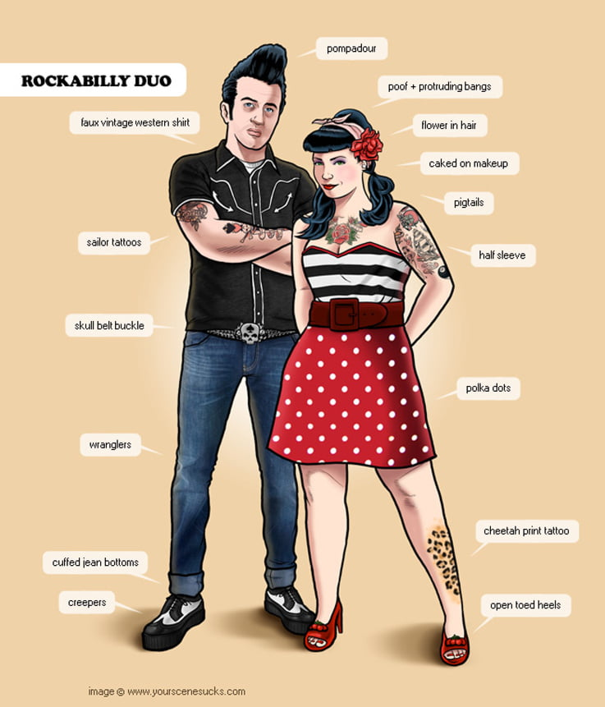
Section 1: PART 2
Introduction to 1950s Rock ‘n’ Roll
The “Rockabilly” Aesthetic
The Rock ‘n’ Roll aesthetic was heavily tied to a sense of rebellion against the conservative norms of the 1950s.
It celebrated youth, freedom, and individuality.
Consider how this might have been different to how their parents of the time (possibly born in the 1910s) would have dressed.
Men | Women
Leather jackets T-shirts & Jeans Greased hairstyles Bowling shirts Chuck Taylor Sneakers or loafers | Poodle skirts/petticoats Ponytails & pin-up hairstyles Capri/pedal-pushers Bobby socks & Saddle shoes Bold make-up

Slide 8
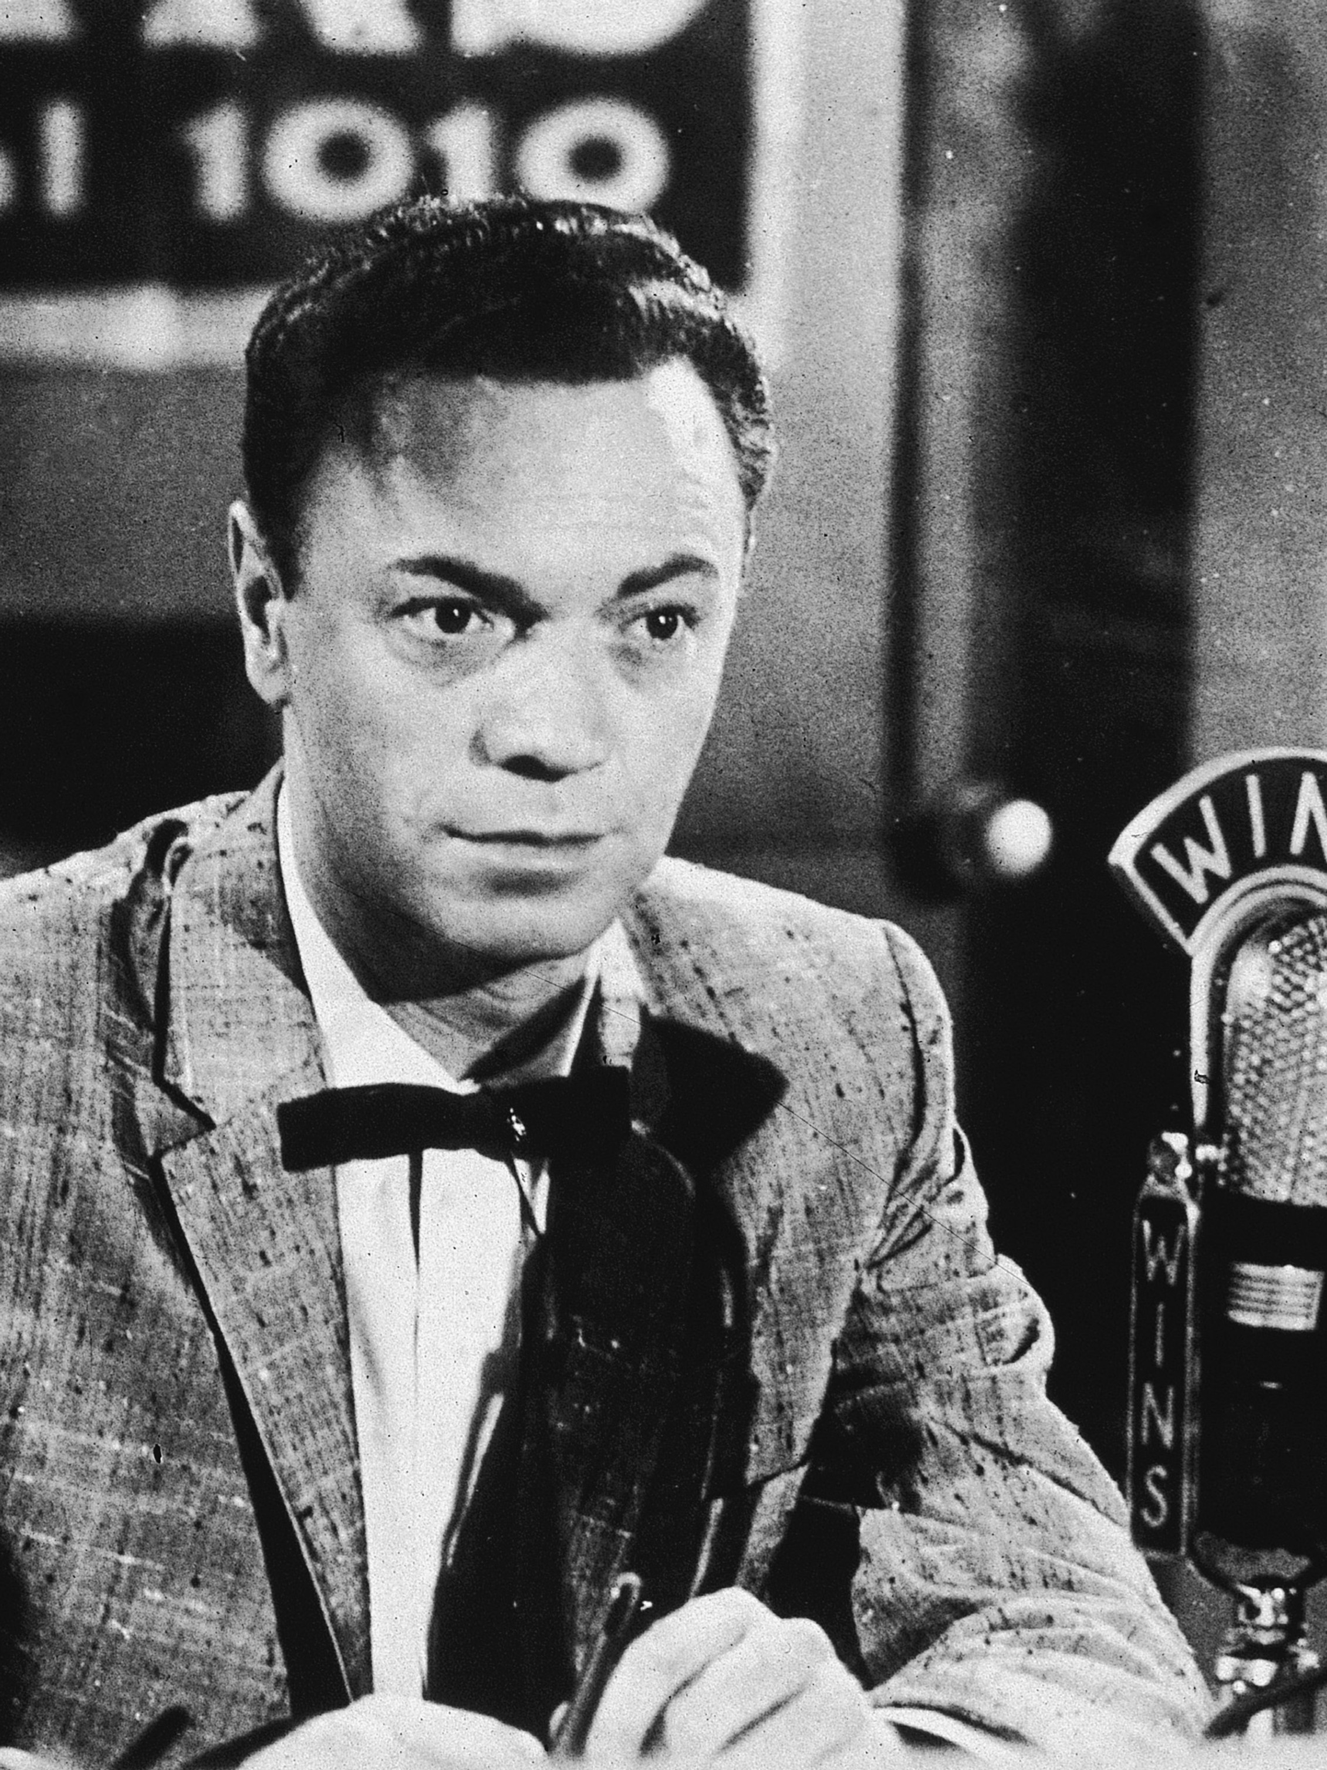
Section 1: PART 3
Introduction to 1950s Rock ‘n’ Roll
2. Social Change & Youth Culture
Alan Freed, a radio DJ from Cleveland, Ohio, noticed that white teenagers, bored with the bland music played on the white radio stations, were getting excited by Rhythm & Blues. Freed started playing it in his programmes, but discreetly called it “Rock ‘n’ Roll”. He quickly became the most successful DJ in the area and a national celebrity.
Early Rock ‘n’ Roll music caused enormous controversy. Parents, preachers, and politicians were outraged by its furious energy and sexual overtones. Many thought that it would also encourage violence! Attempts were made to ban the music entirely, but this was not successful! The broadcasting industry tried to make the music appear less threatening but this, instead, led to a gradual decline in inventiveness. There were, however, three positive things that came out of this.
Independent producers and songwriters became more important in developing the style.
The idea of a “group” of musicians became very popular. Bill Haley, for example, became Bill Haley and the Comets. Cliff Richard was Cliff Richard and the Shadows. It was also during this time that both the electric and bass guitars became the standard part of what became known as the “rock band setup”.
Groups such as The Beach Boys and The Beatles became extremely popular, not only because of their music but because their clean image made them seemingly inoffensive and acceptable to everyone. These bands (amongst others) went onto pioneer the British Invasion movement of the 1960s.

Slide 9
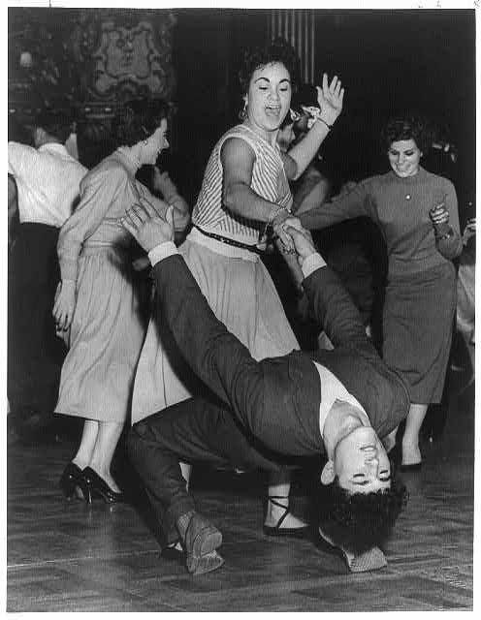
Section 1: PART 4
Introduction to 1950s Rock ‘n’ Roll
Dance Craze
Rock ‘n’ Roll dancing is very athletic and originated from the Lindy Hop from the “swing” era (1920s). It is danced by both couples and groups and is normally a very fast and physically demanding dance, often performed by young dancers.
Dance halls were noisy, featuring the clattering of many feet on the floor. Therefore, the music needed to be loud. This was initially with large horn sections to drown out the sound but eventually ensembles started to reduce in size with the onset of guitar amplification.
The most obvious feature of Rock ‘n’ Roll dancing are its kicks and acrobatic elements. A typical Rock ‘n’ Roll movement is the kick ball change. Acrobatic movements included a variety of lifts, jumps, throws and flips. Other moves associated with 50s Rock ‘n’ Roll are as follows: Boogie Back, Tuck-Turn, Hand-Jive, Jitterbug, Lindy Hop, Jump, Mashed Potato, Kick-Ball-Change and the Barrel Roll.
The original Rock ‘n’ Roll dancers would have worn bright colours. The shoes worn is one of the most important elements in Rock ‘n’ Roll dancing. Their soles need to possess slip and grip characteristics. The most common footwear are light jazz shoes.
Rock ‘n’ Roll dance works on the 4/4 time signature. This means that each phrase of movement will fit into a count of 4 beats. The music is very fast, between 176 & 200BPM.

Slide 10
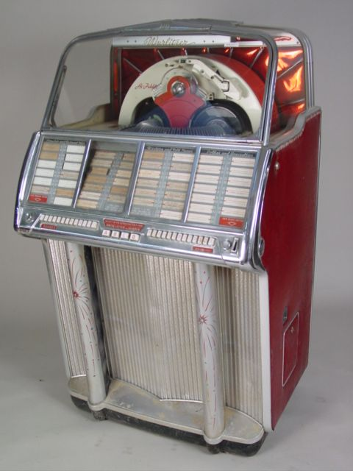
Section 1: PART 5
Introduction to 1950s Rock ‘n’ Roll
3. Jukeboxes
With more and more families enjoying new prosperity after WWII, their teenagers had free time and money to spend. They began attending local dances and concerts, where they heard this new style of music played, and soon began spending their money on records and jukebox plays in diners. Other DJs besides Alan Freed began noticing the popularity of the music and began playing it on their radio stations more and more, pushing it into the mainstream.
Coin-operated jukeboxes were popular in American diners in the 1950s, with popular models including the Wurlitzer jukebox from 1959. They held a range of 7-inch 45 rpm records featuring an A/B side (approx. 70 discs, 140 tracks). With more and more families enjoying new prosperity after WWII, their teenagers had free time and money to spend on music.
A jukebox cost approx. 25 cents for 3 song plays in the 50s/60s.​ They had easy to use buttons with letters & numbers (much like a vending machine). They received the newest and latest recordings from record companies.​
The most played jukebox songs of all time include "Hound Dog” by Elvis Presley and “Rock Around The Clock” by Bill Haley and the Comets – both classic 1950s Rock ‘n’ Roll tracks.​
There was a sharp decline once more portable ways of listening to music was invented – the portable radio in the 1950s and later the cassette player in the 60s.

Slide 11
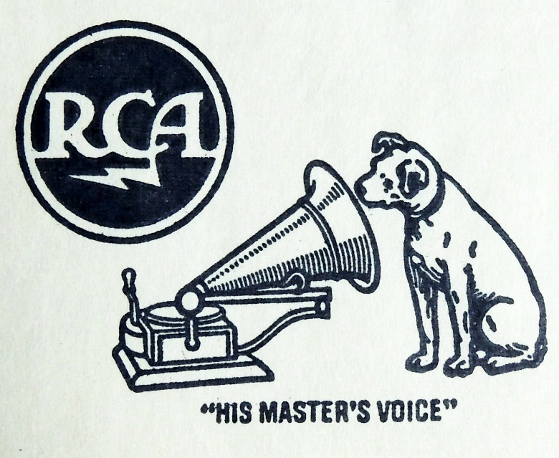
Section 1: PART 6
Introduction to 1950s Rock ‘n’ Roll
3. RCA Victor (45 rpm record)
The RCA Victor company produced a 7-inch record in a more durable material called vinyl in 1949, replacing the previously used brittle shellac material. ​
The record was lightweight and inexpensive, costing approx. $1 per record to own.​
45 rpm = revolutions per minute. They were better audio quality than the previous 33 rpm records. They were a bigger disc, which meant they could hold more audio information, and they had less compression of the signals. Upper frequencies were more audible.
The records included an A side/B side of no more than 5 minutes per side.​
Boxes of 45 rpm records were released in a boxset, which is an early form of an album.
Despite these huge advancements in what a record could hold, we were still listening on a mono output in the 1950s. There was no stereo sound until the 1960s.

Slide 12
Main Musical Characteristics
Simple & repetitive but energetic.
Instrumentation includes – typically male vocals, backing vocals, electric guitars, double bass/electric bass, drums, piano, horn section.
Fast Tempo – 140bpm or faster
Energetic delivery of vocals (screaming, screeching and shouting)
12-bar blues structure
Predominantly uses major keys but with the blues scale or pentatonic minor scale for vocals, lead parts and solos
Blues scale – 1, b3, 4, b5, 5, b7 (Pentatonic minor – 1, b3, 4, 5, b7)
Strong back beat on beats 2 and 4
Often uses a shuffle rhythm – slightly swung quavers
Walking bass line, often based on ascending and descending patterns
Use of ‘stop time’ where instruments play only on beat 1 then leave space for vocals or instruments
Use of flamboyant guitar or piano solos
Call and response – often between vocals and guitar
Piano comping role – repeated quavers, high register
Doo wop lyrics at times, using non-sensical syllables
Lyrical content – young love, cars, school, parents, etc.
Approx. 2-2.5 minutes in length
Live recordings, direct to tape and mixing is done on the fly
Poor quality of instrument capture
Use of slap-back delay on vocals and guitars (short single-repeat echo effect)

Slide 13
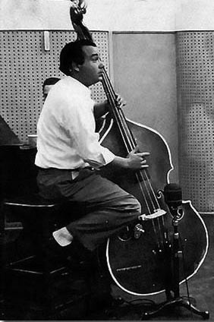
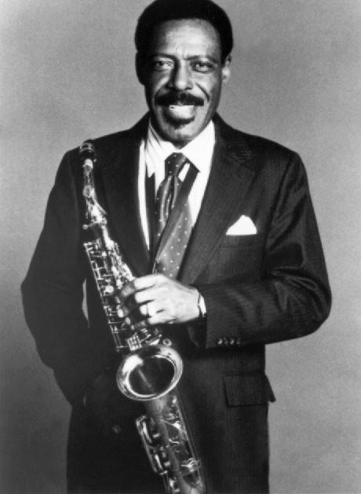
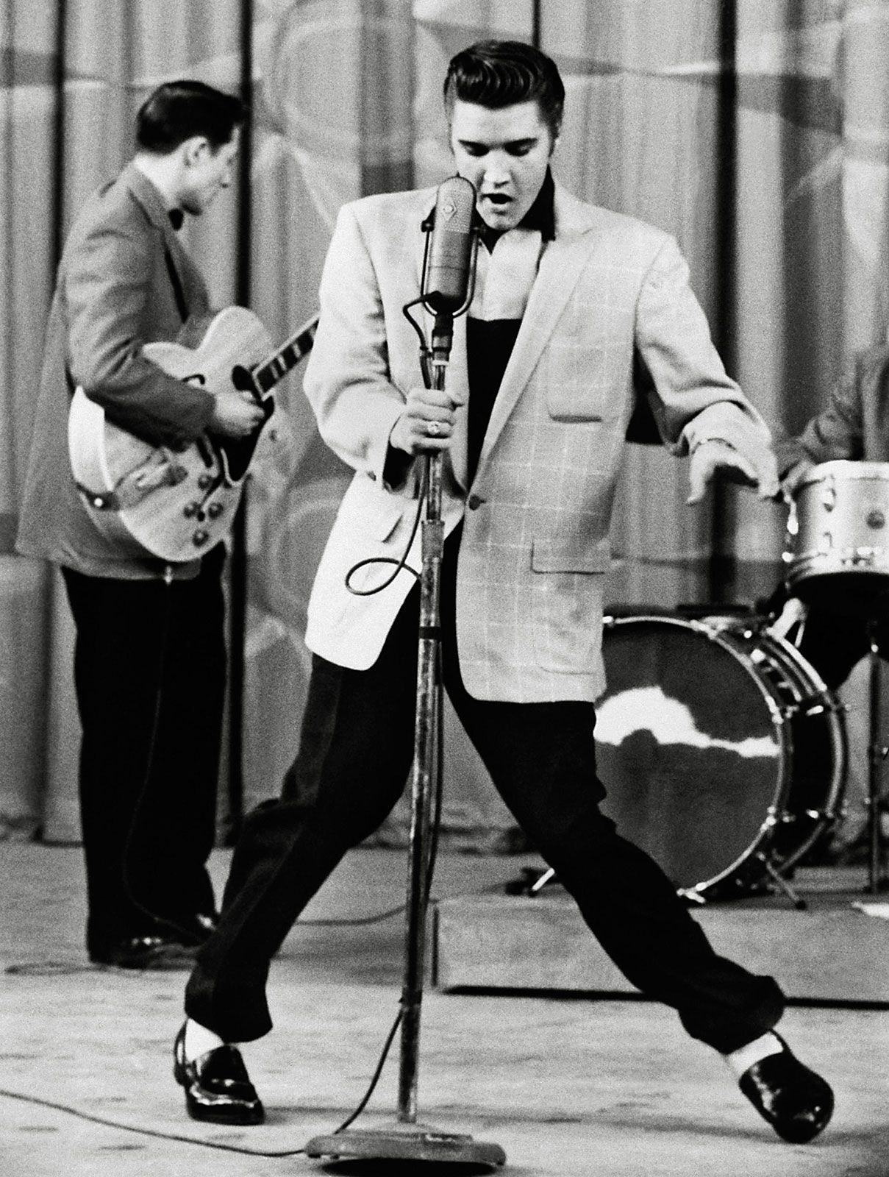
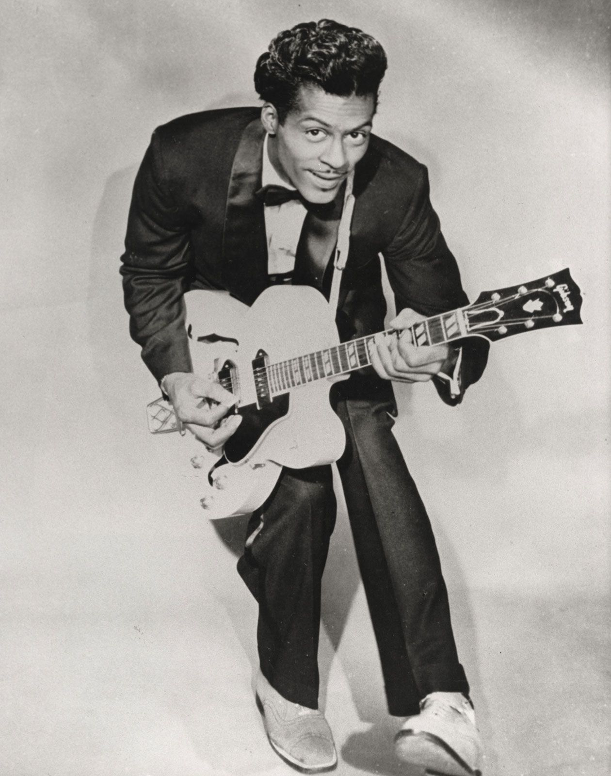
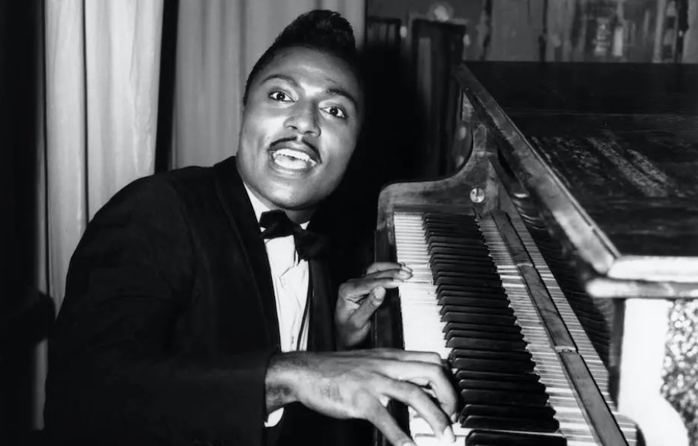
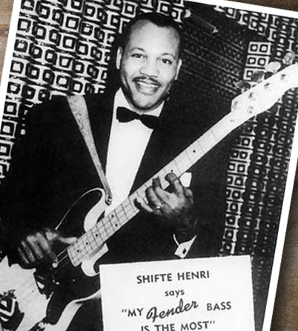
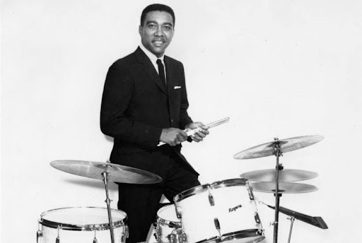
Section 2: PART 1
Iconic Performers of 50s Rock ‘n’ Roll

Slide 14
Section 2: PART 2
Iconic Performers of 50s Rock ‘n’ Roll
Vocalists | Guitarists | Bassists | Drummers | Pianists | Horns
Elvis Presley Chuck Berry Little Richard Buddy Holly Jerry Lee Lewis Fats Domino Roy Orbison Gene Vincent Bo Diddley Carl Perkins Eddie Cochran Ritchie Valens | Chuck Berry Buddy Holly Scotty Moore Carl Perkins Bo Diddley Eddie Cochran James Burton Mickey Baker Duane Eddy | Bill Black Willie Dixon Marhsall Lytle Joe. B Mauldin Jerry Jemmott Carol Kaye James Jamerson Monk Montgomery Roy Johnson | Earl Palmer D.J. Fontana Jerry Allison Charles Connor Fred Below Sandy Nelson | Jerry Lee Lewis Little Richard Fats Domino Ray Charles Huey “Piano” Smith Professor Longhair Lloyd Price Johnnie Johnson | Lee Allen (alto sax) David “Fathead” Newman (tenor sax) Hank Crawford (alto sax) King Curtis (tenor sax) Louis Jordan (alto sax) Plas Johnson (tenor sax) Rudy Pompilli (tenor sax)

Slide 15
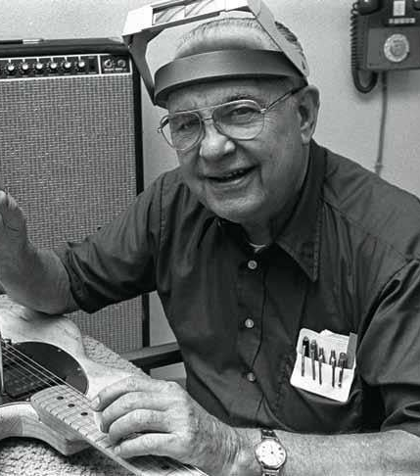
Section 2: PART 3
Iconic Names of 50s Rock ‘n’ Roll
Although they are not known for their performances within the 50s Rock ‘n’ Roll genre, the following names are still integral to the fabric of the genre and should be further researched:
Alan Freed (DJ)
Sam Phillips (Producer)
Leo Fender (Guitar & Amplifier innovator)
Colonel Tom Parker (Manager of Elvis Presley)
Dick Clark (TV Personality & Presenter of “American Bandstand”)

Slide 16
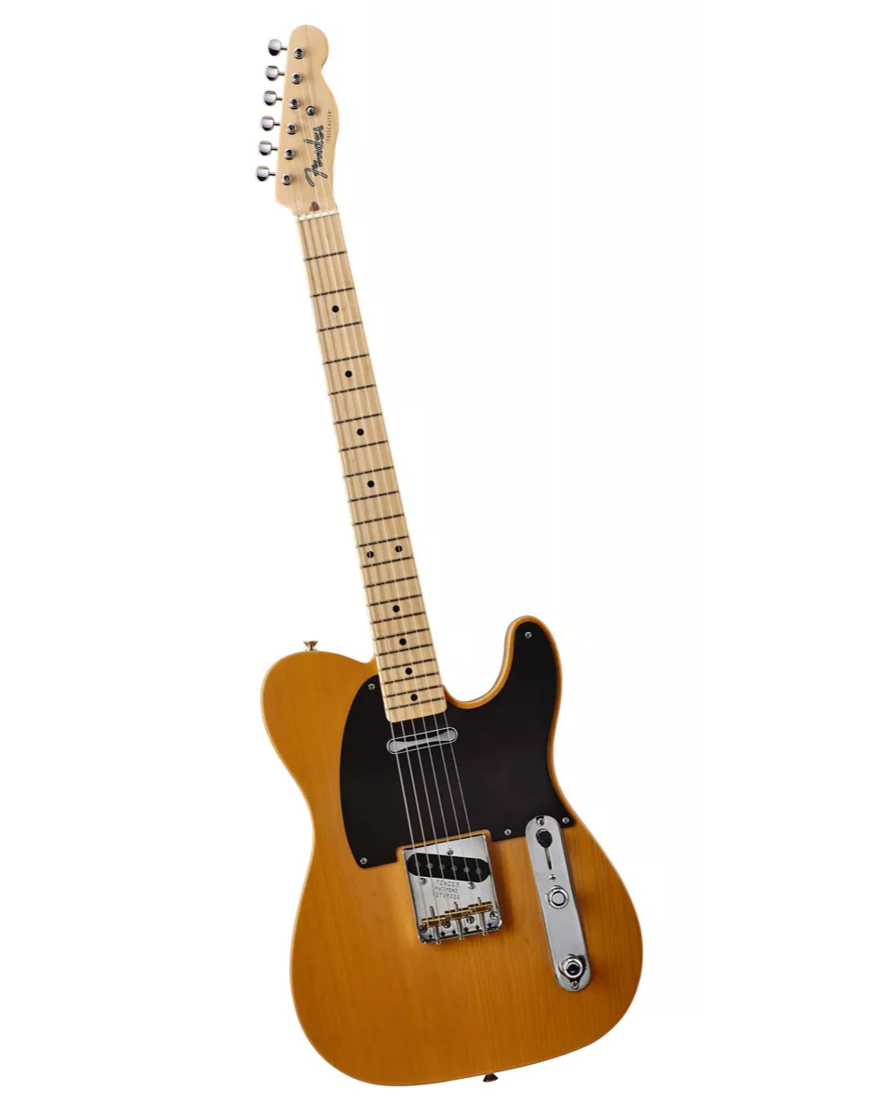
Section 3: PART 1
Roles of Instrumentation
Fender Telecaster
The development of the Fender Telecaster electric guitar in the 1950s was a huge turning point for the sound of popular music forever more.
ORIGINS: The Fender Telecaster (and then later the Fender Stratocaster) was developed in the 1950s. It was easy to use and stylistically suited to rock genres.​
First made famous by Buddy Holly and Jimi Hendrix. ​
It was the first commercially successful electric guitar with a solid body design and is one of the most emulated guitar shapes of all time.​
The solid body design was less likely to cause feedback with heavy amplification. ​
Separate pickups with selector switch feature so tone could be changed during a performance.​
The use of amplified guitars led to much smaller ensembles and many sections disappeared, including large horn sections from 40s Swing Jazz and 50s Rock ‘n’ Roll.​

Slide 17
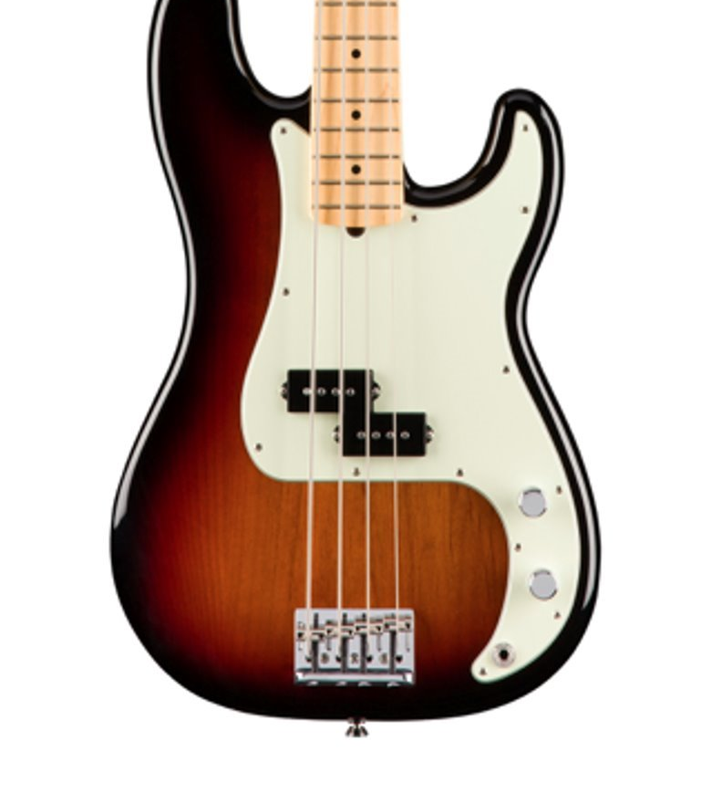
Section 3: PART 2
Roles of Instrumentation
2. Fender Precision Bass
The development of the Fender Precision amplified bass guitar in the 1950s forever changed the sound of popular music and helped to shape the format of the standard “rock band” setup as we know it today.
The Fender brand changed the way music was created and experienced in the 1950s – Precision Bass & Telecaster (1951), Stratocaster (1954), Jazzmaster (1958). ​​
The instrument simply didn’t exist until this point – there wasn’t an electric bass guitar. ​​
Previously used the upright acoustic bass, which was big and bulky and difficult to transport. Also, difficult to hear the finer details over other amplified instruments and big ensembles for dancing (large horn sections).​​
Amplification allowed for a hard-edged sound with more sustain.​​
Iconic shape – with two “horns” to the body, which provided a good balance. ​​
Use of frets allowed players to be able to play in tune more easily (doesn’t exist on an upright bass). ​Also, more user-friendly, being lighter and more portable than a double bass.​

Slide 18
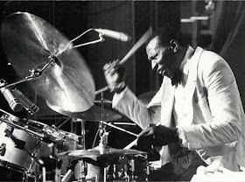
Section 3: PART 3
Roles of Instrumentation
3. Drum Kit
Important time-keeping role.
Clearly still influenced by the drumming found in previous jazz genres.
Emphasis on beats 2 & 4 (backbeat).
Shuffle groove pattern on hi-hats or ride cymbal.
Occasional drum solo.
Mimicking boogie-woogie LH of the piano (rolling feel on toms & bass drum).
Simple drum fills, such as a quick roll on the snare.
Heavy use of rimshots (hitting edge and head of the snare at the same time).
To understand more about the role and playing techniques of the drum kit, check out this informative video: https://www.youtube.com/watch?v=E7kjbVQeltA

Slide 19
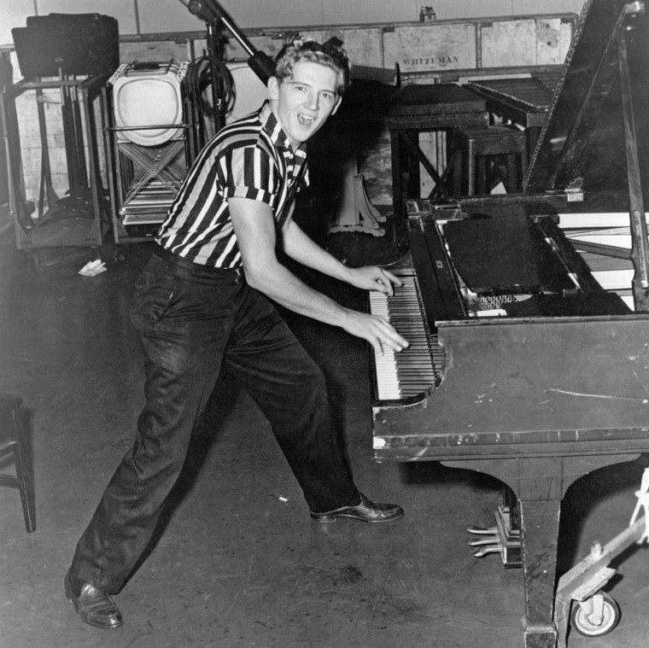
Section 3: PART 4
Roles of Instrumentation
4. Piano
Comping role – repetitive chordal accompaniment. A staple part of the rhythm section, adding a powerful groove.
Occasional solo with heaps of showmanship, including standing up when playing.
Boogie-woogie style – the LH plays a continuous, rhythmic pattern. Often alternating 2 chords. https://www.youtube.com/watch?v=SIX2-2_ALaQ
Upper register repetitive quavers (sometimes in a shuffle rhythm) to cut through the noise of the rest of the ensemble. Adds energy.
Percussive playing - played with force and energy, striking the keys harshly (sometimes with the elbow or feet!).
Doubling the walking bass pattern in the LH.
Call & response.
Bluesy & Gospel-inspired melodies.
Use of Glissandos (sliding up and down the keys) & Trills.
Syncopated RH riffs.

Slide 20
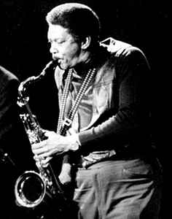
Section 3: PART 5
Roles of Instrumentation
5. Horn Section
The horn section in a traditional jazz band in the 1940s is a mixture of woodwind and brass instruments, typically consisting of saxophones, trumpets, and trombones. Occasionally, you would also find clarinets, amongst others.
Mostly an accompaniment role, with some call & response using riffs/fills (“Yakety Yak”).
Occasional solos, typically tenor saxophone or trombone.
Use of glissandi/slides, popularised in Rockabilly music.
Staccato, tight ensemble stabs, adding a punchy attack to the accompaniment.
Dynamic swells to add to the energy and impact of the music (“Good Golly Miss Molly”).
Harmonic support, playing sustained chords (“Shake Rattle & Roll”).

Slide 21
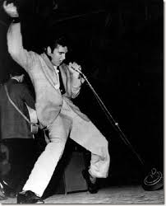
Section 3: PART 6
Roles of Instrumentation
6. Vocals
Doo-wop singing, derived from New Orleans scat (1920s) uses non-sensical syllables to emulate the sound of instruments (“Tutti Frutti”). You should listen to Louis Armstrong’s “Heebie Jeebies” track from the 1920s to further understand the origins and sound of scat singing.
Little Richard style screeches, with use of falsetto.
Main lead of the ensemble.
Lyrical content often about teen romance/heartbreak, dancing, rebellions, cars, self-expression, etc.
Energetic stage presence, engaging with the audience and incorporating movement.
Powerful & expressive vocals, with a wide dynamic range.
Gritty & raw tone, adding to the rebellious nature of the music. Sometimes rough and raspy in sound.
Vocal riffs and ad-libs (sometimes improvisatory feel).
Call & response between backing vocals or ensemble.

Slide 22
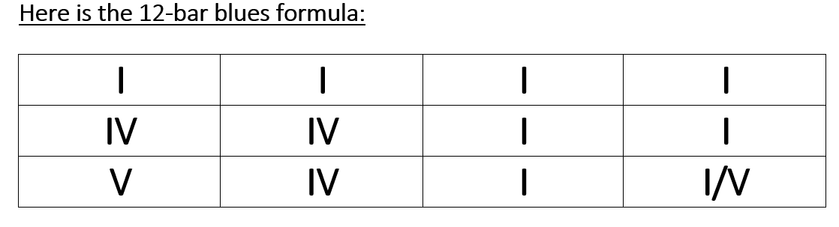
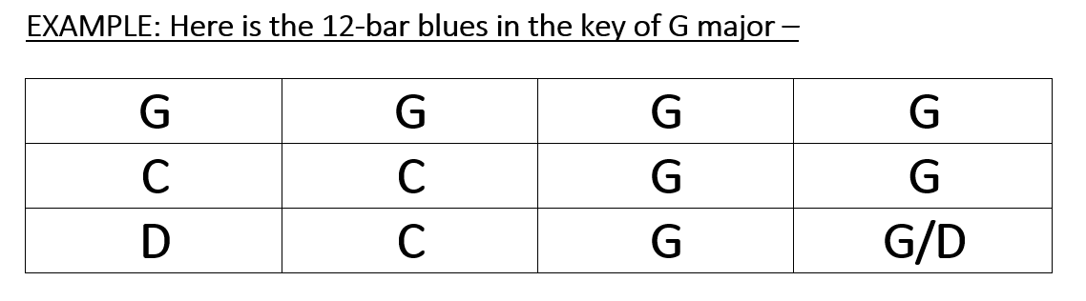
Section 4: PART 1
Structure & Form
12-bar blues
The 12-bar blues formula is both a structure and a harmonic scaffold. All 1950s Rock ‘n’ Roll tracks are based around this predictable and highly repetitive harmonic pattern and it’s a huge part of what gives the music its iconic and instantly recognisable sound. Each individual section would be built around this selection of chords, and you would typically find the pattern repeated approx. 5 or 6 times in the track.
The structure uses 3 chords (I-IV-V). These are known as the primary triads and most music is based around them. They are all major chords, adding to the upbeat flavour of Rock ‘n’ Roll music.
A perfect cadence is created at the end of each 12-bar pattern, as the music repeats from V-I. On the final section, the music settles on a plagal cadence (IV-I).

Slide 23
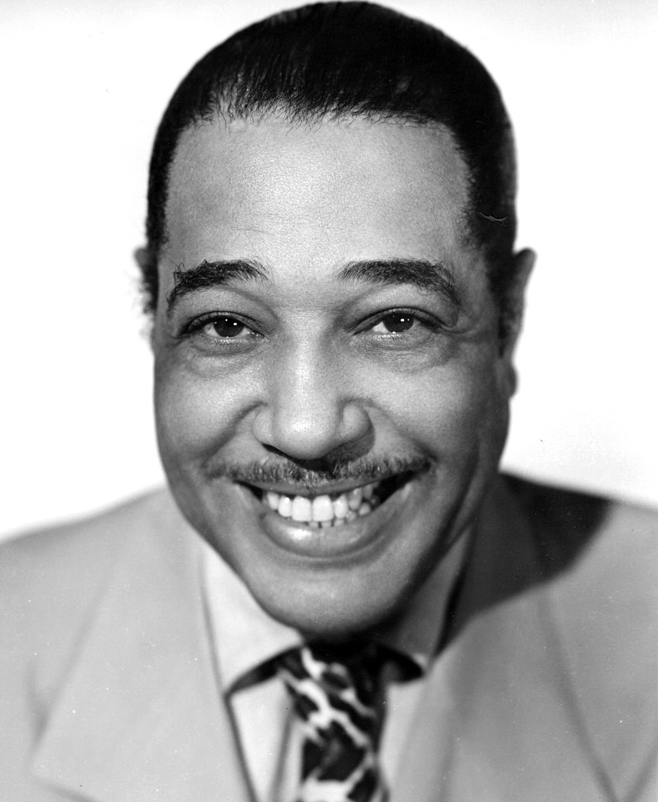
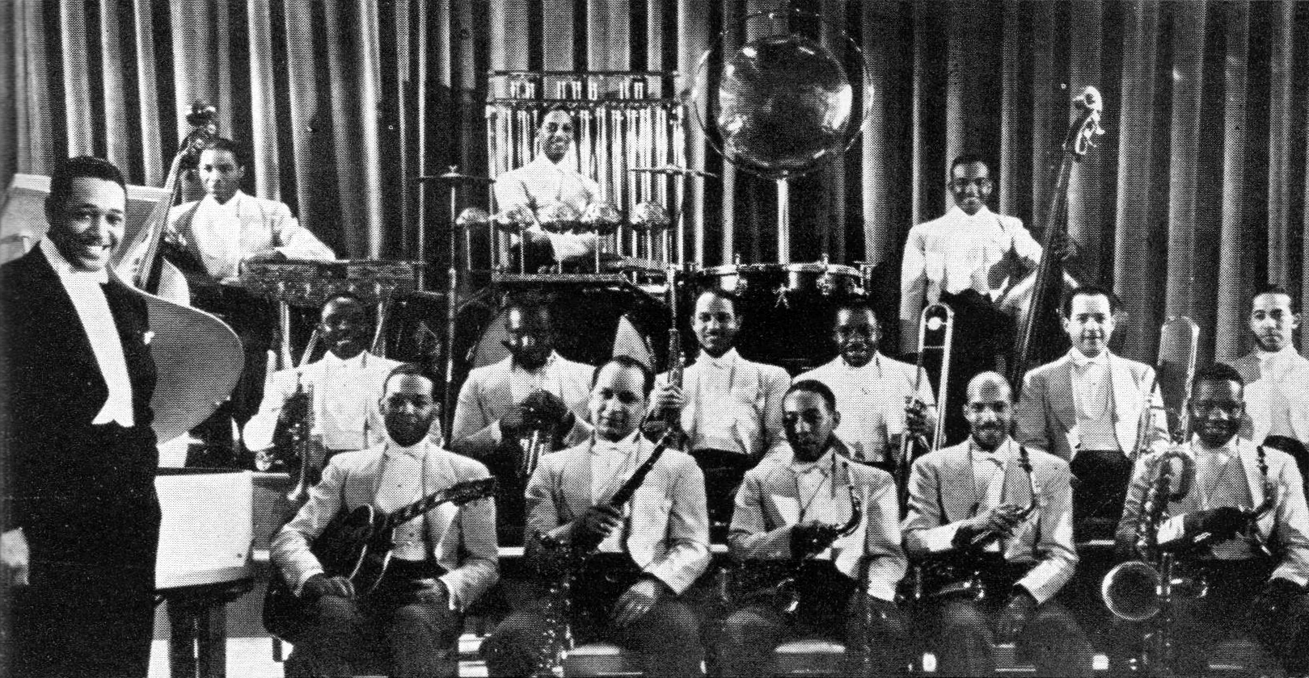
Section 4: PART 2
Structure & Form
2. Stop Time
Stop time is both a textural and a structural feature of music, prominently found in 1950s Rock ‘n’ Roll and, also, in later genres such as 1980s Heavy Rock. As with many of the features of 50s Rock ‘n’ Roll, the stop time phenomenon can be originally found in 1940s Swing & Big Band jazz.
"Stop time" is where the accompaniment or rhythm section momentarily pauses, allowing the soloist to briefly perform unaccompanied. The music alternates between full ensemble stabs and soloist before returning to a main section in full (see the opening of “Blue Suede Shoes”).
Originally found in tracks such as Duke Ellington’s Koko in the 1940s, involving the two penultimate sections (known as Choruses in jazz) – Chase Chorus, followed by the Shout Chorus. A Chase Chorus would feature a “chase” between ensemble and soloist (in this track the soloist is a double bass). The Shout Chorus would be loud involving the whole ensemble to finish the track, providing a huge contrast in texture, timbre and dynamics.
Motorhead’s Ace of Spades track from the 1980s uses a developed version of stop time. Listen to this track and assess the differences in the use of stop time.

Slide 24
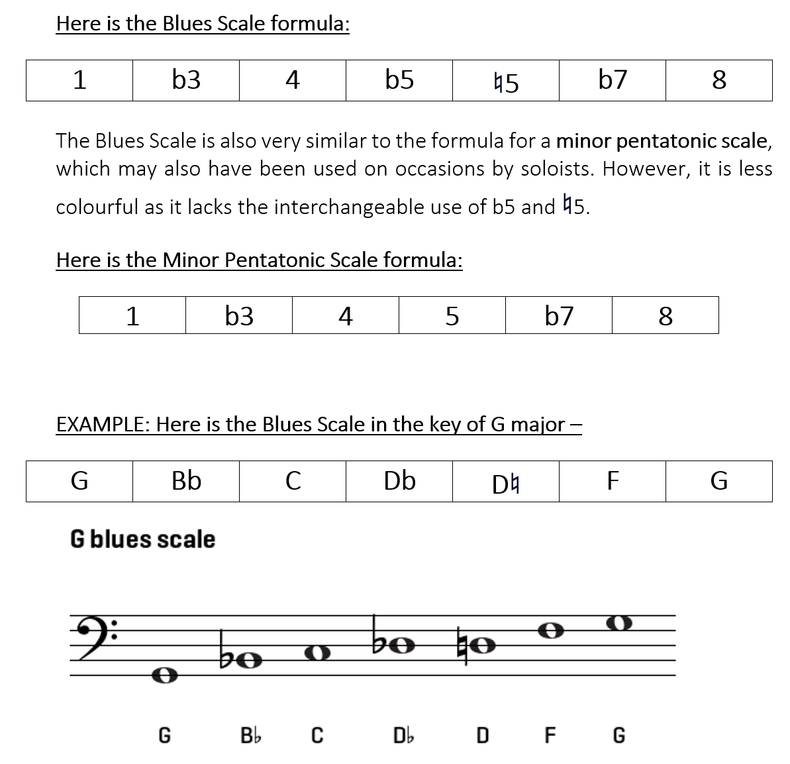
Section 5: PART 1
Harmony & Tonality
Blues Scale
The blues scale would typically have been used by electric guitarists, horn players, or pianists to improvise a solo with. It’s a colourful scale that includes three flattened notes, giving it a highly “bluesy” flavour. It provides interest and comfortably fits over the top of the 12-bar blues structure.
The Blues scale is similar in formula to the minor pentatonic scale but has one extra note (b5) which adds extra flavour.

Slide 25
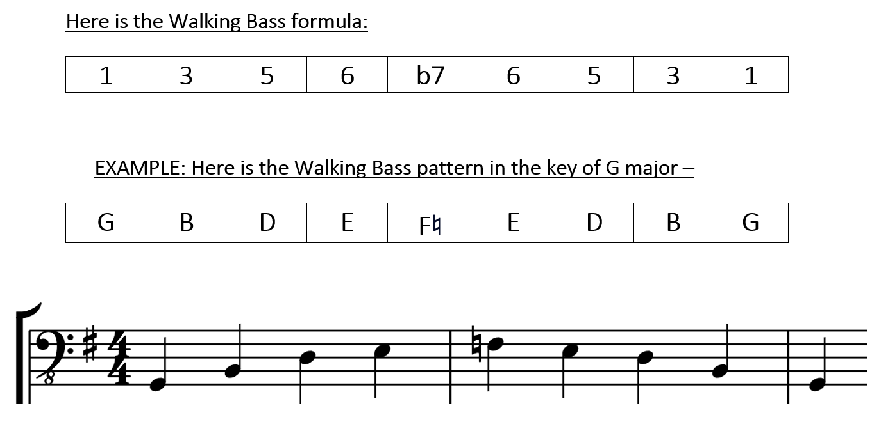
Section 5: PART 2
Harmony & Tonality
2. Walking Bass
The walking bass pattern is integral to a successful 1950s Rock ‘n’ Roll track. It is highly melodic and constantly mobile, helping to keep time as a tight rhythm section with the drum kit. It features the “bluesy” flattened 7th note, adding to the flavour of the music.
It is characterised by a distinctive sounding rising and falling pattern, beginning on the root of the chord and rising to the flattened 7th (b7), before walking down to the tonic again.
The scale features moments of triadic movement at the bottom and some stepwise movement at the top.
The pattern is used in sequence and applied to the x3 primary triads used in the 12-bar blues (I-IV-V).

Slide 26
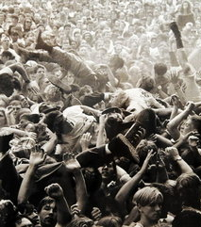
Section 6:
Lyrical Content
Typical lyrics in 1950s Rock 'n' Roll tracks often revolved around themes that resonated with the youth culture of the era. The songs frequently celebrated the joys and tribulations of teenage life, with a particular focus on love, heartbreak, and the excitement of romance.
Lyrics also captured the spirit of rebellion and independence, reflecting the desire of young people to break away from the constraints of tradition and authority.
Dancing and having fun were also common motifs, with many songs providing a soundtrack to the energetic social scene of the time.
Car culture was another prevalent theme, with lyrics highlighting the thrill of driving and the freedom it symbolised.
The language was typically straightforward and relatable, often delivered with a sense of urgency and exuberance that matched the upbeat rhythms and lively melodies of the music, making Rock 'n' Roll the voice of a generation seeking expression and identity.

Slide 27
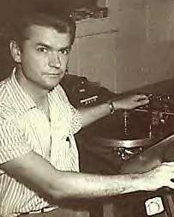
Section 7: PART 1
Technology & Production Values
SLAPBACK DELAY
In 1954, Sam Phillips, the legendary producer at Sun Records, stumbled upon a groundbreaking technique that would forever change the sound of Rock 'n' Roll. Using two cutting-edge Ampex 350 tape recorders, Phillips experimented with what we now call "slapback delay." This effect became a signature sound of the era, particularly in the recordings of Elvis Presley.
The magic of slapback delay lies in how it was created. Phillips recorded vocals onto one tape machine and simultaneously captured the playback on another machine. The physical distance between the tape heads caused a slight delay in the sound, creating a quick, sharp echo that became synonymous with early Rock 'n' Roll. This delay was subtle but impactful, giving the vocals a unique "slapped back" sound that made them stand out, adding energy and a sense of space to the recordings.
One of the best examples of this technique is heard on Elvis’ track "Blue Moon of Kentucky," where the slapback echo gives his voice a lively, almost bouncing quality. This sound was so distinctive that it became one of Phillips' secret weapons in the studio, and it contributed significantly to the iconic Sun Records sound that defined much of 1950s Rock 'n' Roll. Few other producers knew how to achieve this effect as effectively as Phillips, making it a hallmark of his recordings.

Slide 28
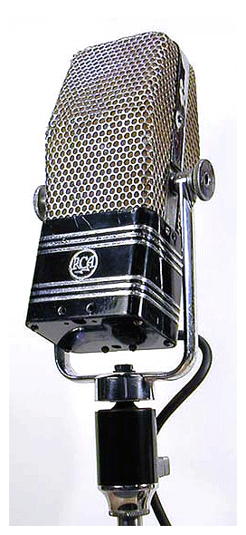
Section 7: PART 2
Technology & Production Values
b) RCA Victor Ribbon Microphone
The RCA Victor ribbon microphone from the 1950s is a legendary piece of recording equipment, cherished for its unique sound and classic look. If you've ever listened to old Rock 'n' Roll records, chances are you've heard this microphone in action. Several versions of the ribbon microphone exist but RCA created their own version.
One of the most notable things about the RCA Victor ribbon microphone is its warm, smooth sound. It captures voices and instruments in a way that feels rich and natural. This warmth is especially noticeable in the lower-mid frequencies, which the microphone emphasizes beautifully. Unlike some other mics that might sound bright or sharp, ribbon mics tend to have a softer, mellower quality.
However, the RCA Victor ribbon microphone is a bit delicate. Inside, it has a very thin metal ribbon that vibrates to pick up sound. While this ribbon is what gives the mic its special sound, it’s also quite fragile. Loud sounds (like a blast of a trumpet right up close), strong winds, or moisture can easily damage it. Because of this, these microphones need to be used carefully.
This microphone isn’t just about great sound—it’s a piece of music history. It was used to record many classic tracks in the 1950s, helping to shape the sound of early Rock 'n' Roll. Even today, musicians and producers often seek out ribbon microphones when they want to capture that warm, vintage sound in their music.

Slide 29
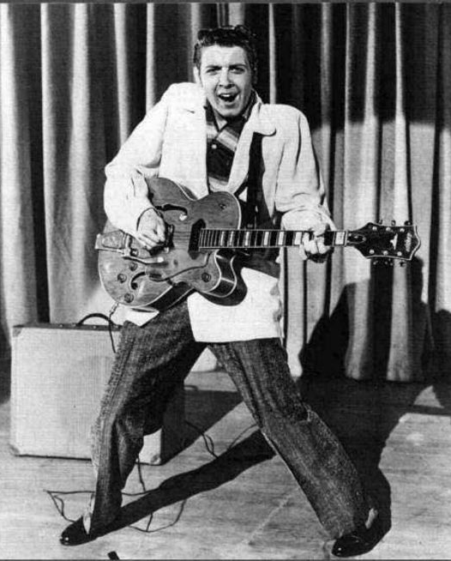
Section 8:
Analysis of Iconic 1950s Rock ‘n’ Roll Tracks
It is important to listen to and dissect as many 50s Rock ‘n’ Roll tracks as possible to really understand the genre and how the music is built. Iconic tracks for the genre include the following:
Rock Around the Clock by Bill Haley & His Comets
Johnny B. Goode by Chuck Berry
Hound Dog by Elvis Presley
Jailhouse Rock by Elvis Presley
Tutti Frutti by Little Richard
Great Balls of Fire by Jerry Lee Lewis
Peggy Sue by Buddy Holly
Shake, Rattle & Roll by Big Joe Turner
Summertime Blues by Eddie Cochran

