Slide 1
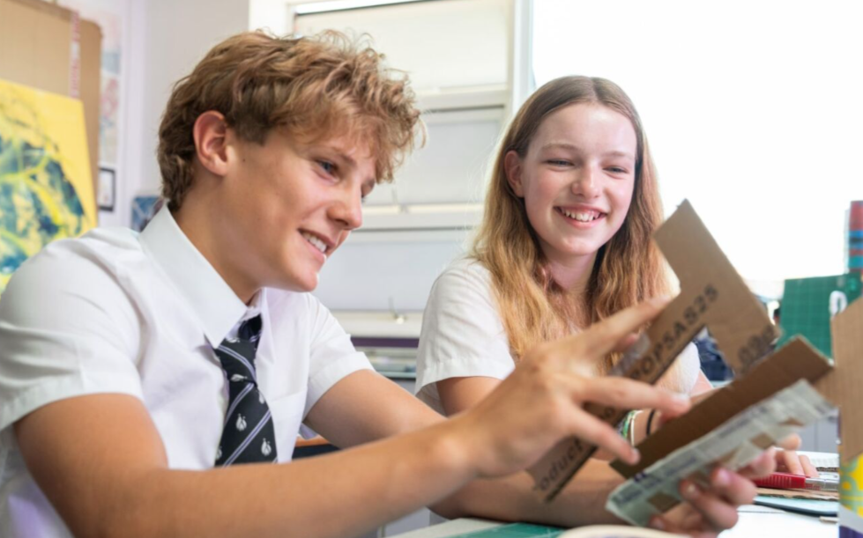
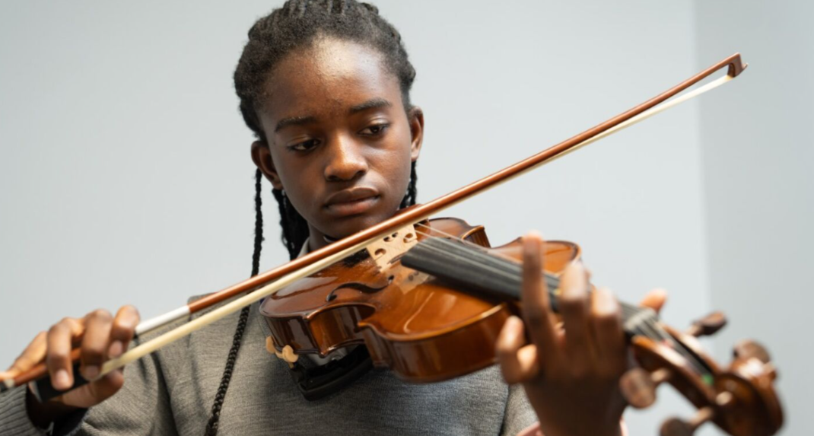

A warm welcome to King’s School on our Open Evening 2025
Presentation by Mrs Sarah Price – Headteacher

Slide 2
Is this school right for my child? Can I see them flourishing here?
Distinctive Christian values and ethos which permeate everything we do – core value of Love
Academic stretch and support for all to ensure enjoyment of learning and excellent outcomes
Outstanding pastoral care, nurturing culture and positive relationships
Heavily invested and highly skilled and successful staff team

Slide 3

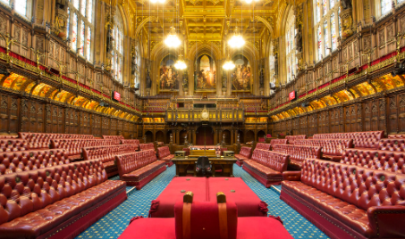

Who am I?

Slide 4
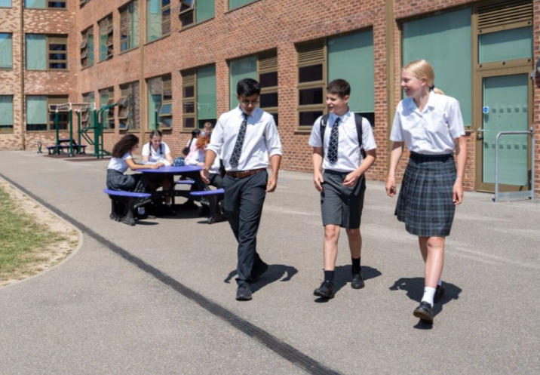
Distinctive Christian Ethos and Values
“Let all that you do be done in love.” 1 Corinthians 16:14
School vision statement: “To share God's love and wisdom, and enable our school community to flourish emotionally, academically, and spiritually.”
Biblical Christian values of Love, Forgiveness, Respect and Responsibility promoted daily
Daily tutor worship
Inclusive collective worship
RP as part of the core curriculum
Character education & relationships
Opportunities to serve and grow
Fully accessible and inclusive of all

Slide 5
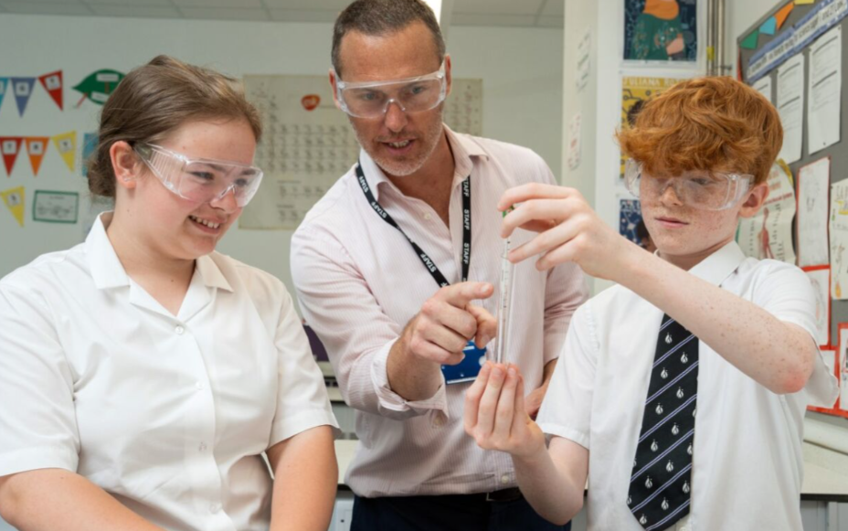
High Standards and Academic Stretch and Support for all
Uncompromising standards and ambition for all students, regardless of starting points
Regular tracking of progress and close communication with home
A traditional curriculum, with an emphasis on
Mathematics and English
Value placed on all subjects,
including the Arts and PE
Judicious use of ICT
Invested and talented staff team

Slide 6
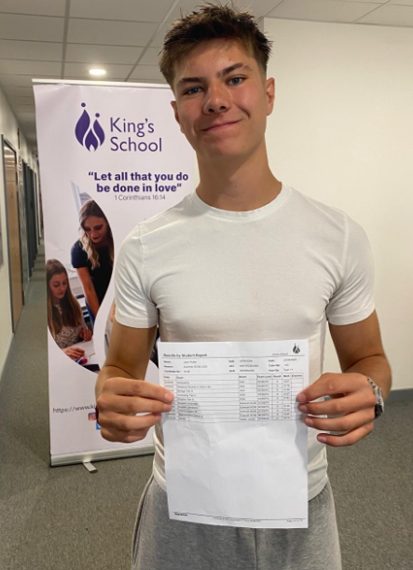
GCSE Results
A non-selective and fully comprehensive school
Outstanding results throughout the school’s history, including in 2024 and 2025
Outstanding overall attainment; top in the city for the past two years
81% of students achieving at least a grade 4 in both English and Mathematics 2025 (92% in 2024)
85% of students achieving at least a grade
4 in English (75% achieving a 5 or above) 2025
83% of students achieving at least a grade 4 in
Mathematics (66% achieving a 5 or above) 2025
35% of all grades at Grade 7+ 2025 (42% 2024)
Progress 8 +0.71 2024 (estimated +0.54 2025)
Students in receipt of SEND support outperformed
their peers not in receipt of support in terms of progress in 2025

Slide 7
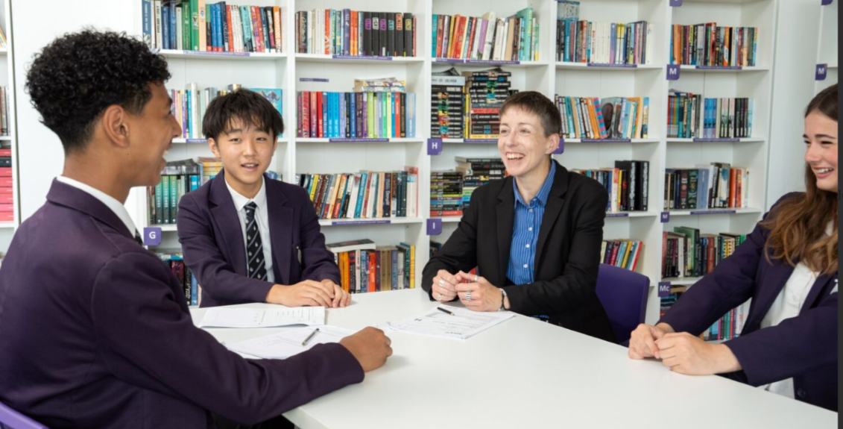
Outstanding Pastoral Care and Nurturing Culture
We actively nurture an orderly culture in which all students are known, valued and loved as individuals
We cultivate a clear sense of community and positive relationships
Outstanding pastoral care is
a priority for all staff
Value placed on extracurricular
and enrichment
Proactive response to current
national and international challenges
including smart phones and AI

Slide 8
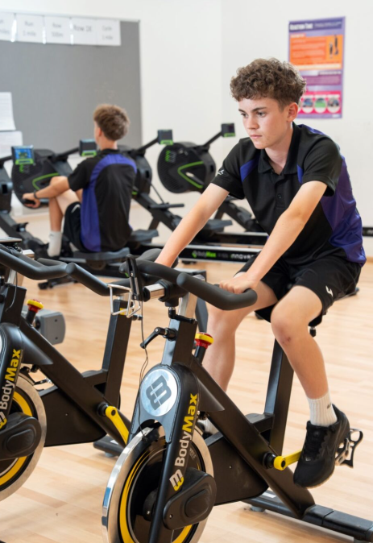
Our Permanent Home
Spacious, light and airy building with good temperature control
Quiet location – clearly defined boundaries ensure student safety
Excellent sports facilities
State of the art science
laboratories and DT rooms
Outstanding provision for the
arts
Direct bus routes from central
Hove and Portslade in the
mornings to the site and served
by the new 3X service

Slide 9
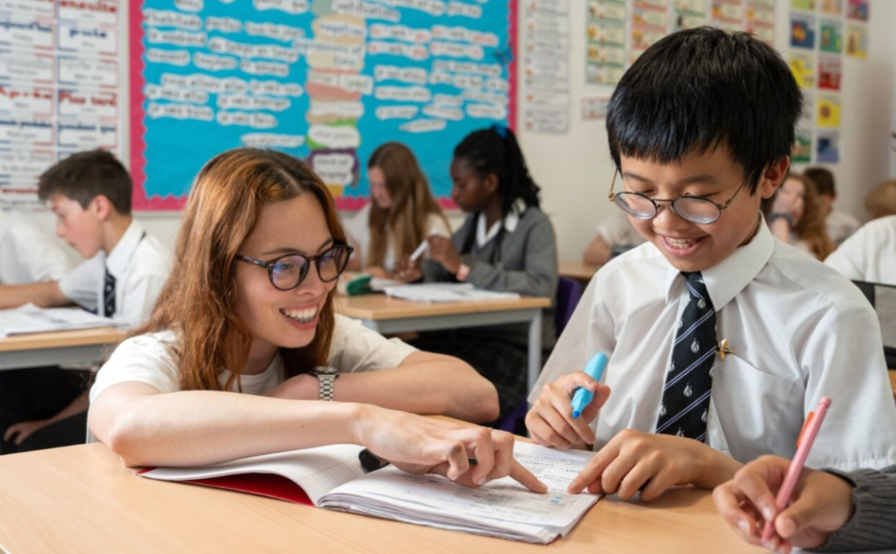
What is it like to be a Year 7 student here?
Very well supported transition
Consistent morning tutor time and very careful tutor group allocation
Separate playground for social times
Early break and lunch
Optional homework for first
half term and core homework
only until Christmas
Year 9 buddy system

Slide 10
Year 7 Students
Lara
Robin

Slide 11
What do we want for our students when they leave us?
A great set of results to open doors for them;
A love of learning, in the classroom and outside of it, and a desire to be a lifelong learner;
A clear sense of their own identity and self-worth;
The knowledge that they have had the opportunity to explore their spirituality at school and ask some ‘bigger questions’ of life that are not on the standard curriculum;
Happy memories and the knowledge that they were known and loved during their time with us.

Slide 12
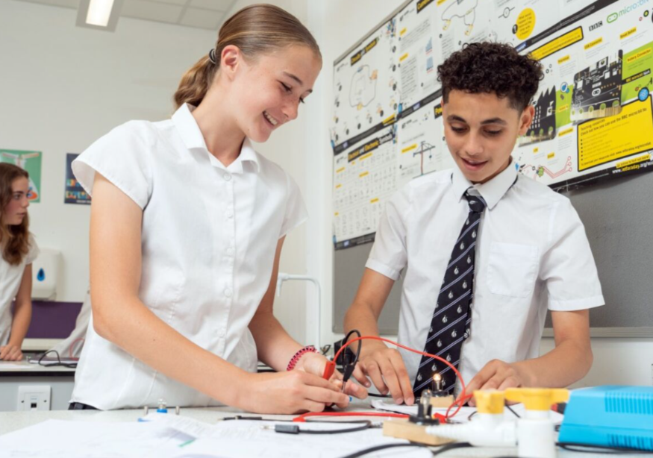
You are most welcome in our school this evening – we hope you will choose to join our special community next year!

