Slide 1
Cambridge Technicals – Sport and Physical Activity
Cambridge Technicals - Sport and Physical Activity
‘Extended Certificate’ = 1 A-Level and gives you equivalent UCAS points

Slide 2
Year 12 |  | How Assessed
Unit 1: Body Systems and the effects of physical activity | In this unit learners will gain an understanding of the structures and functions of the key body systems, how these support and impact performance in sport and physical activity and the effects that physical activity, training and lifestyle can have on them. This unit is 90 GLH (guided learning hours) | Exam at end of year 12
Unit 2: Sports Coaching and Leadership | This unit will give you an understanding behind the theory of what makes good sports coaches. You will explore the roles and responsibilities of coaches and leaders. The main part of the unit is related to you developing the skills to plan and deliver a series of sports or activity sessions reflecting on your own practice and using this feedback to improve your performance as a sports coach or activity leader. This unit is 90 GLH (guided learning hours) | Internally Assessed: Written assignment to meet the LO’s Lesson plans + delivery for 6 lessons Evaluations to those lessons Risk assessment.
Unit 18: Practical skills in sport and physical activities | This unit assessed you in an individual, team, referee and outdoor and adventurous activities. In this unit you will learn how to apply skills, tactics, techniques and knowledge in individual sports, team sports and outdoor and adventurous activities which will allow you to participate effectively, safely and enjoyably. This unit is 60 GLH (guided learning hours) | Internally Assessed: Performance filmed in: Individual (will do in school but can be done outside of school) Team (has to be outside of school) Official (can either be in or out of school) OAA (organised within school)

Slide 3
Year 13 |  | How Assessed
Unit 3: Sports organisation and development | In this unit you will gain an understanding of the organisations involved in sport in the UK, their roles and responsibilities and how they work together. You will also gain an understanding of sports development, including the organisations involved, who sports development is targeted at and why, how sports development is carried out and how the success of sports development initiatives can be measured. This unit is 60 GLH (guided learning hours) | Exam around March time year 13 (you finish the course around this time giving you chance to revise your two other subjects)
Unit 8: Organisation of sports events | This unit is designed for you to develop skills in planning, promoting and delivering a sports event; with a focus primarily on your individual role as well as working as part of a team and reflecting on your input and future personal development. This unit will enable you to establish transferrable skills which can be used within sport and active leisure as well as within the fitness industry. It will also enhance skills such as team work, organisation and safeguarding awareness. This unit is 60 GLH (guided learning hours) | Internally Assessed: Written assignment to meet the LO’s Plan and promote sports events Deliver the sports events Review and evaluate sports events

Slide 4
Each week – Year 12
6 lessons:
2 lessons = theory lessons: Unit 1: Body Systems and the effects of physical activity
2 lessons coursework = Unit 2: Sports Coaching and Leadership
1-2 lessons practical/coursework = Unit 18: Practical skills in sport and physical activities

Slide 5
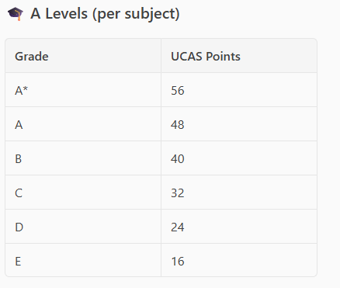
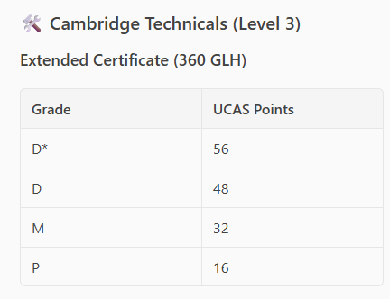
Grades and UCAS points
If you get a D* - it is the equivalent of getting an A*
If you get a M – it is the equivalent of getting a C

Slide 6
Bridging Work
The topics that we will be studying are (Unit 1) Body Systems and the effects of Physical Activity, (Unit 2) Sports Coaching and Activity Leadership, (Unit 3) Sports Organisation and Development, (Unit 8) Organising Sports Events and (Unit 18) Practical skills in sports. To help prepare for 6th form we would recommend completing some of the below activities. Make sure you research a range of topics.
Subject Content for this course can be found here… https://www.ocr.org.uk/qualifications/cambridge- technicals/sport-and-physical-activity/#level-3
Task 1 – Develop knowledge of the structure of the skeletal system (Unit 1)
Major bones to include cranium, clavicle, ribs, sternum, scapula, humerus, radius, ulna, carpals, metacarpals, phalanges, pelvis, vertebral column (cervical, thoracic, lumbar, sacrum, coccyx), femur, patella, tibia, fibula, tarsals, metatarsals.
Type of bone – long, short, flat, sesamoid, irregular.
Task 2 – Can you label the human muscular system? (Unit 1)
Deltoids, biceps, triceps, wrist flexors, wrist extensors, supinator's and pronators, pectorals, abdominals, obliques, quadriceps, hip flexors, tibialis anterior, erector spinae, trapezius, latissimus dorsi, gluteals, hamstrings, gastrocnemius, soleus.

Slide 7
Task 3 – Watch some clips below regarding anatomy and physiology of the human body - and make notes (Unit 1)
Skeletal system - https://www.youtube.com/watch?v=ltFutvTye8c Muscular system - https://www.youtube.com/watch?v=YPVnlPeZKT0
Task 4 – Watch the sports documentary called ICARUS (Unit 1)
This provides excellent background knowledge on the pressures sports performers face and why they make the choices they do.
Task 5 - Research the traits of a sports leader and design a lesson plan for a sport of your choice (Unit 2) Understand what traits you need to become an effective leader. Design a basic warm up, 3 progressive tasks and a cool down for a sport of your choice. Think about delivery to a mixed ability group and what you need change and adapt due to this.

Slide 8
Task 6 – Research Roles and responsibilities of sports organisations in the UK (Unit 3) Research the following areas:
Sports development, Setting of rules and regulations, Organising competitions and tournaments, increasing participation, education, training coaches, providing funding (e.g. for facilities). Som examples of Sport organisations you could research are Sport England, Uk sport and national Governing bodies for sports such as the RFU.
Task 7 – Plan a sports event (Unit 8)
Scenario: Create a tournament format and consider the risks involved in a large event such as this. Design a risk assessment for a chosen sport tournament. (Unit 8)
Task 8 – Practical Sport (unit 18)
You will be assessed in 2 sports. Do you currently participate in 2 sports? It will drastically help your grade if you do. Worth looking at joinging any sports clubs?

Slide 9
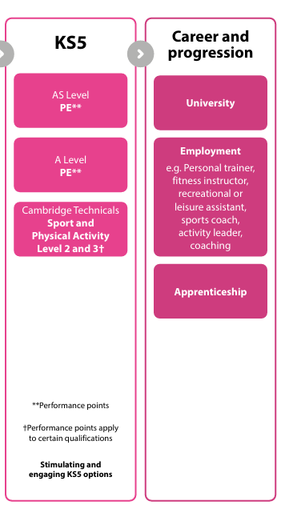
What does this lead to?
University:
Sport and exercise science
PE teaching
Physio / sports therapy
Sports journalism
Sports management and coaching
Employment:
Personal Trainer
Fitness Instructor
Sport and leisure assistant
Sports coach
Activity leader
Coach

