Slide 1

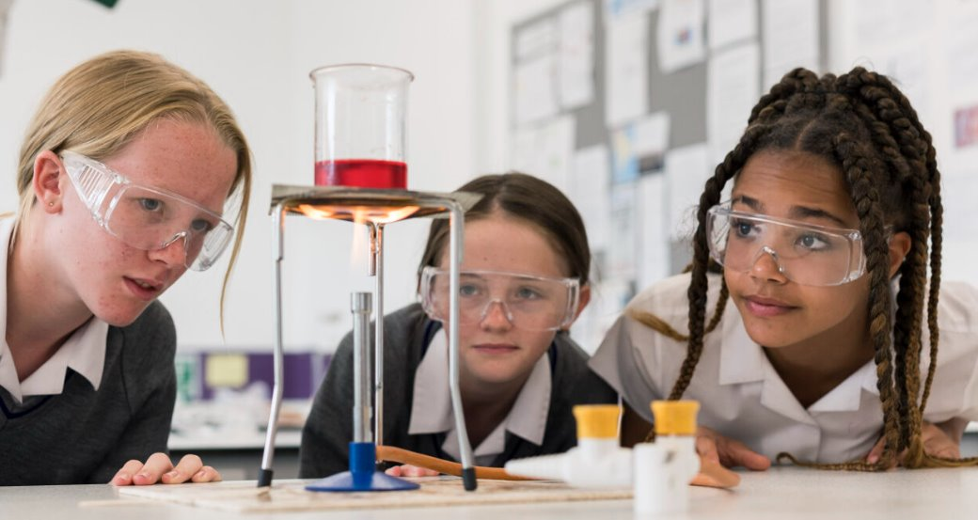
Year 6 Taster Sessions
“Let all that you do be done in love.”
1 Corinthians 16:14

Slide 2

King’s is a Church of England school within the Diocese of Chichester.
We opened in September 2013 and moved to our permanent site in September 2019.
We opened our Sixth Form in September 2023.
We were judged to be a ‘good’ school with outstanding behaviour and attitudes and outstanding personal development by Ofsted in March 2022.
Diversity and full inclusion are very important to us.

Slide 3
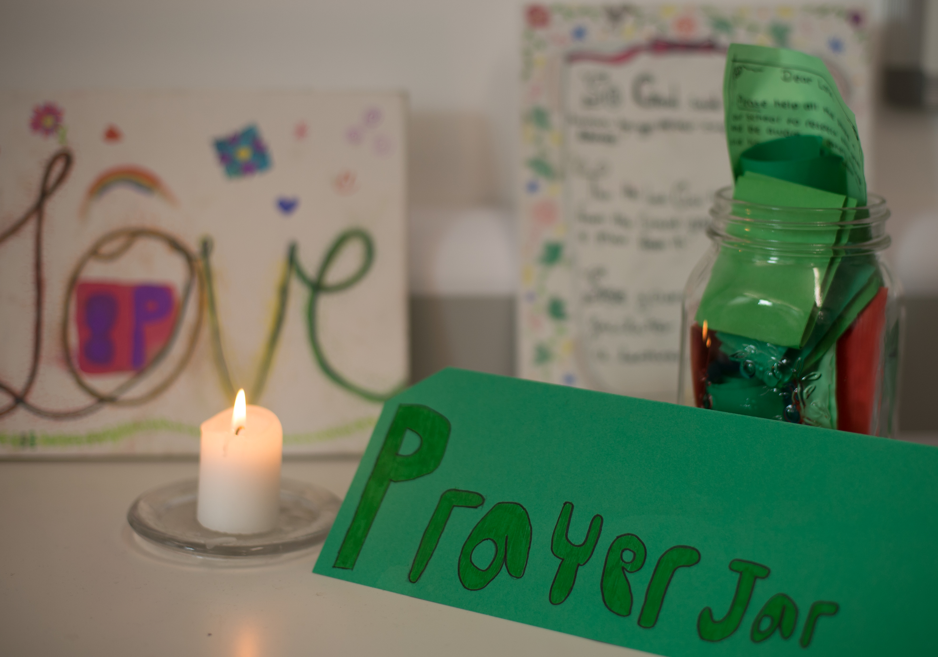
The King’s Experience:
A Russell Education Trust school
Dedicated and highly invested staff team
Distinctive Christian ethos and values
Outstanding teaching &
learning & student outcomes
Outstanding pastoral care
Notes:
Outstanding Teaching
Small School
Christian Ethos

Slide 4
Our Vision for Our School
To share God's love and wisdom, and enable our school community to flourish emotionally, academically, and spiritually.

Slide 5
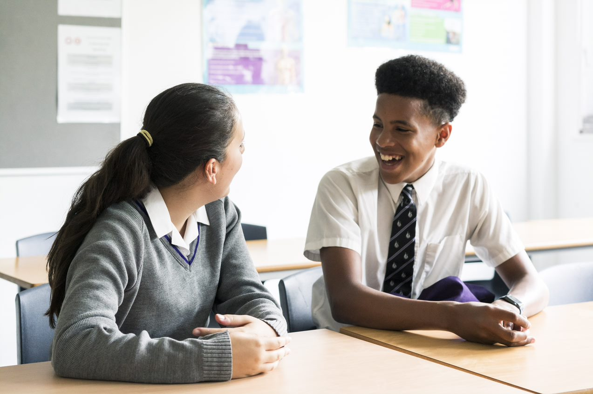
Our Core Christian Values
Love and Forgiveness
Respect and Responsibility
"The Christian ethos ensures that pupils are kind to one another and look after each other well. The school values of love, forgiveness, respect and responsibility permeate the school environment."
Ofsted 2022
Notes:
In the Bible there are different words to describe different kinds of love. Our core value of Love is what the Bible refers to as Agape. Agape is the love of God for His people and the corresponding love that Christians have for other people. Whereas our common notion of love is emotional, the focus of Agape love is an act of the will. It is not just about feeling, it is action. Love, in this Christian sense, should be self-sacrificial, generous, unconditional and boundless. This love is seen most clearly in the life, death and resurrection of Jesus Christ. At King’s we seek to love one another in this way, as Christ loves us.

Slide 6
What is our aim for your child?
For them to be known and loved at school within our community.
To support them to achieve their full potential in terms of their academic outcomes.
To support them as they begin to think about life beyond school and careers.
To give them enriching experiences inside and outside the classroom.
To help them to develop their moral character and to discover their unique skills and interests.
To give them an opportunity to explore life’s bigger questions and their own spiritual beliefs.

Slide 7
Staffing Structure
Headteacher
Mrs Price
Deputy Headteachers
Mr Stevenson (Curriculum) Mr Chamberlain (Pastoral)
Senior Assistant Headteacher/SENDCo Head of Finance & Operations
Mrs Vincent Mrs Mooney
Assistant Headteachers
Mr Walker Ms Staples
Heads of Department: Maths (+ 2ic), English (+2ic), Science (+2ic), Arts, DT, MFL, Geography, History, PE, RP
Heads of Year: 7, 8, 9, 10, 11
Teachers of other subjects and support staff including Pastoral Officers, Inclusion Officer, Behaviour and Attendance Officer

Slide 8
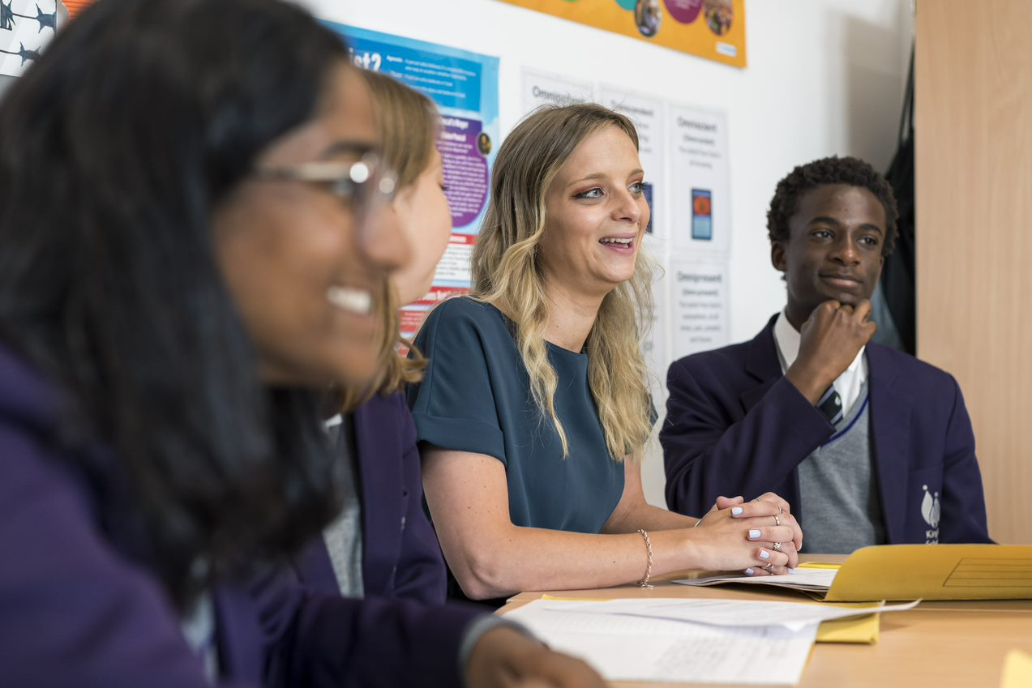
Every student will make excellent academic progress and become a lifelong learner

Slide 9
Support and Challenge
Individually focused, regardless of ability
Challenging, fluid targets
Adaptive teaching for all abilities
A blend of setting and mixed ability classes depending on subject
Outstanding teachers = outstanding student progress
Differentiation: in class support and challenge
Focus on core subjects: English, maths, science and RP
Valuing the wider curriculum, including the arts and sport
Close monitoring of progress
Targeted learning support and intervention
RET support and challenge

Slide 10
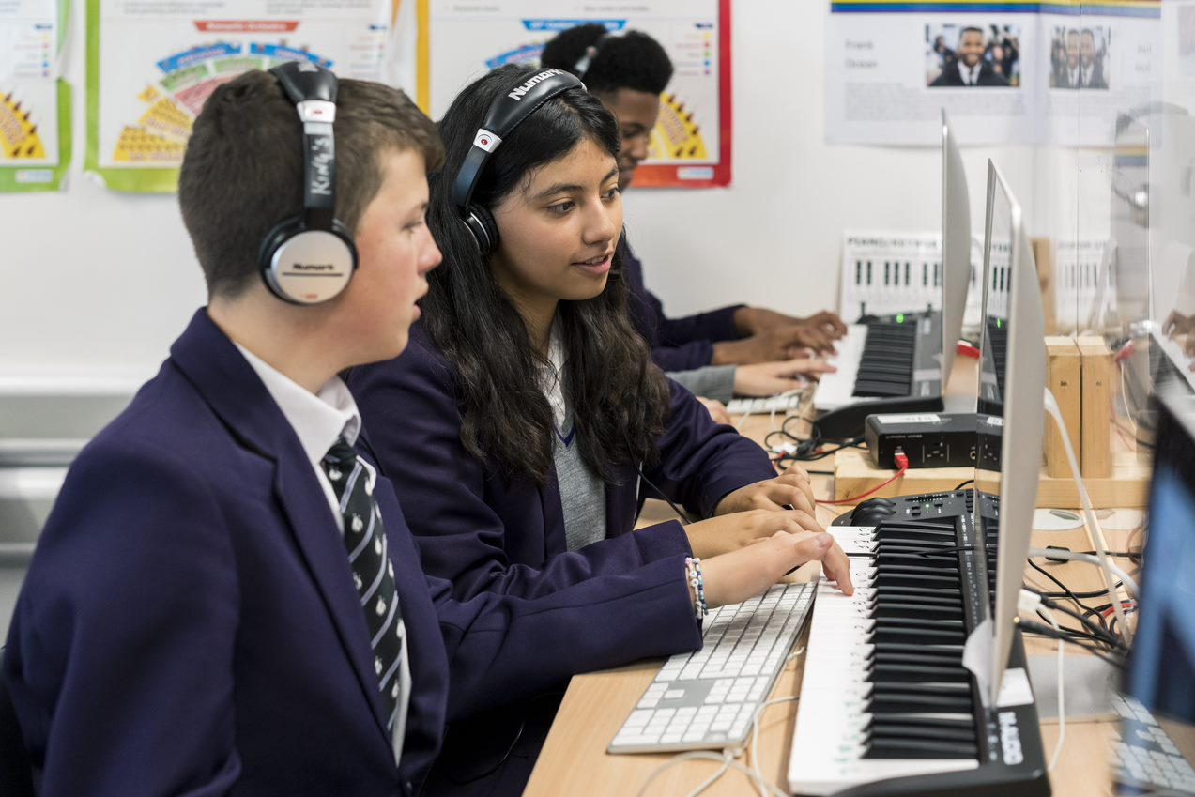
Latest technology, used intelligently supports learning, challenges and accelerates progress

Slide 11
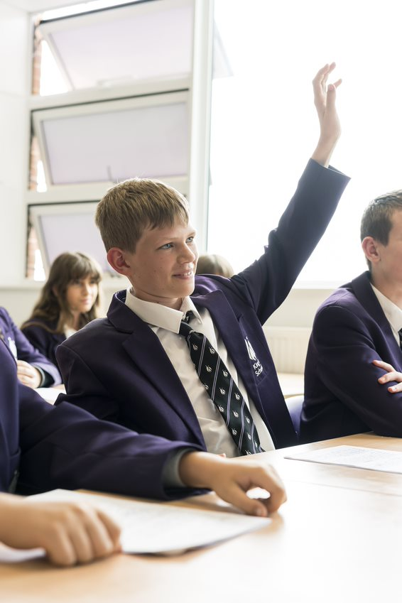
King’s Curriculum
The intention of our curriculum is to teach our students to become wise.
"Love wisdom" Proverbs 4:8
Our students achieve excellent results
Progress 8 provisional +0.54
Attainment 8 provisional 53.6
% at least 5 GCSEs at 9-4 including EM– 80%
% at least 5 GCSEs at 9-5 including EM – 56%
% of all grades at 7 and above – 35%
"Pupils are confident, articulate and aspiring."
Ofsted 2022

Slide 12
King’s Curriculum offer in Year 7
Subject | Lessons
English | 4
Maths | 4
Science | 4
Religious Education | 1
French & Spanish | 3
History | 2
Geography | 2
Technology | 2
Art | 1
Music | 1
PE | 2
Drama | 2
Computing | 1
PSHE | 1
The arts allocation changes yearly through KS3 to ensure even coverage of the three arts subjects – Drama, Music and Art

Slide 13
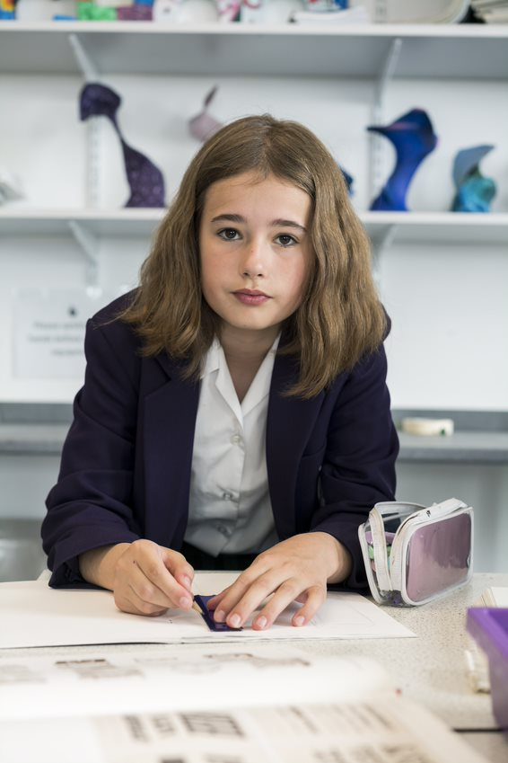
Normal School Day for Year 7 Students
Site Opens | 07.45
Tutor | 08.30 – 09.00
Lesson 1 | 09.00 – 09.50
Lesson 2 | 09.50 – 10.40
Break | 10.40 – 11.00
Lesson 3 | 11.00 – 11.50
Lesson 4 | 11.50-12.30
Lunch | 12.30 – 13.20
Lesson 5 | 13.20 – 14.10
Lesson 6 | 14.10 – 14.55
Extra-Curricular Programme | 15:15-16:15

Slide 14
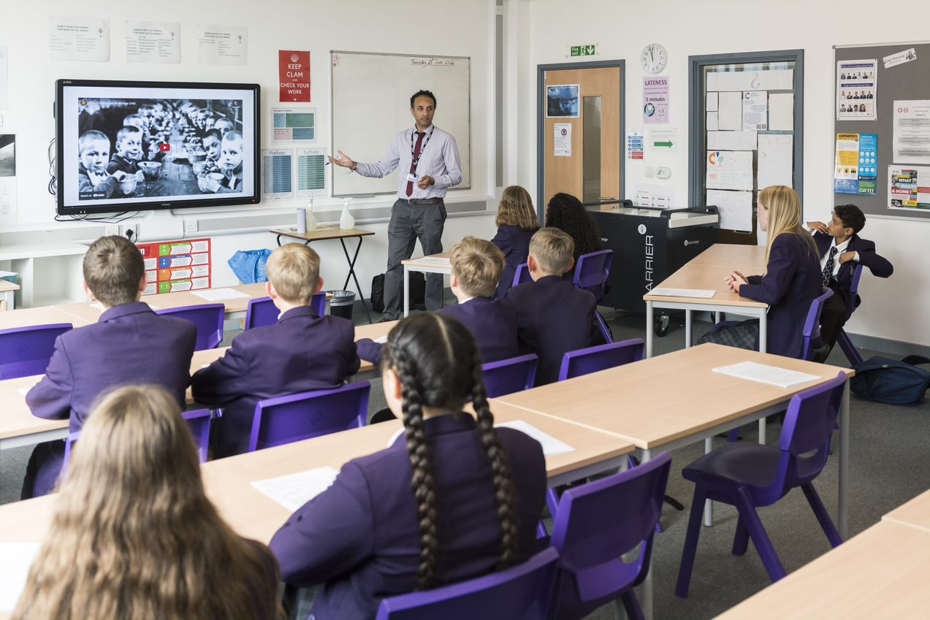
What does collective worship look like at King’s?
Theme of the week
Centrally resourced tutor sessions; values stations in form rooms
Assemblies
Regular Communion/worship services
Working with outside agencies and church groups

Slide 15
Extra-Curricular and Enrichment
Our extra-curricular programme runs Monday-Friday from the second week of each term, through to, and including, the penultimate week
Many clubs are free of charge to parents
Some clubs are offered at cost price to parents
Students are encouraged to sign up for at least one club per week but many do more
Four Enrichment Days per school year and good range of trips and visits as well as in school events
"Pupils enjoy an extensive programme of coherently planned extra-curricular activities."
Ofsted 2022
Notes:
BEN

Slide 16
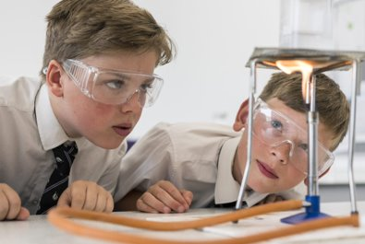
House System
Each student will be allocated to a house as well as a form group. Our houses are based on New Testament place names. They are:
Ephesus - red
Colossae - blue
Philippi - green
Galatia – yellow
Berea – orange
Rome - pink

Slide 17
Pastoral Care
Pastoral care focuses on looking after the social and emotional wellbeing of students.
How students feel (in the short and long term) has a direct impact on their learning.
At King’s, we look to address not only students’ academic needs, but also their emotional needs through support such as group work, themed workshops and events, PSHE lessons and one-to-one provision.
At King’s we believe that each child is unique, and we offer flexible, individualised pastoral support to reflect this.
We also recognise that there are many common challenges faced during puberty, and will offer support (e.g. themed assemblies or lessons) to address this.
“Staff value each pupil and know them well. The provision for personal development is first class. ” Ofsted 2022
Notes:
JEN

Slide 18
Behaviour – Character Education
We aim to prepare students for life beyond school and to help them develop as individuals. We have high expectations of attendance, uniform and conduct.
Our ‘character education’ approach is consistent with our school values.
In lessons we expect behaviour that supports learning and engenders a nurturing environment where people feel safe, secure and supported.
Around the school we expect courteous, respectful, safe behaviour.
We operate a ‘consequences ladder’ for students who fail to meet behaviour expectations and an ‘achievements ladder’ to ensure students’ achievements are recognised.
We will keep parents fully informed of any concerns regarding behaviour.
"Pupils are happy and safe. Behaviour is exemplary."
Ofsted 2022
Notes:
SARAH

Slide 19
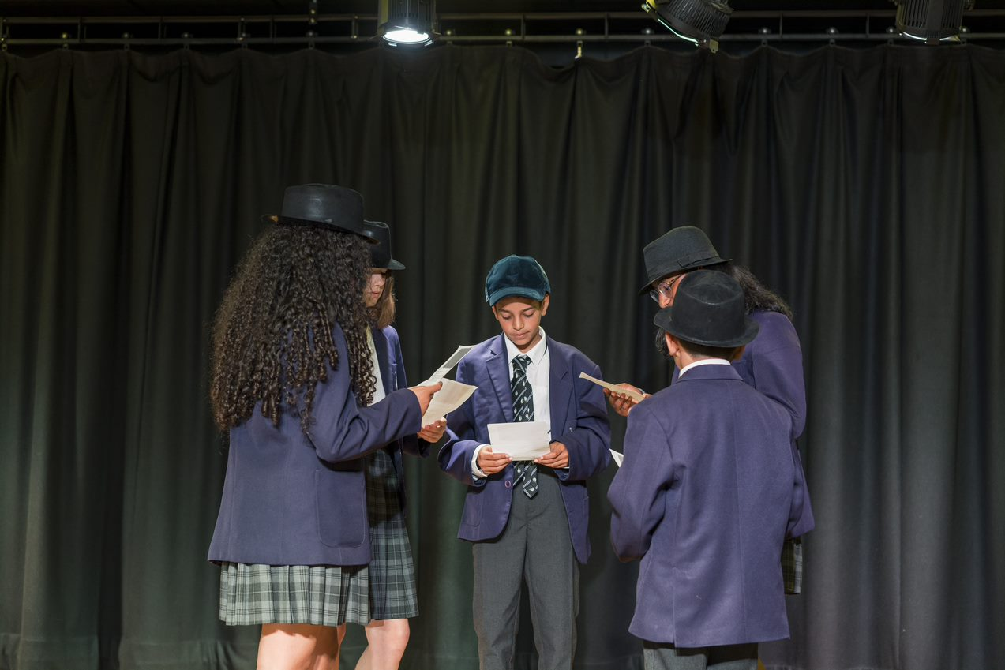
Our Site and Safe Transport
A new site with excellent facilities including Sports Hall, Activity Studio, Drama Studio, beautiful top floor Art rooms, suite of Music rooms, eight fully equipped science laboratories and full suite of DT rooms, including a Food and Nutrition classroom.
Regular public bus services.
Students are strongly encouraged to cycle or walk to school where possible.

Slide 20
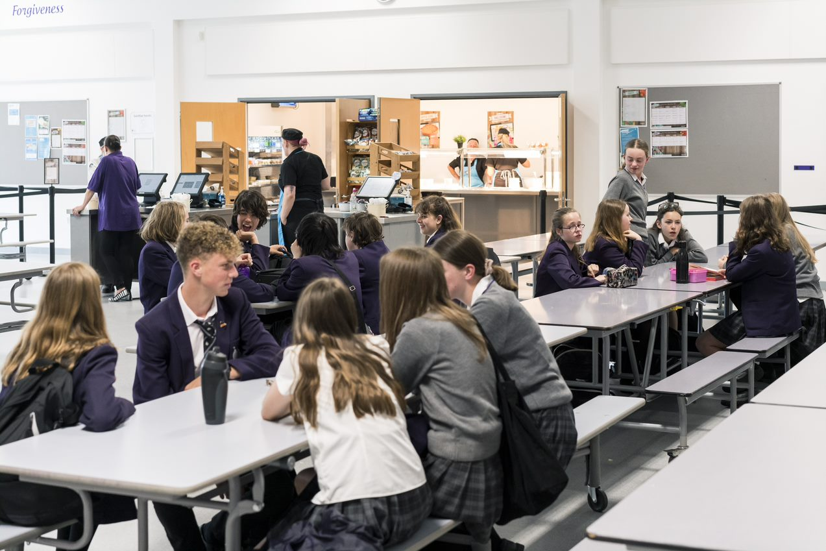
Catering Arrangements
We operate a cashless catering system: this can be topped up online and enables you to monitor what your child is purchasing.
Full catering service provided.
Packed lunches may be brought in.
We are a strictly ‘no nut’ school.
Notes:
SARAH

Slide 21
Admission Process for 2026
180 spaces for September 2026
All applications considered regardless of preference
EHCP applications go through usual consultation process
Admissions criteria 1-4 applied (LACs, Siblings, Special considerations, Staff)
A) Faith allocation with valid SIF
B) Non-Faith allocation; includes unallocated Faith
Faith
50% spaces
Non-Faith + unallocated Faith
50% spaces
Allocation process flows
left to right
Distance from Hove node
70%
Distance from school gate
30%
Distance from Hove node
70%
Distance from school gate
30%
Allocation process flows
left to right

Slide 22
Will this school suit my child?
We might well be the right school for your child if:
You welcome our Christian ethos and values;
Your child would benefit from a nurturing approach in a school where they are known;
You want to send your child to a school with high expectations of behaviour, attendance, and uniform;
You want to work with school staff to ensure the best possible educational outcomes for your child;
You want to ensure that your child has access to outstanding pastoral care.

Slide 23
How can I find out more?
Wealth of information on our website
  www.kingsschoolhove.org.uk
Open Evening on Thursday 25th September
Open Mornings 29th September to 3rd October; sessions at 9am and 11am; booking via our website

Slide 24
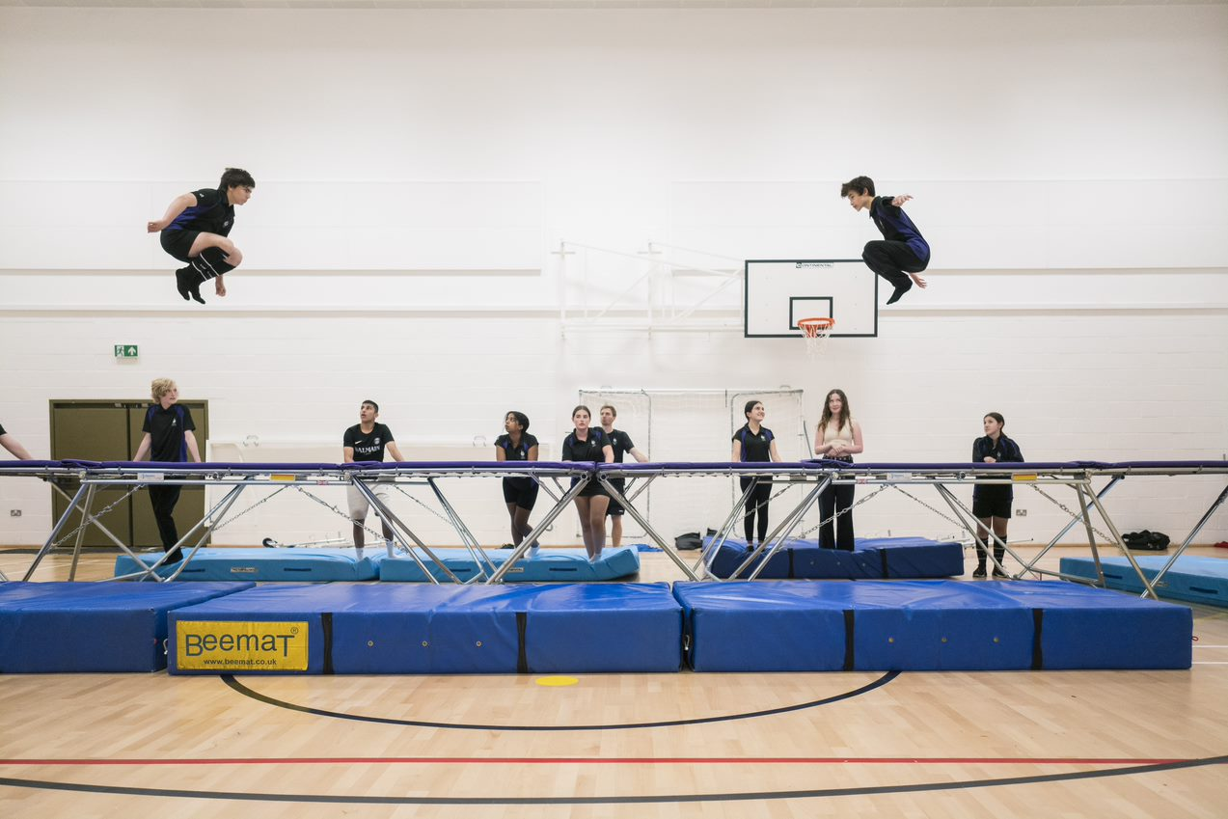
Any Questions?
Notes:
SARAH

