Slide 1
How do I help my son/daughter revise for the English Exams?
I don’t know where to start
Do I just re-read the core texts?
I have so many notes, but don’t know what to do with them

Slide 2
Equipment needed
Past exercise books
Highlighters
Core texts- A Christmas Carol, Poetry Anthology (for first mock) in addition to Macbeth and An Inspector Calls for the second mock
Key Skills Checklist (I’ll provide this)
Post it notes
Plain Paper
Index Cards
Access to online resources

Slide 3



English Language
Paper 1 | Paper 2
Fiction and Imaginative Writing Overview of assessment ● Section A – Reading: 4 questions on an unseen 19th-century fiction extract. ● Section B – Writing: a choice of two writing tasks. The tasks are linked by a theme to the reading extract. ● The total number of marks available is 64. ● Assessment duration 1 hour and 45 minutes | Non-fiction and Transactional Writing Overview of assessment ● Section A – Reading: 7 questions on two thematically linked, unseen non-fiction extracts. ● Section B – Writing: a choice of two writing tasks. The tasks are linked by a theme to the reading extracts. ● The total number of marks available is 96. ● Assessment duration: 2 hours and 5 minutes

Slide 4



English Literature
Paper 1 | Paper 2
Shakespeare and Post-1914 Literature Overview of assessment ● Section A – Shakespeare: a two-part question, with the first task focused on an extract of approximately 30 lines. The second task is focused on how a theme reflected in the extract is explored elsewhere in the play. ● Section B – Post-1914 British play or novel: ONE essay question. ● The total number of marks available is 80. ● Assessment duration: 1 hour and 45 minutes. ● Closed book (texts are not allowed in the examination). | 19th-century Novel and Poetry since 1789 Overview of assessment ● Section A – 19th-century novel: a two part question, with the first part focussed on an extract of approximately 400 words. The second part is an essay question exploring the whole text. ● Section B – Part 1: ONE question comparing a named poem from the Pearson Poetry Anthology collection to another poem from that collection. The named poem will be shown in the question paper. Part 2: ONE question comparing two unseen contemporary poems. ● The total number of marks available is 80. ● Assessment duration: 2 hours and 15 minutes. ● Closed book (texts are not allowed in the examination).

Slide 5
Smart revision
Organisation is key to establishing a productive and non-stressful revision program. I have given you a checklist of the key knowledge and skills needed by students to succeed in each exam
You can take a copy of this for students to tick off as they go. If they are struggling with a particular skill, they must be proactive and tell their teacher

Slide 6
Paper 1 Language Select specific language and structural devices used in a few lines of a 19th century text, using correct terminology Evaluate how successfully a writer has used Setting, Ideas, Themes and Events in the same text Plan and write an imaginative descriptive piece with a clear structure and engaging opening and closing line | Paper 1 Literature Analyse a key passage from Macbeth, selecting language and structural devices and commenting on how they contribute to dramatic effect. Write about the way in which a theme or character is presented in the whole of Macbeth, linking in context and using quotation. Respond to a whole-text question on An Inspector Calls, using quotation and weaving in context.
Paper 2 Language Select specific language and structural devices used in a non-fiction text, using correct terminology Evaluate how successfully a writer has used Setting, Ideas, Themes and Events in a non-fiction text to present an idea. Find similarities between ideas and attitudes presented in 2 non-fiction texts, using quotations Compare HOW these ideas have been presented, commenting on the methods used. Plan and write a piece of Transactional Writing, e.g. a letter, article, review or report | Paper 2 Literature Analyse a key passage from A Christmas Carol, selecting language and structural devices and commenting on how they impact on the reader. Write about the way in which a theme or character is presented in the whole of A Christmas Carol, using quotation. Compare how a theme is presented in 2 of the Conflict poems from the Anthology. One will be printed, the other will be written about from memory. Comment on language, structure and context Compare 2 unseen poems, commenting on language, structure and any relevant context

Slide 7
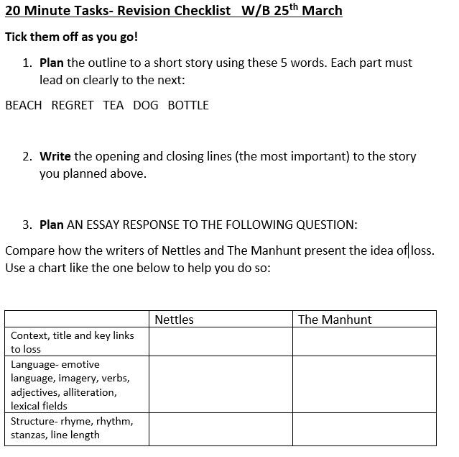
Useful activities- 20 minute tasks- example
I have provided you with a list of these

Slide 8
20 minute tasks for Mock 1 (November)
Summarise each of the 5 staves of A Christmas Carol into 5 bullet points
Select 2 characters from A Christmas Carol- first list as many links between them as you can, then list as many differences as you can
Which of the anthology poems are about war? After you’ve listed them, summarise the main point about war that you think each poet is trying to make.
Plan a 5-part narrative about an escape. It should have a clear setting and 5 key plot points. Then write the opening and closing line.
Around a sketch of Ebeneezer Scrooge, write quotations which describe him at the start of the novella in one colour, and then those at the end in another colour.
Plan a response, with the quotations you’d use to this question: Compare how the writers of ‘Cousin Kate’ and ‘Catrin’ show change
7. Summarise the main idea presented in each of the Conflict poems in no more than two sentences
8. Briefly research the political views of Charles Dickens and summarise how they are relevant to A Christmas Carol
9. Draw a sketch of each of the ghosts of past, present and future and around the sketches write down quotations.
10. List the key features of these text types: Guide, Letter, Article, Speech
11. List as many language techniques (eg powerful verb) as you can. Do the same with structural techniques.
12. Commit to memorising one of the shorter poems from the anthology. Try to recite it to a family member without looking.

Slide 9
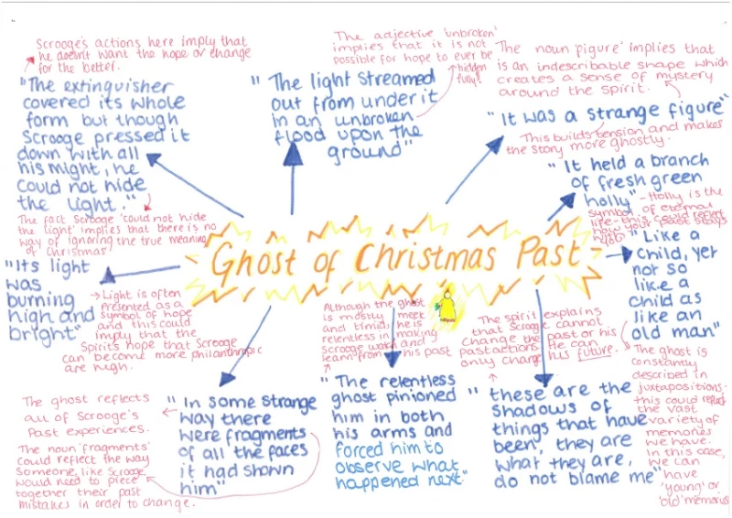
Methods
Key quotations on index cards
Detailed mind- maps- see example
Detailed essay plans- outlining an
Introduction, 3 main points, with
quotations and a conclusion (plus context if relevant)
Practice exam papers- details of where to find these are on the next slide.
Highlighting or transferring key notes from exercise book
Selecting extracts of your own from Macbeth and A Christmas Carol and writing your own questions, using the wording set out in the sample exam papers

Slide 10
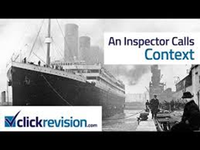


To Succeed in English…
Students need the confidence to express their own ideas and interpretations about texts, supporting these ideas with carefully selected evidence and linking in context.
It is vital, therefore, that they know their texts really thoroughly.
Here’s what you can do at home: Focus on the knowledge
Memorise the plotlines of the core texts! This is an absolute starting point. Try summarising each chapter/act in no more than 10 words.
Use post-it notes, mind maps, flip notes to learn key quotations and put them up in bedrooms/around the house.
Buy the study guides- there are a huge range out there.
Research to develop confidence in the key contexts of the texts- Jacobean England, Victorian England- realise that texts are a product of their time
Watch the film interpretations to help with engagement.
Go on the Teams folder to access Department study guides and revision activities
There are a plethora of online resources/studyguides- Sparknotes, BBC Bitesize, Youtube lessons

Slide 11
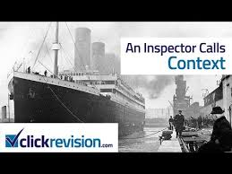
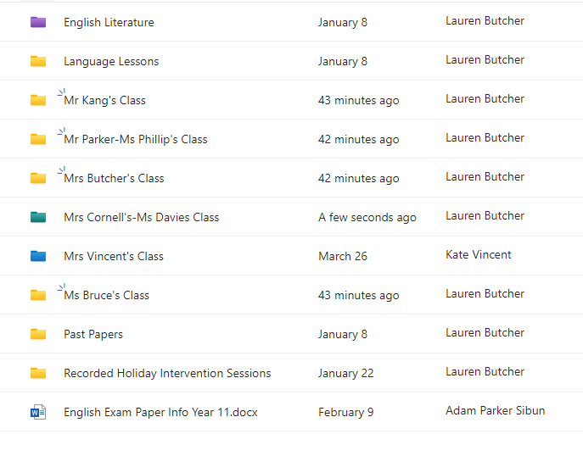

Other sources of information
Teams folder- sample papers to work through in addition to the revision booklets made by the English Department for each area of the exam
Using mock papers- book time with me during tutor time
GCSE pod- can download so listen offline
Revision videos- plenty on Youtube, for example Mr Bruff and Click Revision
Post-it key quotations around the house
Watch live performances of the core texts. Read critic’s reviews of them.

