Slide 1

Mathematics at King’s School

Slide 2
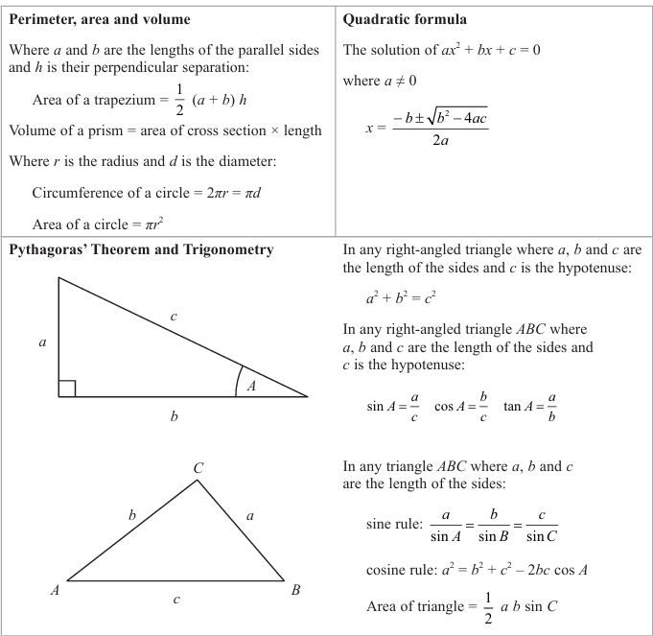
GCSEs – What you need to know
Teaching from 2015, Tested from 2017:
Students at Kings will study the Edexcel maths course (1MA1)
Mathematics will remain split between higher (grades 5-9) and foundation (grades 1 – 5)
Each student will now sit three 90-minute exams.
(1 Non Calc, 2 Calc)
Students will be given a formulae sheet for the GCSE. This is part of the post-Covid support from the exam board.
Harder topics will be introduced into the higher and foundation exams.
Notes:
Grades 4 will be roughly equivalent to current grade C
Grade 5 will roughly equates to half a grade above a C
Grade 7 equates to a current grade A
Grade 9 is the new A** to help differentiate A* students
More high mark questions that will assess communication & reasoning skills
More content and links with applications like using the SUVAT equations in science.

Slide 3
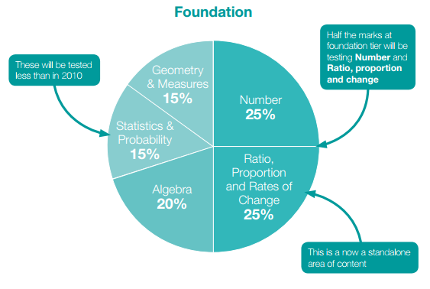
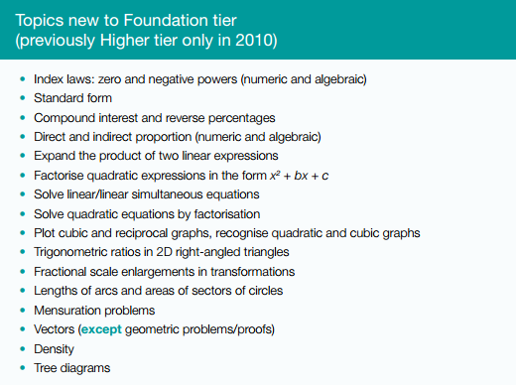
Foundation Content
Notes:
Used to be 4 main strands, there are now 5 main strands. New strand re-enforces idea of reasoning, communication and problem solving.
New topics that were previously only in higher at grade B and A are now to be included in foundation exam

Slide 4
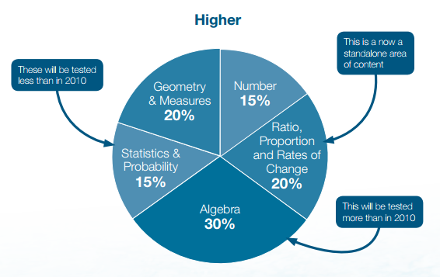
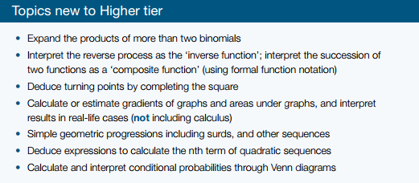
Higher Content
Notes:
More links towards A-Level maths including rates of change.
Calculus will not be included but working out turning points and other AS-topics will be tested.
All the above is new to GCSE for first time.

Slide 5
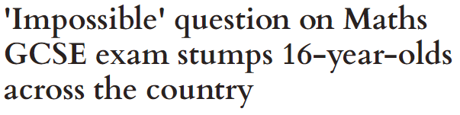

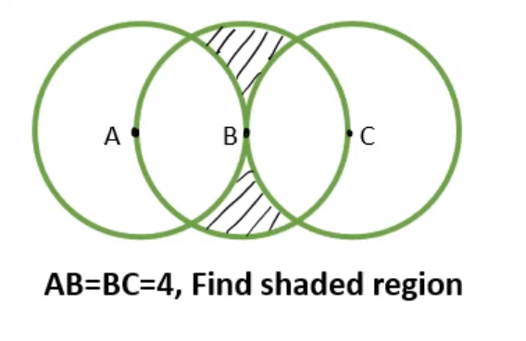
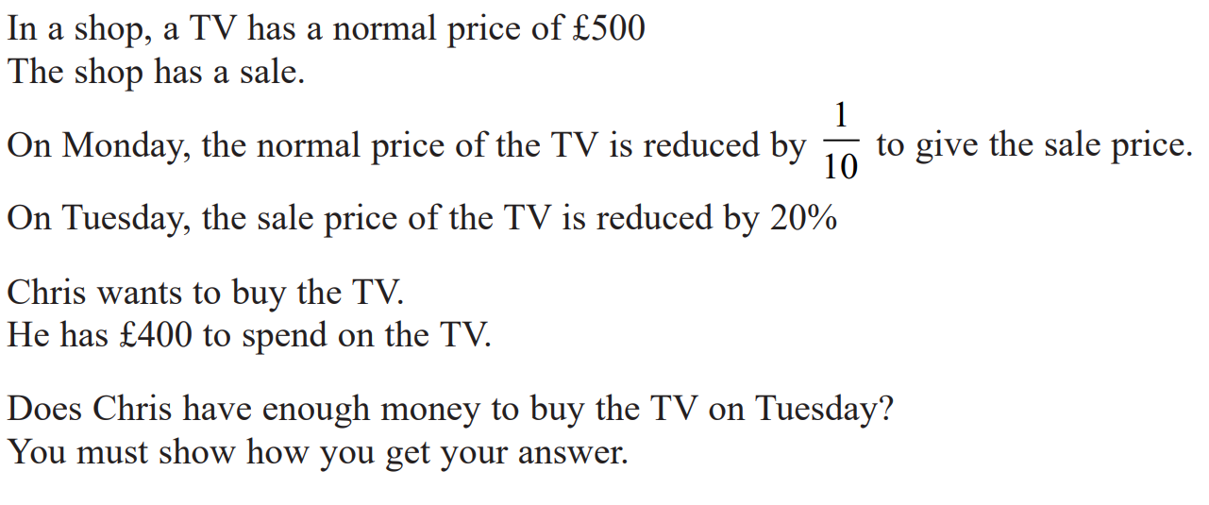
Preparing for the challenge questions
New specification has more focus on the A03 topics. These are what we might call wordy questions or questions that involve multiple topics.
Students are exposed to these types of questions regularly in class and as part of their homework and learn how to gain marks for the trickiest of questions.

Slide 6
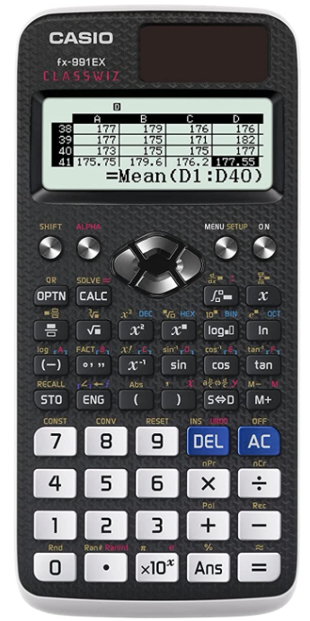
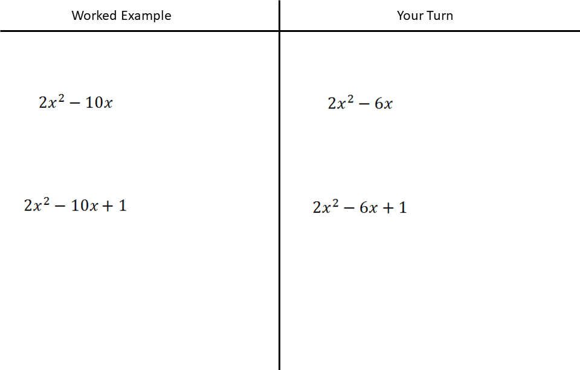
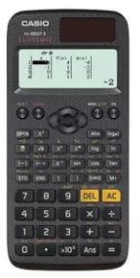
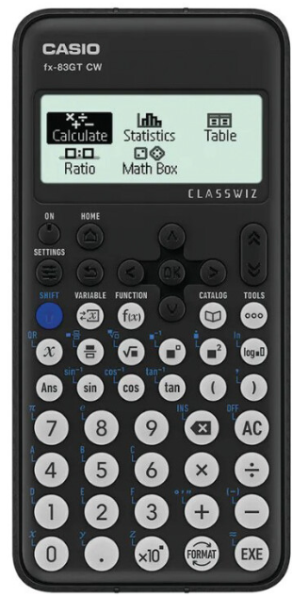
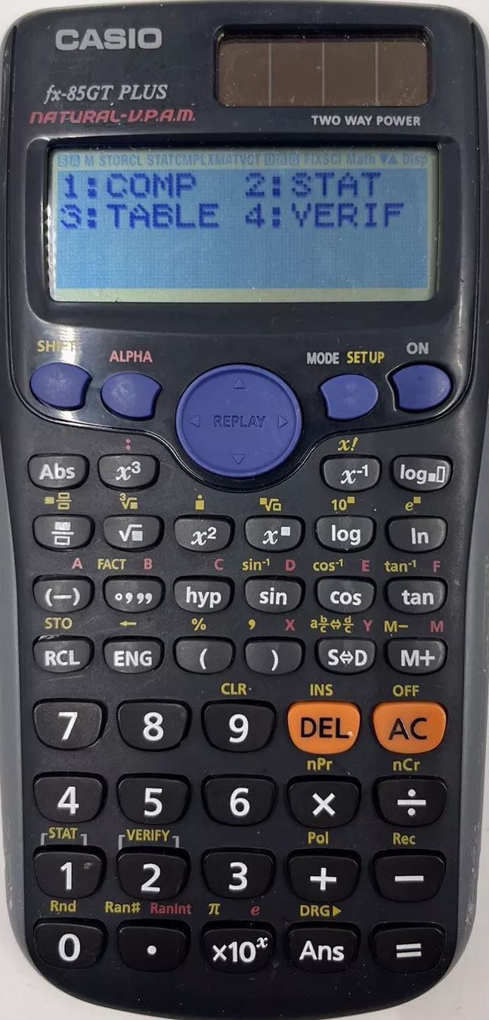
Schemes of work & learning mathematics
Casio FX-83GTCW
≈£12
Updated version of the previous Casio that most supermarkets sell. Good for foundation and higher
CASIO FX-991EX
≈£25
Good for students considering maths at A-Level
Scheme of work for year 11 builds upon KS3 and year 10 content.
Students are generally taught mathematics through the practice of a worked example followed by a ‘your turn’ task.
Students are encouraged to copy down examples and key notes.
Students need to ensure they attend lessons with the correct equipment for the learning.

Slide 7
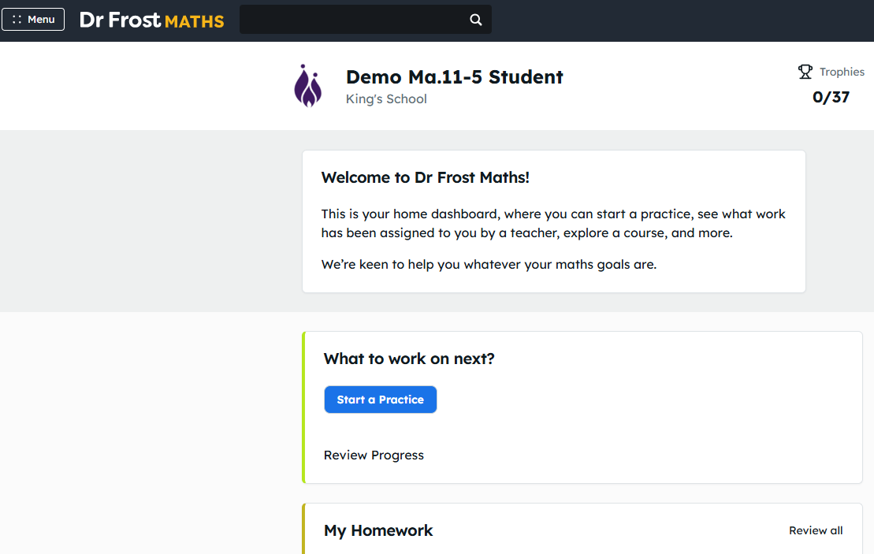
DrFrostMaths Homework
Homework will be set every Monday on DrFrostMaths.
Due date will be the following Monday.
Past papers will be set on platform as year progresses.
Communication will be sent home for non-completion with expectation students attend support session.
Success in mathematics comes from consistent practice.
AI and homework concerns.

Slide 8
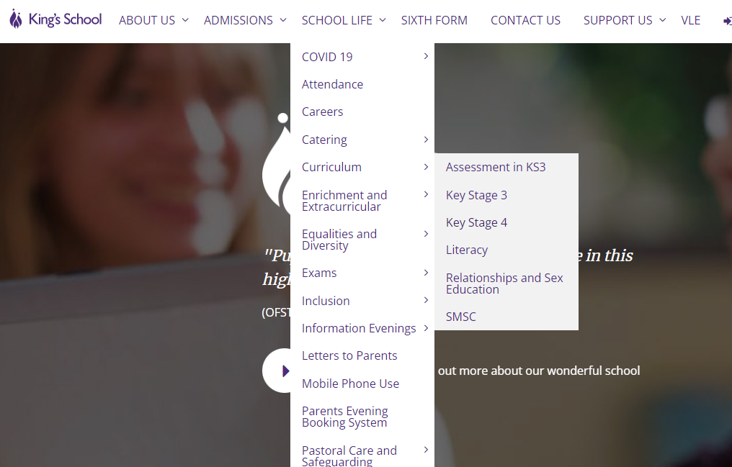
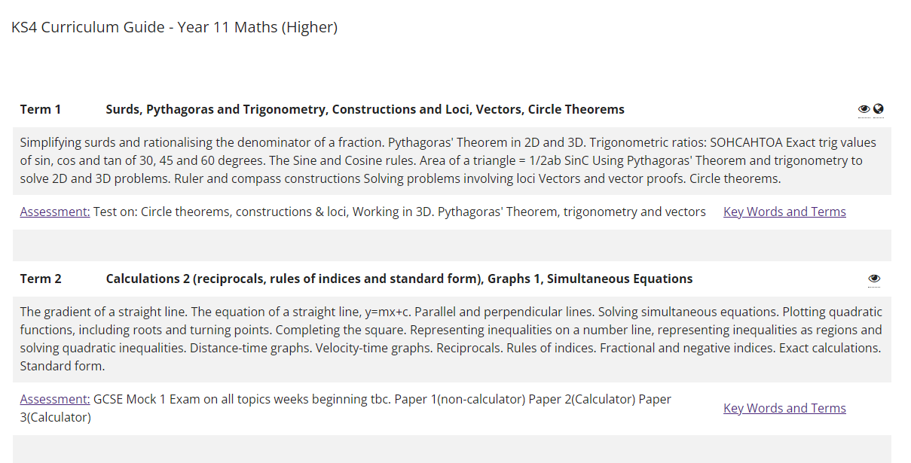

Slide 9
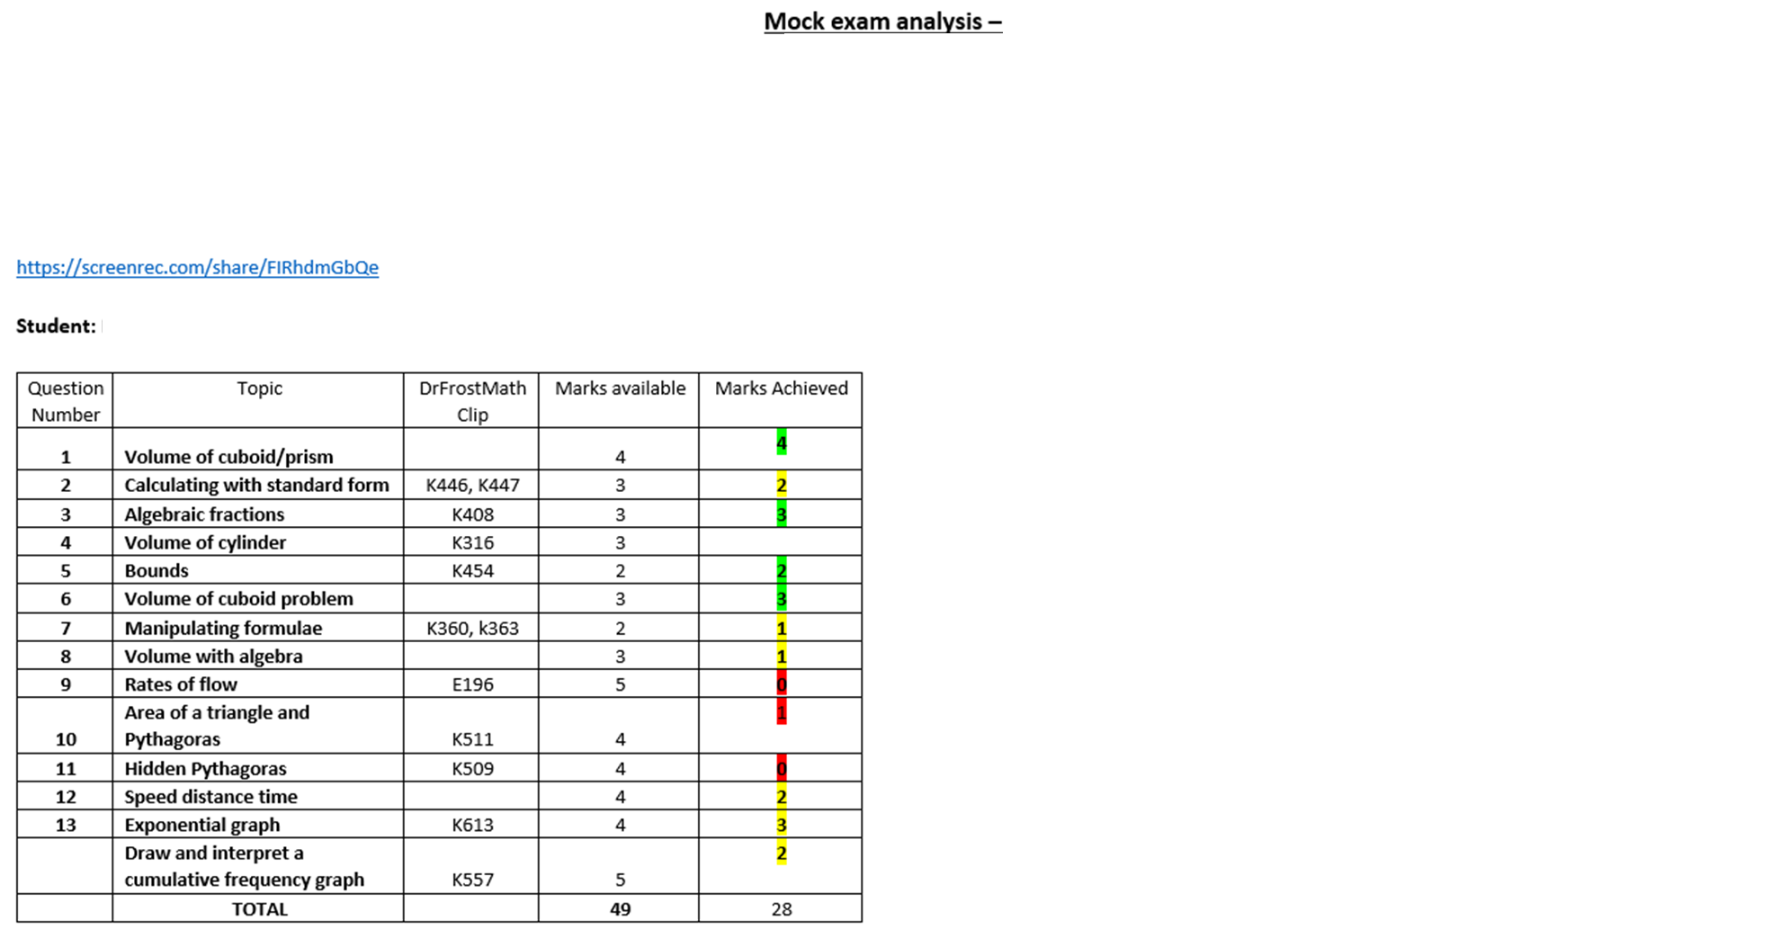
Examination schedule & QLA’s
QLA will be emailed home:
After term 1 exam (unit test)
After Mock 1 exam (Before Christmas)
After Mock 2 exam (Before Easter)
Areas for development:
Topics in red should be revisited by students as part of a good revision strategy. DrFrostMaths reference numbers are included.
Tutors

Slide 10
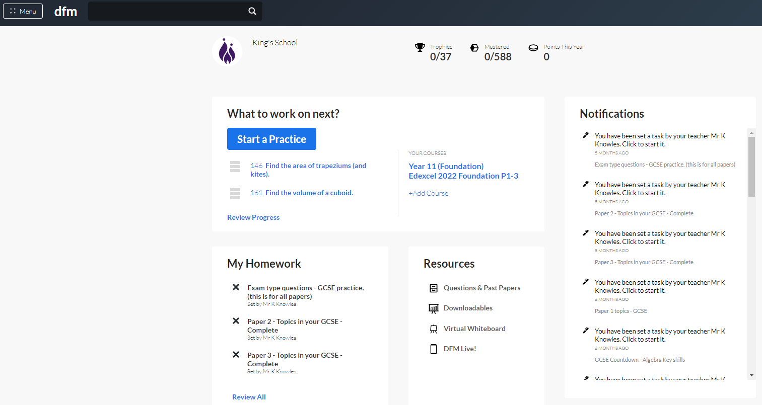
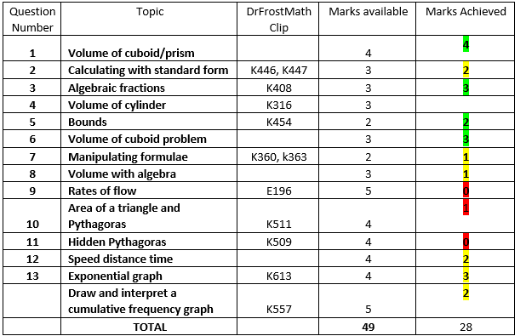

Slide 11
Key exam dates – Mathematics
GCSE Mathematics
14th May – Paper 1 (Non- Calculator)
3rd June – Paper 2 (Calculator)
10th June – Paper 3 (Calculator)
AQA Further Mathematics
8th June – Paper 1 (Non-Calculator)
15th June – paper 2 (Calculator)
Level 1 number and measure exam
Thursday 8th January 2026 (School starts back on the 6th Jan)
30 minute non calculator paper
1 hour calculator paper
9am start

Slide 12
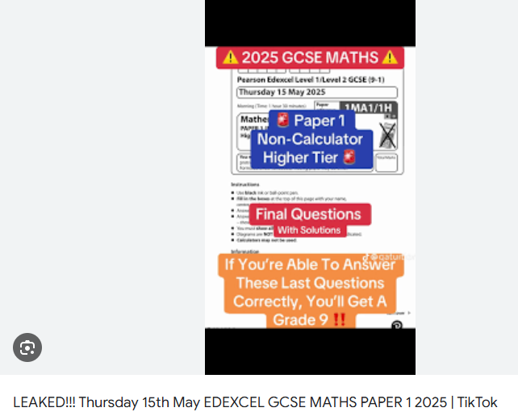
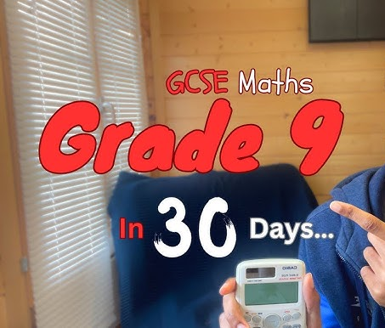
Social media and revision
Online platforms are promoting ‘hacks’ for passing GCSE maths exams. These are often tricks that work in a limited number of scenarios.
Online platforms are offering to sell leaked papers. They do not exist.
You cannot get a grade 9 in 30 days from watching a 10-minute video.

Slide 13
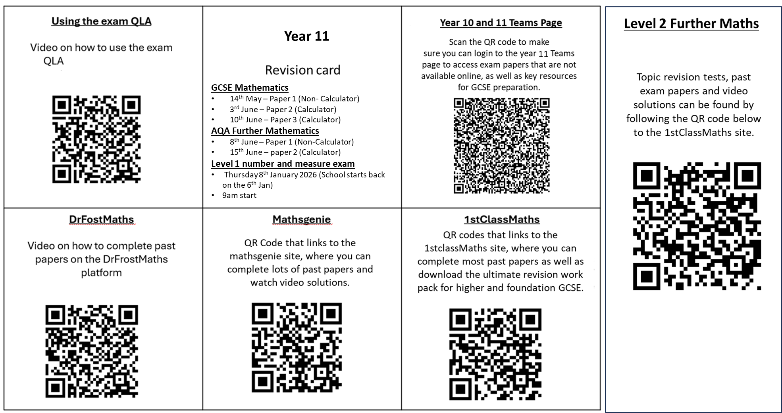
Revision resources - Mathematics

Slide 14
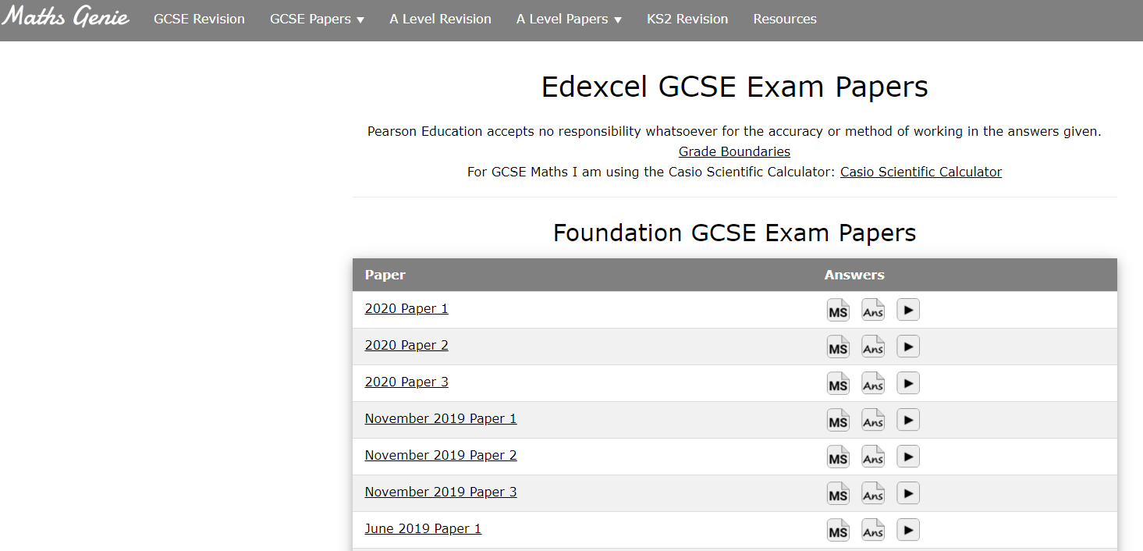
Other sites & resources

