Slide 1


Why do we teach the Religious Studies GCSE at King’s?
Academies and free schools are contractually required through the terms of their funding agreement to make provision for the teaching of RE.
The RE curriculum is determined by the local Standing Advisory Council on Religious Education (SACRE), which is responsible for producing the locally agreed syllabus for RE.
Schools with a religious designation may prioritise one religion in their RE curriculum, but all schools must recognise diverse religions and systems of belief in the UK both locally and nationally.
In brief, legislation requires that: academies and free schools must teach RE within the requirements for a locally agreed syllabus, set out in section 375 (3) of the Education Act 1996 and paragraph (5) of Schedule 19 to the School Standards and Framework Act 1998.
The requirements are that a syllabus must ‘reflect the fact that the religious traditions in Great Britain are, in the main, Christian while taking account of the teaching and practices of the other principal religions represented in Great Britain’

Slide 2

Success in Religious Studies at King’s.
2025
74% grade 9-4
30% grade 9-7
Average grade in RP 5​-6
​

Slide 3

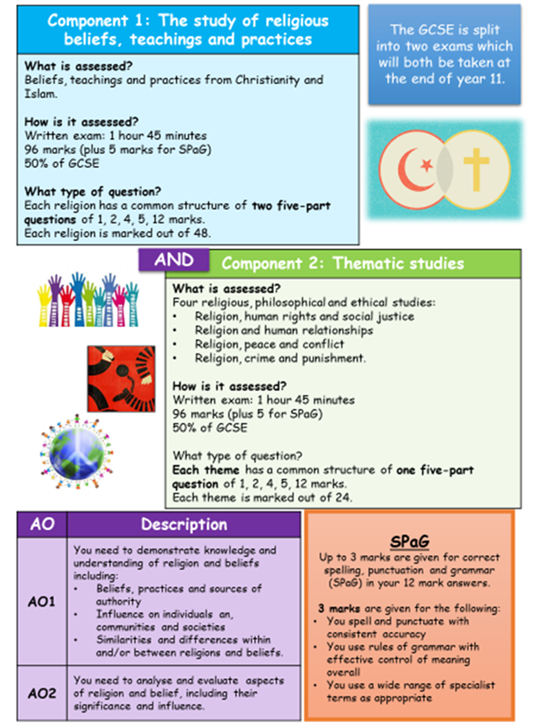
The Course: AQA Specification A (8062)
 | Year 10 AQA GCSE | Year 11 AQA GCSE
Term 1 | Christianity Beliefs and Teachings | Islam Beliefs and Teachings
Term 2 | Christianity Practices | Islam Practices
Term 3 | Theme A: Relationships and families | Theme F: Prejudice, Discrimination and Social Justice
Term 4 | Theme D: Religion peace and conflict | Themes Revision
Term 5 | Theme E: Religion and Crime and Punishment | Religion Revision
Term 6 | Revision and Mocks | Exams

Slide 4
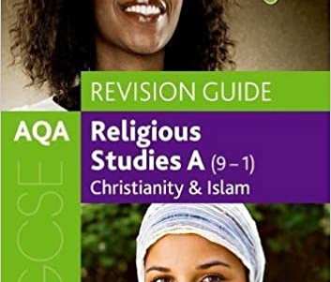
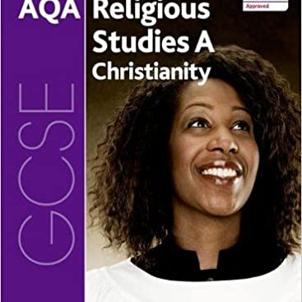
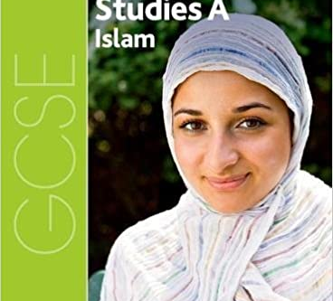
Textbooks and Revision Guide
AQA Religious Studies A Christianity (978 019 837033 8)
AQA Religious Studies A Islam (978 019 837034 5)
AQA GCSE Religious Studies A: Christianity and Islam Revision Guide by Marianne Fleming, Harriet Power, Peter Smith.
Available on Amazon

Slide 5

A reminder why this GCSE is important:
Issues of religion and belief frequently top the news agenda and RP helps make sense of them.
RP allows young people growing up in a diverse society to understand the views and opinions of people whose beliefs and values differ from their own.
RP provides space for young people to reflect on their own ideas and develop their thoughts about questions of meaning and ethics.
By having access to good RP in schools, young people are equipped to handle issues in their lives, preparing them for the workplace and adult life.
Studying religion and philosophy gives you…
Research, analysis and presentation skills
Organisational and time management skills
Teamwork and communication skills
Writing skills, including the ability to construct a reasoned argument
Empathy and the ability to understand people and take on board others' views
The ability to work methodically and accurately
Clear & Logical thinking skills
Critical evaluation skills
Negotiating skills
Problem solving skills

Slide 6
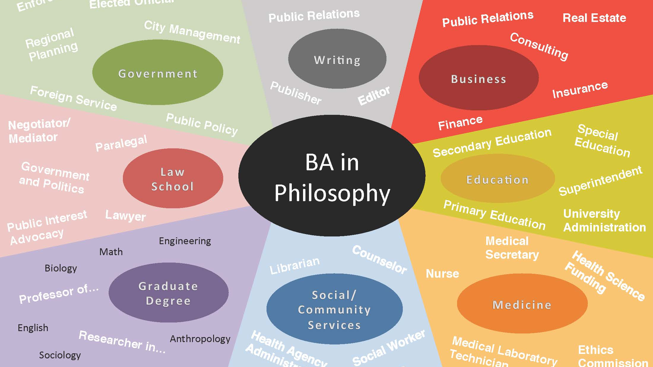
Where can a GCSE in RP take you?

Slide 7
