Slide 1
HEAD OF SCIENCE
Mrs Ross

Slide 2
Key information
Set 1 and 2 are Triple Science classes
Set 3-6 are Combined Science classes
The exam board is AQA
There are two tiers of entry – higher and foundation
Tier of entry will be finalised after the second mock (February)
Every student will sit 6 papers in total. The combined science papers are 75 mins long and the triple science papers are 105 mins long.

Slide 3
Structure of science exams
Questions increase in difficulty as you progress through the paper
A mixture of question styles:
Multiple choice
Structured short answer
Mathematical
Extended response (6 marks)
Understanding command words is essential – describe, explain, evaluate etc

Slide 4
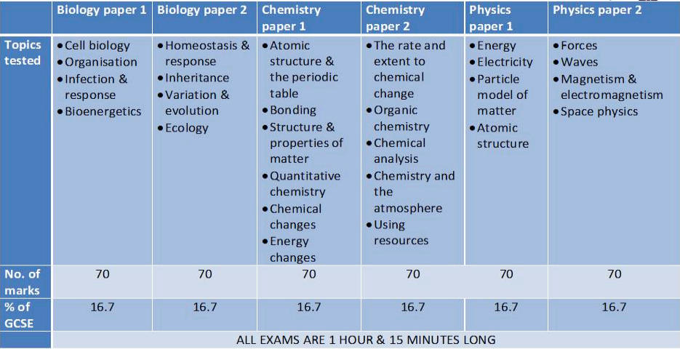
Examination information - Trilogy Science
All three sciences count equally. Two overall grades awarded.
No grades awarded for individual sciences.

Slide 5
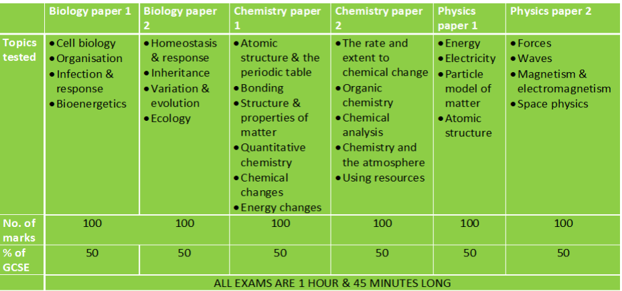
Examination information - Triple Science
Examination information - Triple Science
Each science is separate from the others
Three individual grades awarded.

Slide 6
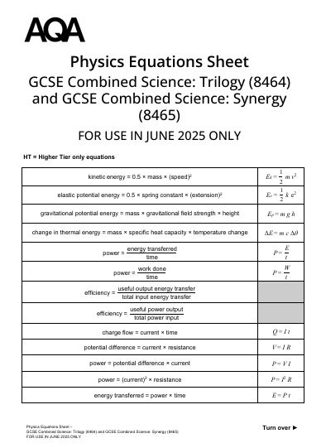
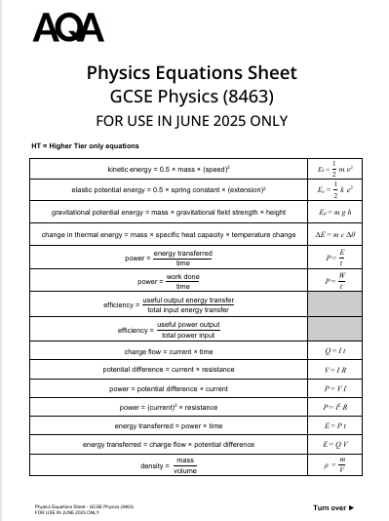
Physics equation sheets

Slide 7
To Succeed in Science
Students need to:
Ask lots of questions and be prepared to mistakes – science isn’t easy!
Start revision early – there is a lot of content to revise and little and often is the best way
Learn the steps involved in the required practicals and be able to apply practical skills to new situations
Learn keywords and definitions
Ensure they complete all homework (Seneca Learning and exam questions)
Use their transferable maths skills and be able to apply them to science questions
Complete past papers in timed conditions and assess using the mark schemes
Attend after school / lunchtime revision sessions

Slide 8
Revision suggestions
Look on Teams in the Year 11 Team – lots of resources here
Flash cards Mind maps Revision guides CGP
Exam questions Cognito BBC Bitesize Seneca
Past papers (AQA website) Knowledge organisers
You Tube – Free Science Lessons and various other good revision videos
CLASS EXERCISE BOOKS!

Slide 9
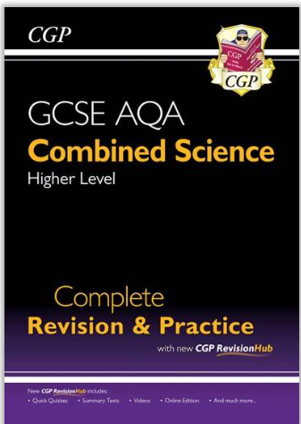
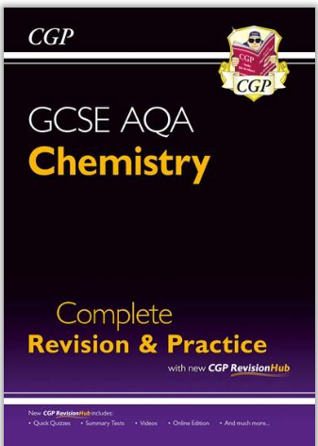
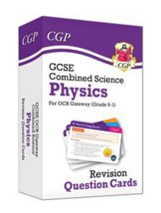
CGP guides and flash cards

