Slide 1
An overview of what to expect in Year 11
Recap of what to do now
Dates for your diary
Info. From core subjects
Mr. Stevenson – Deputy headteacher

Slide 2

The emotional journey
Year 11 = change and pressure and stress!
Even though we don’t anticipate school’s closing again, your son’s and daughter’s have had a difficult preparation for GCSE
Change always brings on an emotional reaction.
Understanding the emotional journey helps
Be prepared to support them
Notes:
First of all a reminder – the emotional temperature is likely to kick up as the exams become closer and more present.

Slide 3
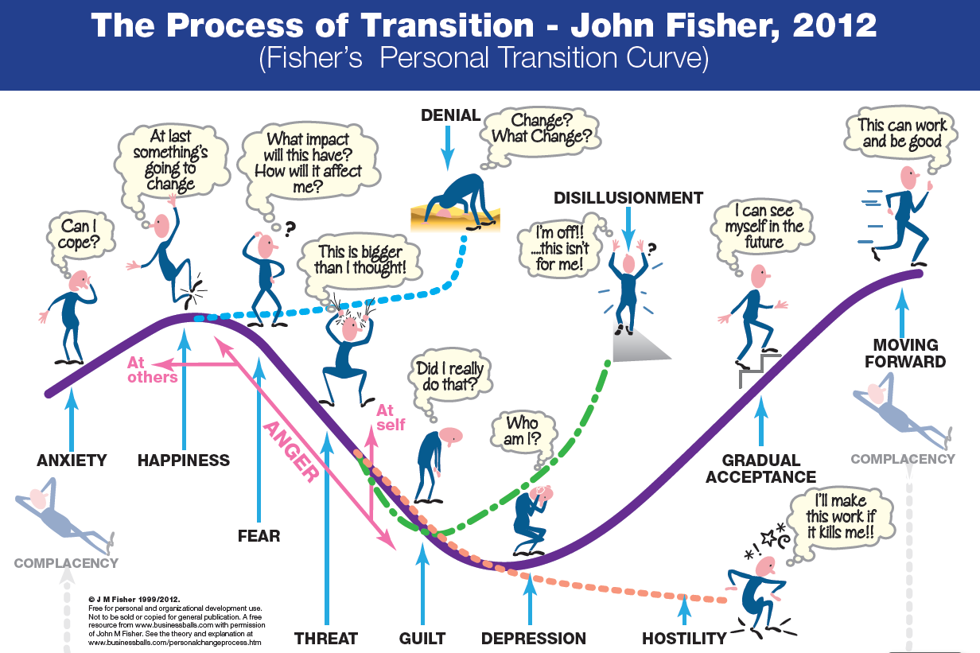
Notes:
The fear, guilt, paralysis is likely to hit – before mocks, after mocks … - we need to be supporting them to recognise it is normal to feel like this and that they will get through it by looking at the big picture and going step by step.
Getting prepared now may mean there is less chance of complete paralysis later

Slide 4
Headline Measures – this year’s GCSE results
Good outcomes for students
Projected very high progress figure – well above the average
A8 figure high against local and national figures

Slide 5
We know what we are doing and have a tried and tested routine around year 11
We will teach them and give them the resources they need
We will offer support for students who we think are falling behind
We will monitor and check how well students are doing
We will keep in contact with you
We will look out for the pastoral needs of our students
Notes:
This shows that we have a tried and tested routine for year 11 students. We have good support in place for students who are falling behind and students with additional needs – learning or pastoral. If you have individual concerns about your son or daughter please do contact your head of year in the first instance.

Slide 6

The Last leg of the Journey starts now …
What are the key milestones?
Notes:
The final journey (for this stage anyway!) starts now – what will be the milestones on the way?

Slide 7
Key Dates: 2025 - 26
Start of term – period 7 and tutor time intervention continues
24th October – full reports issued
Half Term
13th November to 21st November– Year 11 mocks (results sent home by Christmas – will include a “target” grade to use for college applications
11th November – Sixth form open evening
Thursday 15th January – Year 11 Parents evening
February Half Term
Wb 23rd February – Year 11 Mocks part II
March to May – NEA deadlines
30th – 13th April 2026– Easter holiday
Leavers Day
Friday 8th May – GCSEs start
25th May - half term.
17th June – GCSEs finish officially (contingency day 24th and 25th June)
Prom
GCSE results day – Thursday August 20th
Notes:
This term is really important – get ahead – get into good habits

Slide 8
Intervention
Purpose
In practice
Who to contact
Notes:
Purpose – address gaps – either knowledge or exam technique and skills.
In practice – will be time limited and reviewed. May take place in tutor time, lunchtime or after school in a period 7. some will take place during the holidays (not Christmas!)
Who to contact – the Head of subject – if you are concerned, think your child needs some extra help, have questions about intervention
Most students may not need this and will certainly not need it in every subject – don’t panic if your child is not having any – it probably means they are doing well!

Slide 9

NEA subjects (DT, Food, Art, PE, Music, Drama, Media)
Check when they are due!
Notes:
This is coursework – DT, Food, Art, PE, Music, Drama.
If in doubt – contact the subject teacher!
Check when they are, monitor, support if they need to work on them independently at home or in school

Slide 10
Next Steps
Look out in the Newsletter for open days and careers opportunities
Attend Careers Fair!
1:1 careers interviews – every student will have a session with an independent advisor
Tutor Time will be used to help with study skills
Attend open days - check with providers. Websites will have the information now
BHASVIC/Varndean/MET coordinated application process – deadline for priority applications is 5PM first Friday in December (5th )
King’s deadline will also be in December

Slide 11
Nicer things
We always have a leavers day with an assembly and a service and some free food before the exams
There will be a leavers committee after first mocks that will plan things like:
Hoodies
Prom (has been at Pangdean Barn the last two years)
Yearbook

Slide 12
Who to contact …
Pastoral support
Careers Advice and Guidance
Tutor team and Mr Parker-Sibun (first port of call – email is on website)
Pastoral support workers and group work as necessary
First port of contact is Mrs Coles (Careers Lead)
Support in different subjects – the Heads of Department
https://www.kingsschoolhove.org.uk/contactus.php
Notes:
Introduce new head of year

Slide 13
What can your children do to be successful??
Notes:
This is a whistlestop recap from last year!

Slide 14

Reminder – how to be successful
Attitude
Attendance
Classwork, Homework and Revision (start now)
Notes:
3 key things

Slide 15

Keep positive
Attitude trumps ability
Keep going
Expect and learn from failure
Take it one step at a time
Start doing small things now – they add up
Attitude
Resilience
Notes:
Help students to have the correct attitude:
Don’t give up, accept and learn from failure, keep going and do the work from now
At GCSE attitude definitely trumps ability (by the end of the course!)

Slide 16
Attendance – turn up!
Is 90% good enough?
Adds up to 4 weeks missed over a year
Research suggests that 17 missed school days a year can equal 1 grade drop in achievement relative to their peers (DFES)
Positively – improving attendance can increase their grades!
Notes:
Every day makes a difference – encourage them to be in as much as possible. There is a KS4 team they have access to where subjects place revision resources and lesson resources (on next slide) and the subject PPTs on the website give info about resources to use for revision for example

Slide 17
Do the work! That is what will make the difference Classwork – don’t waste the time with the teachers Homework – do it on time and don’t just dash it off Revision – start NOW!
Notes:
This is really what separates success from average or disappointing!

Slide 18
1. Practically - Make a revision timetable
Don’t spend too long on one subject
Switch between subjects
Make sure it is realistic and there is time for breaks and down time
Include space for learning and studying new material as well as for revising old material
Go back over topics again and again over time
Notes:
Maybe no. 1 tip is start now by using a revision timetable – doesn’t have to be loads at this point – but starting a bit now and increasing up to the mocks in November will really help confidence and attainment

Slide 19

If you’re not sure how to support with revision
Get in contact with their subject teacher!

Slide 20
How can parents support
Motivation – next steps, discussions, prodding, encouragement
Revision – know the process, monitor it, get them to show you, help them organise, help them test
Support – recognise the emotional journey and help them navigate it

